Slide 1
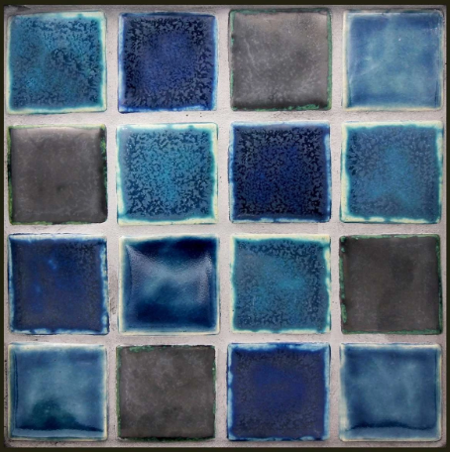
What do you notice? What do you wonder?

Slide 2
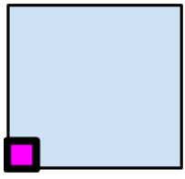
How many tiles will I need along the inside border of this area?

Slide 3
How would you define border?
Is a border the same thing as perimeter?

Slide 4
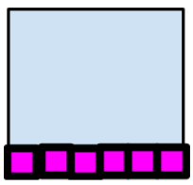
How many tiles do I need along the inside border?
This will be your job to find out in today’s lesson!

Slide 5

Quick Write!
What is a variable?
What is an expression?
How can we rewrite the border strategies using variables?

