Slide 1
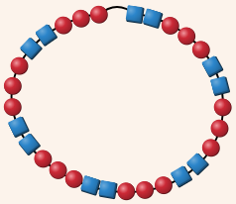
Beaded Factors
Factors and Multiples with Proportion Playground

Slide 2
Warm-Up
Find the greatest common factor (GCF) and least common multiple (LCM) of each number pair.
Create a pair of numbers that have 5 as their greatest common factor. Can you create more than one pair?
 | GCF | LCM
9 and 6
12 and 8

Slide 3

Learning Targets
I can use factors and multiples to predict patterns.
(Advanced) I can explain the relationship between the GCF and LCM of two numbers

Slide 4
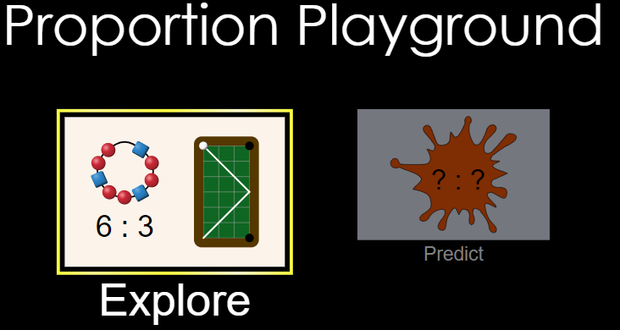
Explore
Take 5 minutes to explore the sim.
What can you do?
What do you notice?
https://phet.colorado.edu/sims/html/proportion-playground/latest/proportion-playground_en.html

Slide 5



Activity Sheet Directions
Work with a partner
Be sure to pause and discuss with your partner when you see
Part A: Use
Part B: Use

Slide 6
Discussion
How did you predict the patterns and the number of repeats?
  For example, how would you predict the pattern and number of repeats for 18 red and 24 blue beads?
If you want a pattern that does not repeat, what must be true about the number of red and blue beads?
Notes:
Make a note that # repeats is the GCF,
# blue in pattern = total # blue / GCF,
# red in pattern = tota #red / GCF

Slide 7
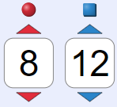
Discussion (Part 2)
Dan’s prediction:
The pattern will be
and will repeat 2 times.
Dan is making a prediction for the number of beads shown.
Do you agree with Dan? Why or why not?

Slide 8
Discussion (Part 3)
What did you discover in #7 (the challenge)?
Notes:
(# red in pattern)(# blue in pattern)(# repeats) = LCM of total reds and total blues

Slide 9
Exit Ticket
A teacher has a class of 12 native Spanish speakers and 16 non-Spanish speakers. She would like to break up the class into groups such that each group has an equal number of Spanish speakers, and each group has the same total size.
List at least two different ways the teacher can make groups.
___ groups with ___ Spanish speakers and ____ non-Spanish speakers in each group
___ groups with ___Spanish speakers and ____ non-Spanish speakers in each group
2) The maximum number of groups the teacher can create is ______ groups because
___________________________________________________________________
___________________________________________________________________

