Slide 1
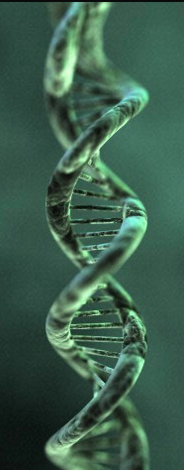
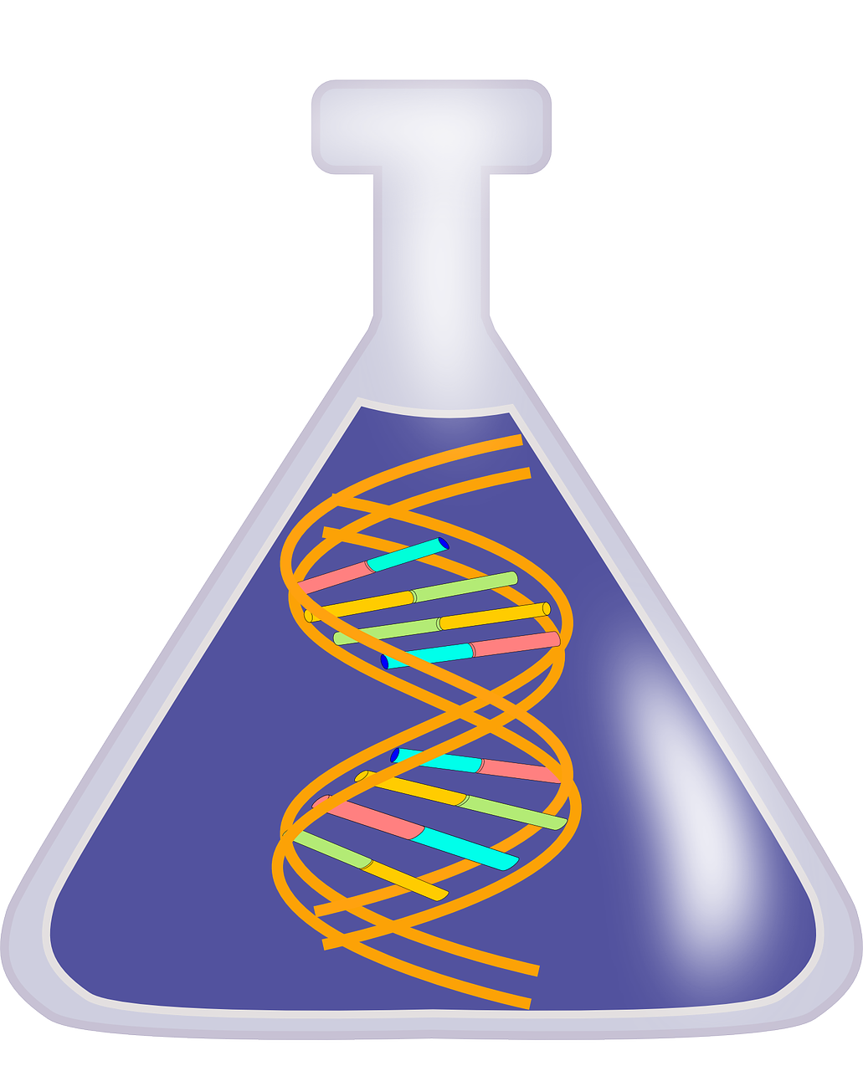

The Basics of Gene Expression
By Sarina Lalla
B.Ed. Secondary Science Education
McGill University

Slide 2
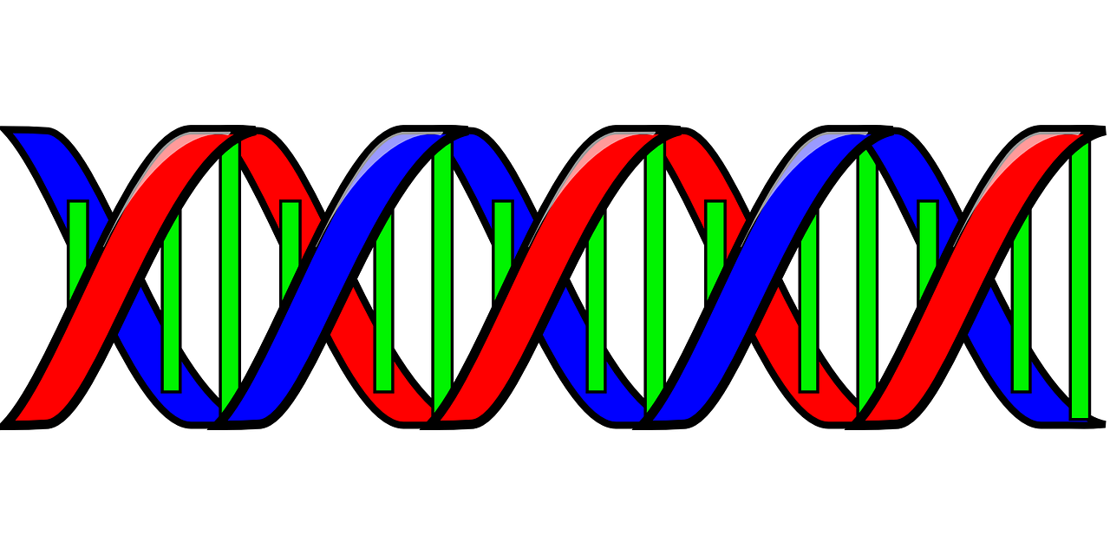
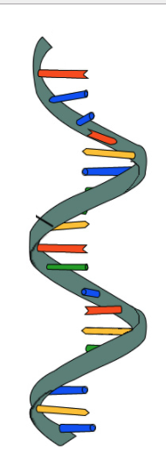
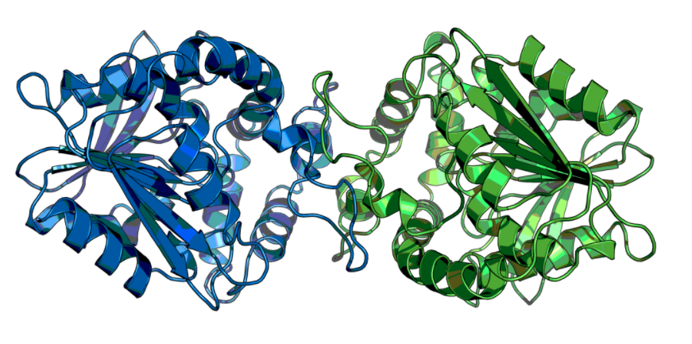
Reminder: The Central Dogma of Genetics
DNA
Transcription
RNA
Translation
Protein

Slide 3

Structure of a gene
Regulatory region
Responsible for controlling when the transcribed region is
used to make mRNA
Acted upon by positive transcription factors (activator) and
negative transcription factors (repressor)
Transcribed region
- Located after the regulatory region in the DNA strand
Region used to make mRNA (the information that the mRNA
strand will contain is found in the transcribed region!)
In PhET simulation: Cell gene expression tab

Slide 4

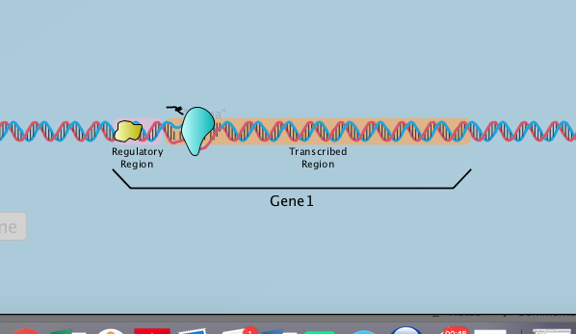
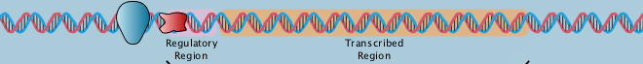
Transcription elements:
RNA Polymerase
In PhET simulation:
Cell gene expression
tab
An enzyme (protein) that ”reads” the transcribed region of DNA
to produce mRNA
Zips down the strand by first passing through the regulatory region
This is why the regulatory region controls when mRNA is produced!
Regulatory region with activators = RNA polymerase can pass through to the
transcribed region and make mRNA
Regulatory region with repressor = RNA polymerase cannot pass through,
cannot “read” the transcribed region and cannot make mRNA
In PhET simulation
In PhET simulation

Slide 5
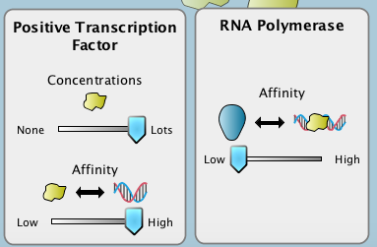
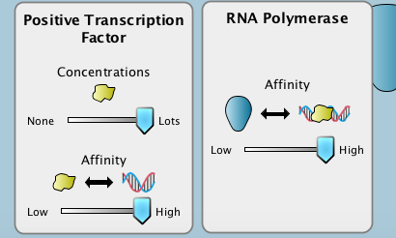
Factors influencing transcription
(mRNA production):
Affinity of RNA Polymerase to DNA
The better RNA polymerase can attach itself to the DNA
strand (high affinity), the easier it can “read” it to produce mRNA
If RNA polymerase has low affinity to the DNA strand,
it will be difficult for it to attach and produce mRNA
In PhET simulation: Messenger RNA production tab
vs

Slide 6
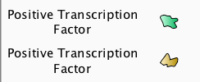
Transcription elements:
Positive Transcription Factor
In PhET simulation: Cell gene expression tab
Also known as an activator
“Parks” itself on the regulatory region
Encourages the binding of RNA polymerase to the regulatory region
Allows RNA polymerase to produce mRNA
More than one can bind to the regulatory region
In PhET simulation: Cell gene expression tab

Slide 7

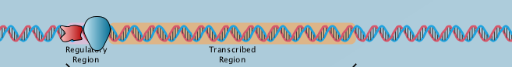
Transcription elements:
Negative Transcription Factor
In PhET simulation:
Cell gene expression tab
Also known as a repressor
“Parks” itself on the regulatory region
Prevents the binding of RNA polymerase to the regulatory region
Prevents RNA polymerase from producing mRNA
More than one can bind to the regulatory region
In PhET simulation: Cell gene expression tab

Slide 8
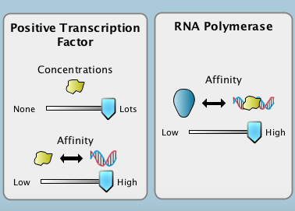
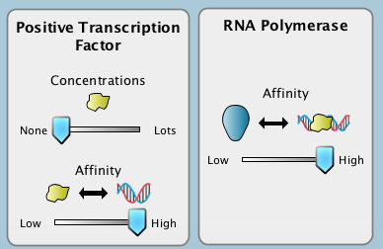
Factors influencing transcription
(mRNA production):
Concentration of positive transcription factor
The higher the concentration of positive transcription factor,
the more it is available to bind to the regulatory region
The more it is available to bind to the regulatory region, the faster RNA polymerase
can bind to DNA
The faster RNA polymerase can bind to DNA, the faster mRNA can be made
In PhET simulation: Messenger RNA production tab
vs

Slide 9
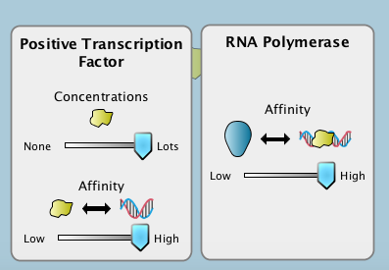
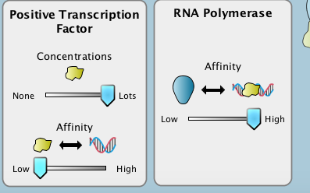
Factors influencing transcription
(mRNA production):
Affinity of positive transcription factor
To DNA
The easier the positive transcription factor can bind to DNA, the easier it can bind
to the regulatory region
- The easier it can bind to the regulatory region, the easier RNA polymerase
can bind to DNA
The easier RNA polymerase can bind to DNA, the easier mRNA can be made
In PhET simulation: Messenger RNA production tab
vs

Slide 10
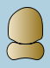
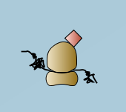
Translation elements:
Ribosome
In PhET simulation: Cell gene expression tab
An RNA structure that ”reads” mRNA strands to produce proteins
Clamps the RNA strand between its two subunits
In PhET simulation: Cell gene expression tab
Protein
mRNA
Ribosome
Subunits

Slide 11

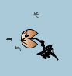
Translation elements:
mRNA destroyer
In PhET simulation: Cell gene expression tab
An RNA structure that ”reads” mRNA strands to produce proteins
Clamps the RNA strand between its two subunits
In PhET simulation: Cell gene expression tab
mRNA destroyer
mRNA
Degraded mRNA

Slide 12
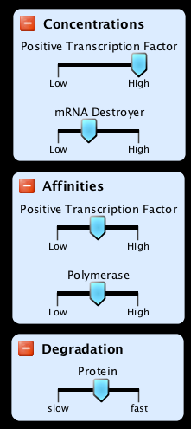
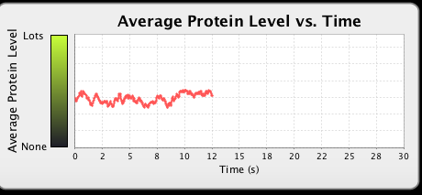
More to explore in the PhET Simulation
Protein expression in cells
Go in the Multiple Cells tab. Using the sliders, determine how all of the discussed variables influence
protein production over time in the cell or cells.
What is the name of the cells that are being used in this simulation?
Why do you think the cells are green?
In PhET simulation: Multiple Cells tab

Slide 13
Image sources
B0006092 DNA double helix illustration © Spooky Pooka, used under Creative Commons Attribution-NonCommercial-NoDerivs 2.0 Generic (Image was cropped with permission from provider)
Beaker © OpenClipart-Vectors, used under Creative Commons CC0 1.0 Universal
DNA © Clker-Free-Vector-Images, used under Creative Commons CC0 1.0 Universal
DNA vs RNA © Zappys Technology Solutions, used under Creative Commons Attribution 2.0 Generic
McGill CoA © Waov12, used under Creative Commons CC0 1.0 Universal
All screenshots are from the PhET Interactive Simulation Gene Expression-The Basics.

