Slide 1

Isotopes
(Teacher Guide)
Learning Objectives:
SWBAT...
Describe that isotopes are the same element but with different atomic masses, each with a specific number of protons and neutrons.
Be able to explain why the atomic numbers on the periodic table are not whole numbers
Description:
For my class, this is coming on the heels of the introduction to atomic structure. I’ve discussed with some colleagues and we felt that this would serve as a good springboard to other real world tasks exploring isotopes a bit further. Thus, whatever that application may be could be swapped in for the carbon dating reading.
Potential Misconceptions:
We started the year with organization of matter, which means we have seen colored circles as molecules and atoms so far. Students may be confused that we are now examining a single atom and the components within that atom.
Standards:
NGSS:
HS-PS1-1.PS1.A.1 - Each atom has a charged substructure consisting of a nucleus, which is made of protons and neutrons, surrounded by electrons.
Science and Engineering Practices:
SP2 will be used because they are using a simulation to understand isotopes and stability.
SP5 will be used since they are calculating average atomic masses from mixtures of molecules
SP6 They will be using the model to describe how carbon dating works

Slide 2

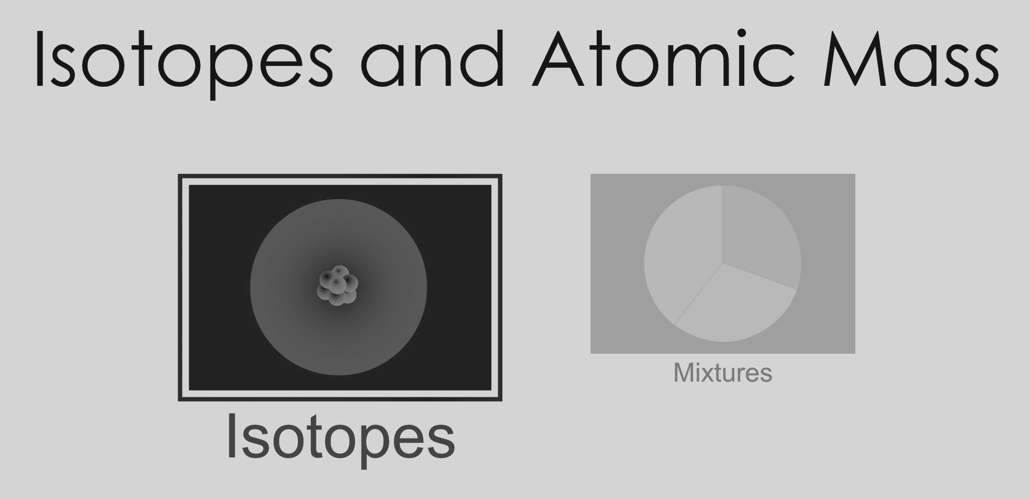
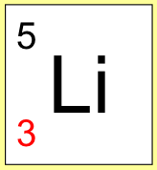
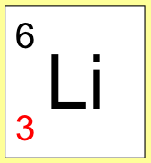
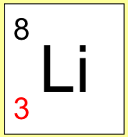
Isotopes Name:
Part A: Exploration
Go to the ‘isotopes’ section of the simulation. Once inside, play around with the various tools for a few minutes.
Were you able to find….
...How to add and remove neutrons
...What adding neutrons does the the atomic symbol and molecular model
...Figure out what abundance in nature means
...Discover which is heavier, a proton or a neutron
...Explore some ideas about what makes an atom stable or unstable
If not, try playing around a bit more until you find all of these items.
Once you’ve found them all, move on to Part B.
Part B: Developing Theories
Symbol
Name | Lithium-5 |  | Lithium-7 | Lithium-8
Number of Neutrons |  |  | 4
Natural Abundance | 0%
Stable? |  |  | Stable

Slide 3
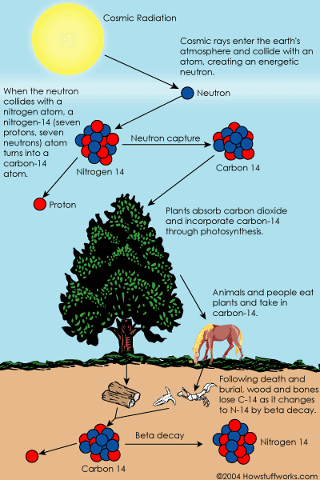
Part B cont.:
What is the relationship between natural abundance and stability?
What is an isotope? Based on your interaction with the simulation, what do you think this is describing? (Hint: look what it says in the abundance in nature tab about isotopes)
Dating a Fossil:
As soon as a living organism dies, it stops taking in new carbon. The ratio of carbon-12 to carbon-14 at the moment of death is the same as every other living thing, but the carbon-14 decays and is not replaced. The carbon-14 decays with its half-life of 5,700 years, while the amount of carbon-12 remains constant in the sample. By looking at the ratio of carbon-12 to carbon-14 in the sample and comparing it to the ratio in a living organism, it is possible to determine the age of a formerly living thing fairly precisely.
3) Why does the amount of C-14 go down? Justify your answer using the simulation.
Marshall Brain "How Carbon-14 Dating Works" 3 October 2000.
HowStuffWorks.com. <http://science.howstuffworks.com/environmental/earth/geology/carbon-14.htm> 25 September 2016

Slide 4
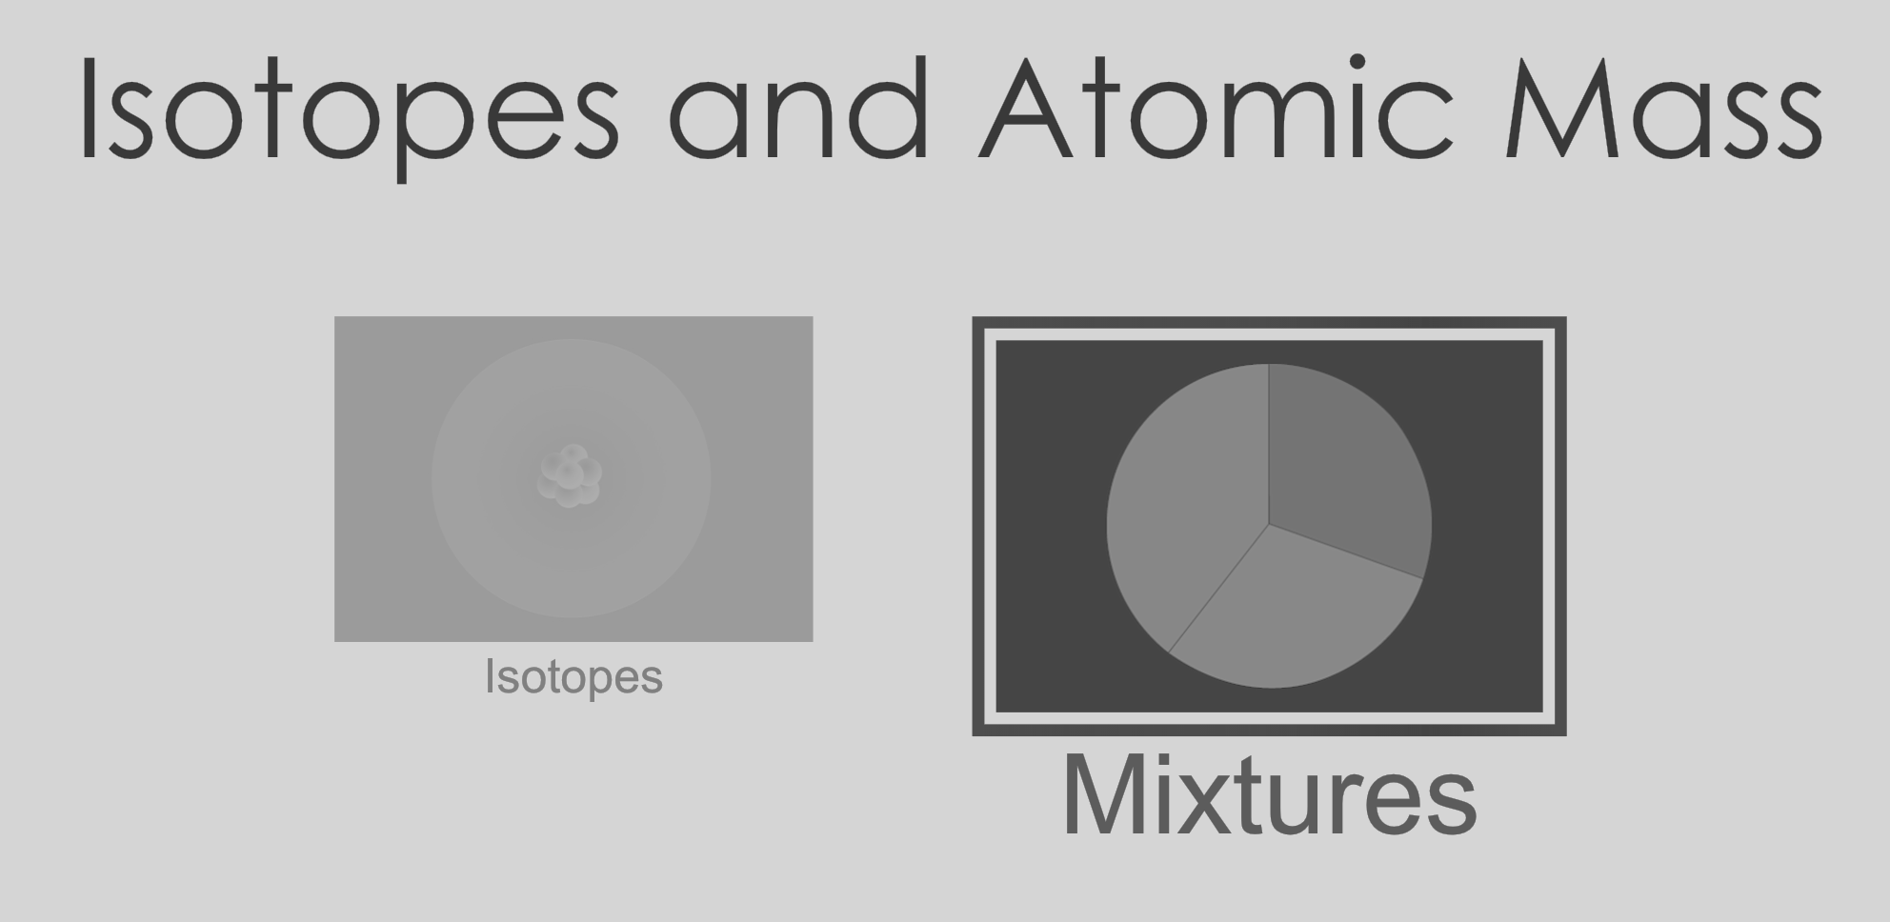
Part C: Mixtures
Play around with the simulation making sure you can do the following…
...Add two different isotopes to the box
...Use the slider tool to quickly add atoms to the box
...Change the percent composition at will
...Make the average atomic mass go up or down intentionally
...See nature’s mix
...Find an element with more than 2 isotopes
Part D: Average Atomic Mass
Clear the box of all atoms. Then add the following combinations of atoms and fill out the table. * challenge problems
Element | Number of Isotopes | Average Atomic Mass
Hydrogen | H-1: 10 H-2: 10
Hydrogen | H-1: 10 H-2: 5
Hydrogen | H-1: 10 H-2: 0
Oxygen | O-16: 3 O-17: 3 O-18: 3
Oxygen | O-16: 3 O-17: 0 O-18: 3
Oxygen | O-16: 10 O-17: 5 O-18: 1
* |  | 25.65 amu
* |  | 37.465 amu
* |  | 21.563 amu

Slide 5
Part D cont.:
Name two things that determine the average atomic mass of an element.
Look at the natural abundance for 3 different elements and find their average atomic masses.
Element 1: Avg. Atomic Mass in Nature:
Element 2: Avg. Atomic Mass in Nature:
Element 3: Avg. Atomic Mass in Nature:
Compare the values you just got for the average atomic mass and look at the periodic table for those elements. What do you notice?
Describe what is the number on the bottom of each elemental symbol on the periodic table telling you?
Take a look at Boron (B) on the periodic table. Make a guess about which isotope of Boron is the most abundant. Justify your answer.

