Slide 1
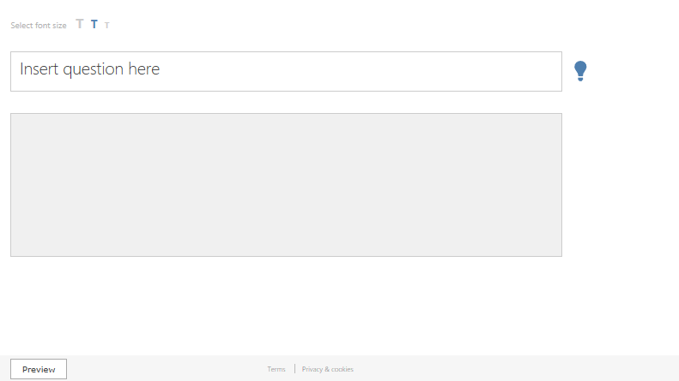
Welcome to Office Mix
1
WATCH
2 CREATE
3 SHARE
Delete this slide (Delete key) and open a new slide (Ctrl + M) when you are ready to create your first Mix

Slide 2

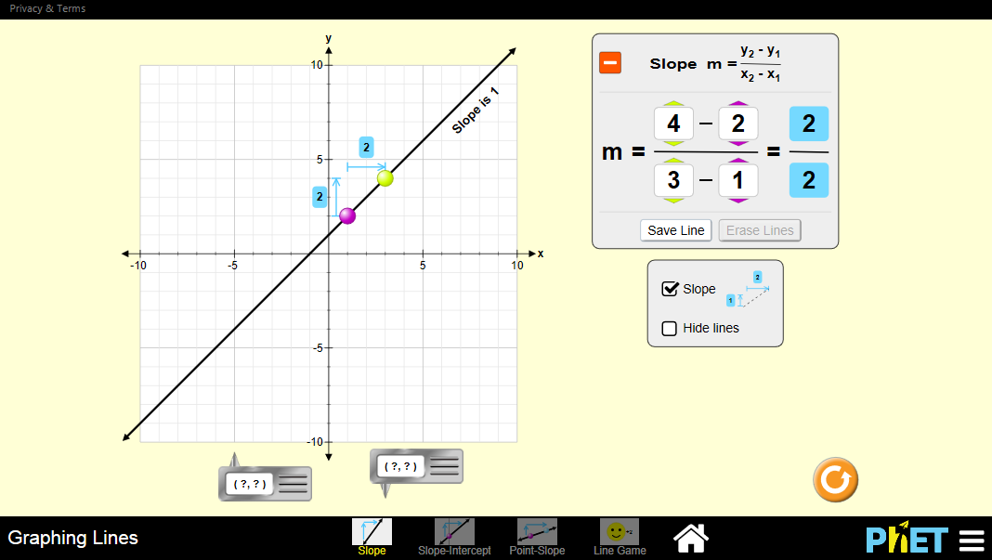

Slide 3
