Slide 1
Clicker Questions to Accompany
Forces and Motion using PhET’s Force and Motion Basics HTML5
Part 2 – Friction

Slide 2
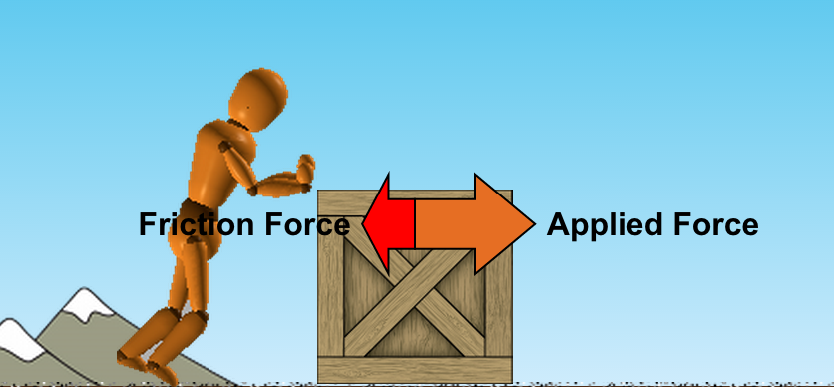
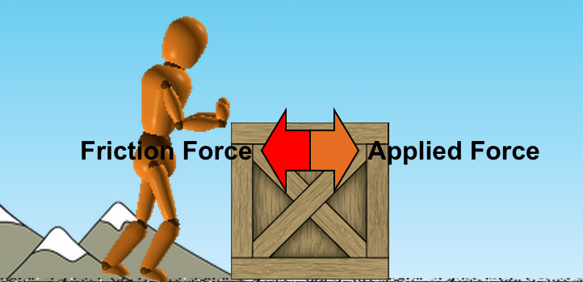
A
B
If the person is pushing the box with the applied force show in (A) and then reduces the applied force to the amount shown in (B), what can we say about the motion of the box?
  The box will gradually slow down to a stop
  The box will immediately stop moving
  The box will keep moving at a constant speed
  There is not enough information to decide

Slide 3
More questions to come in the near future

