Slide 1

Annotated Lecture Slides for
Concentration
AUTHORS:
Robert Parson (University of Colorado Boulder)
Trish Loeblein (University of Colorado Boulder)
COURSE:
Introductory / Preparatory College Chemistry
COPYRIGHT: This work is licensed under a Creative Commons Attribution 4.0 International License.

Slide 2
Learning goals
Distinguish between dilute and concentrated solutions.
Predict how various actions affect the concentration and number of moles of a solution.
Use the molarity of a solution to calculate the moles of solute present in a given volume of the solution.
Use the molarity of a solution to calculate the volume needed to provide a given number of solute moles.
Calculate final volume or concentration of solutions prepared by dilution

Slide 3
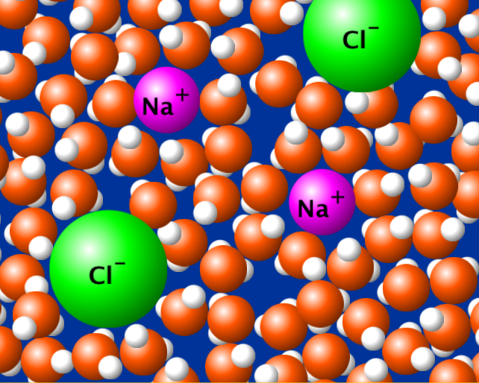
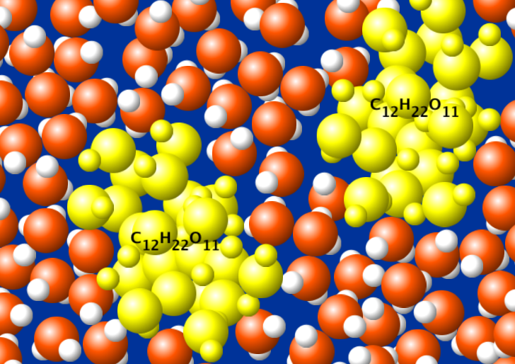
Solutions
  Solute: the substance that is dissolved.
  Solvent: the substance that does the dissolving.
  When a solution forms, the solute molecules or ions become evenly dispersed throughout and surrounded by solvent molecules.
Glucose highlighted in yellow for visibility
Ionic compound
Molecular compound
Notes:
Before introducing the terminology on this slide, use the simulation to demonstrate factors affecting concentration.
See Lecture Demo Guide for details.
Note – graphics are from the related PhET simulation Sugar and Salt Solutions

Slide 4
Concentration units: Molarity (M)
Molarity (M) = moles of solute
liters of solution
If given mol and L, then can determine M.
If given mol and M, can determine L.
If given M and L, can determine mol.

Slide 5
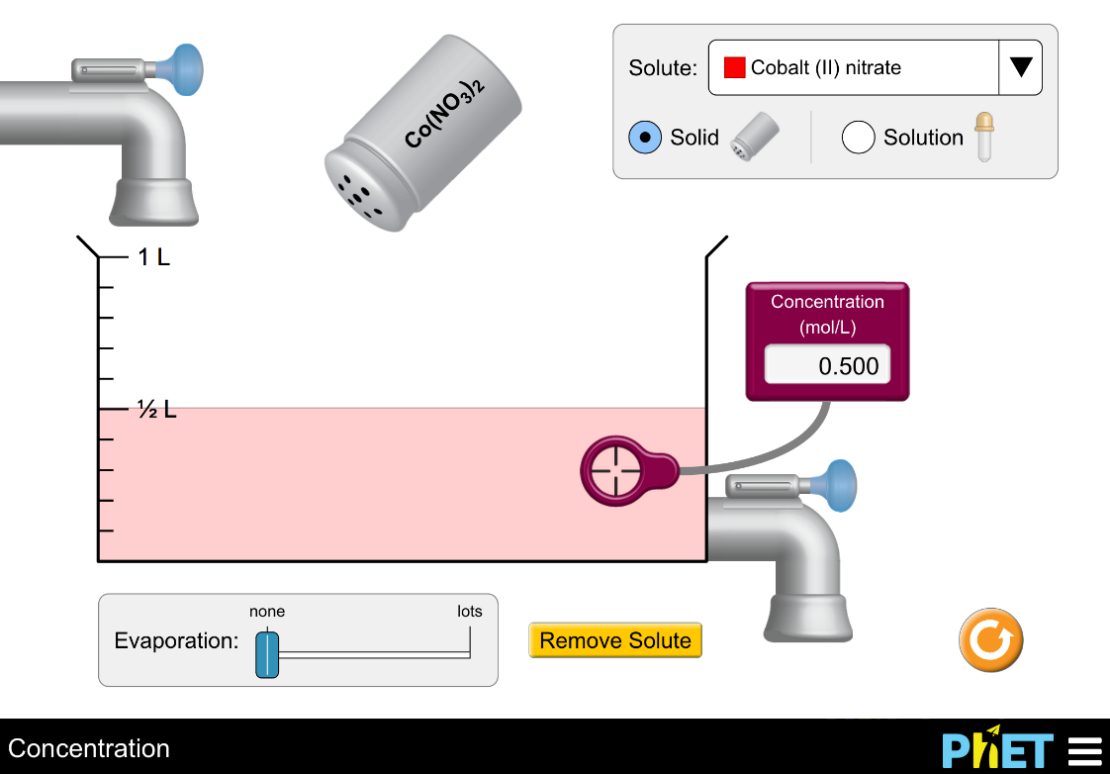
Which action(s) will increase the concentration of the solution?
Add more Co(NO₃)₂
Evaporate water
Drain solution
(1) only
(1) and (2)
(2) and (3)
(1) and (3)
(1), (2), and (3)
Notes:
Sim directions: Show students the various features available in the simulation -- use both faucets, add more solid from the salt shaker, evaporate some of the solution – initially without the concentration probe in solution. Comment on changes in solution colour, then use the concentration probe to show how concentration increases or decreases in response to these actions. Use Drink Mix for initial demonstrations as it gives students a real-world connection that they often find more intuitive for building an understanding of terms like dilute and concentrated, and for understanding what impacts concentration. Use sim observations to construct a definition of concentration before asking the following concept questions.
Correct answer: B
Representative results from pre-general chemistry: 85% correct (remaining students evenly distributed among other answers)
Follow-up discussion: Use the simulation to demonstrate each of the options given, and discuss as a class.
Note that setting up a specific starting solution is easiest if you create a slightly more concentrated solution and then dilute with water as needed (water faucets have higher precision control), and then drain any excess solution away.

Slide 6
Which action(s) will change the
number of moles of solute in the container?
Add water
Evaporate water
Drain solution
(1) only
(2) only
(3) only
(1) and (2)
(2) and (3)
Notes:
Goal: Extend students observations of concentration (from the simulation) to the relationship between moles and concentration.
Correct answer: C
Representative results from pre-general chemistry: 62% correct (21% selected D)
Follow-up discussion: Summarize the observations, and ask the class the effect of each these actions on concentration, in parallel.

Slide 7
Which action(s) will increase the concentration of the solution?
Add more Co(NO₃)₂
Evaporate water
Drain solution
(1) only
(1) and (2)
(2) and (3)
(1) and (3)
(1), (2), and (3)
Notes:
Sim directions: Show students the various features available in the simulation -- use both faucets, add more solid from the salt shaker, evaporate some of the solution – initially without the concentration probe in solution. Comment on changes in solution colour, then use the concentration probe to show how concentration increases or decreases in response to these actions. Use Drink Mix for initial demonstrations as it gives students a real-world connection that they often find more intuitive for building an understanding of terms like dilute and concentrated, and for understanding what impacts concentration. Use sim observations to construct a definition of concentration before asking the following concept questions.
Correct answer: B
Representative results from pre-general chemistry: 85% correct (remaining students evenly distributed among other answers)
Follow-up discussion: Use the simulation to demonstrate each of the options given, and discuss as a class.
Note that setting up a specific starting solution is easiest if you create a slightly more concentrated solution and then dilute with water as needed (water faucets have higher precision control), and then drain any excess solution away.

Slide 8
Which action(s) will change the
number of moles of solute in the container?
Add water
Evaporate water
Drain solution
(1) only
(2) only
(3) only
(1) and (2)
(2) and (3)
Notes:
Goal: Extend students observations of concentration (from the simulation) to the relationship between moles and concentration.
Correct answer: C
Representative results from pre-general chemistry: 62% correct (21% selected D)
Follow-up discussion: Summarize the observations, and ask the class the effect of each these actions on concentration, in parallel.

Slide 9
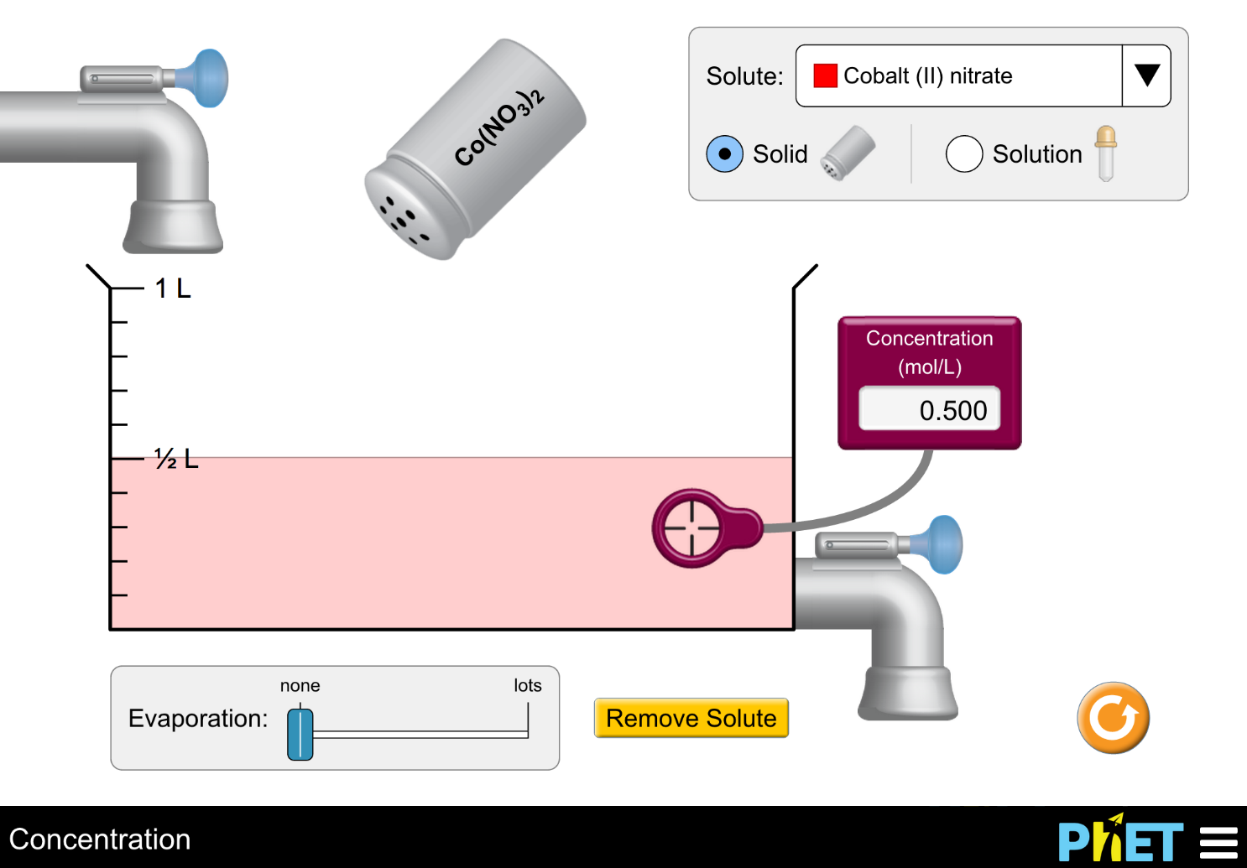
How many moles of solute are in the beaker?
a. 0.05 moles b. 0.50 moles c. 1.00 moles
d. 1.50 moles e. None of these
Notes:
Goal: Have students begin to think about concentration quantitatively
Correct answer: C
Representative results from pre-general chemistry: 63% correct (B and C are popular alternate answers)
Follow-up discussion: Ask students how many moles are in the beaker, and how they figured that out. Ask students to discuss with their peers, and offer the suggestion of thinking about how many moles would be in 1L of this same solution.

Slide 10

What will happen to the concentration and the number of moles when water is added?
Concentration Number of moles
  Increase Decrease
  Increase Increase
  No change No change
  Decrease Decrease
  Decrease No change
Notes:
Correct answer: E
Representative results from pre-general chemistry: 86-89% correct (remaining students evenly distributed between other answers)

Slide 11
Dilutions
To decrease the concentration of a solution, add more solvent
  The number of solute particles stay the same, but the number of solvent particles increases and the ratio of solute/solvent particles also changes
  This means that the total volume also increases
solvent
solute
Ratio of
solute/solvent:
8/20
Ratio of
solute/solvent:
8/10

Slide 12
Dilutions
Usually, a more concentrated solution is used to make the dilute solutions
Equation: “moles equals moles”
M_{dil}V_{dil}= M_{conc}V_{conc}
M_{dil} = Desired dilute molarity
V_{dil} = desired total volume
M_{conc} = Concentrated molarity (stock solution)
V_{conc} = Volume of concentrated solution

Slide 13
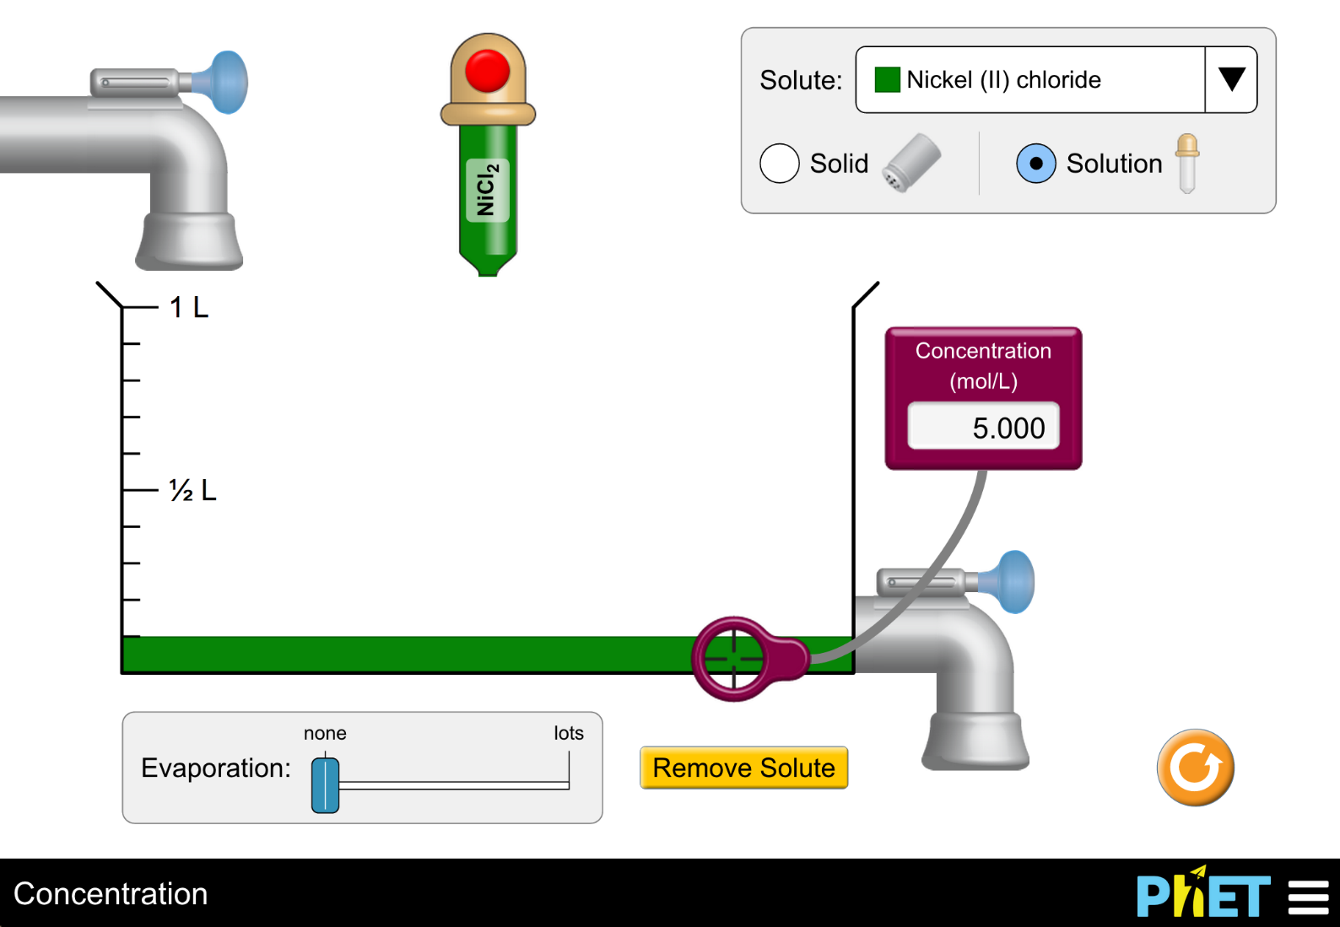
You start with 0.1 L of a 5.00 M solution of NiCl₂, and you plan to dilute it (by adding water) to make a solution with a concentration of 0.625 M. How far should you fill the beaker?
a. 200 mL
b. 400 mL
c. 600 mL
d. 800 mL
e. 1 L
Notes:
A computation-based dilution problem
Correct answer: D
Representative results from pre-general chemistry: 81% correct (C is the next most popular answer at 10% student responses)

