Slide 1

Clicker Questions for
Sugar and Salt Solutions
AUTHORS:
Yuen-ying Carpenter (University of Colorado Boulder)
Robert Parson (University of Colorado Boulder)
Trish Loeblein (University of Colorado Boulder)
COURSE:
Introductory / Preparatory College Chemistry
COPYRIGHT: This work is licensed under a Creative Commons Attribution 4.0 International License.

Slide 2
When salt (NaCl) dissolves in water, …
 | it will produce… | Because…
A | [NaCl]⁺ molecules | It transfers electrons to the water.
B | Na⁺ and Cl– ions | Electrons are transferred from Na atoms to Cl atoms
C | Na⁺ and Cl– ions | The ions in the salt separate
D | H⁺ and OH– ions | It forces water to break into H⁺ and OH⁻ ions
E | More than one of the above
Notes:
Sim directions: Prior to this question, demonstrate the difference in conductivity between solid salt and salt dissolved in water using the sim and discuss conductivity requiring freely moving charged particles
Goal: Get students to commit to a prediction and determine prior conceptions of the origin of charged particles when salt dissolves
Correct answer: C
Representative results from pre-general chemistry (when used prior to instruction): Roughly evenly distributed answers across all options except D.
Follow-up discussion: Use the ‘Water’ tab of the simulation to look at salt before and after it dissolves in water. Emphasize that the ions are already present in the solid salt, and that the ions dissociate in water.

Slide 3
Sodium chloride is solid at room temperature: NaCl_{(s)}
Will melted sodium chloride NaCl_{(l)} conduct electricity?
Yes
No
It depends
Notes:
Goal: Relate the description of conductivity to a context outside of the simulation
Correct answer: A
Representative results from pre-general chemistry: 45% A and 39% B when first asked
Follow-up discussion: Students asked if the ions dissociate from each other when sodium chloride melts. We then reviewed the requirements for a material to be conductive, and students were re-polled.
Representative results from pre-general chemistry on second polling: 62% A and 30% B

Slide 4
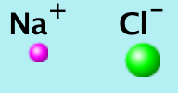
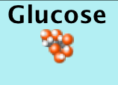
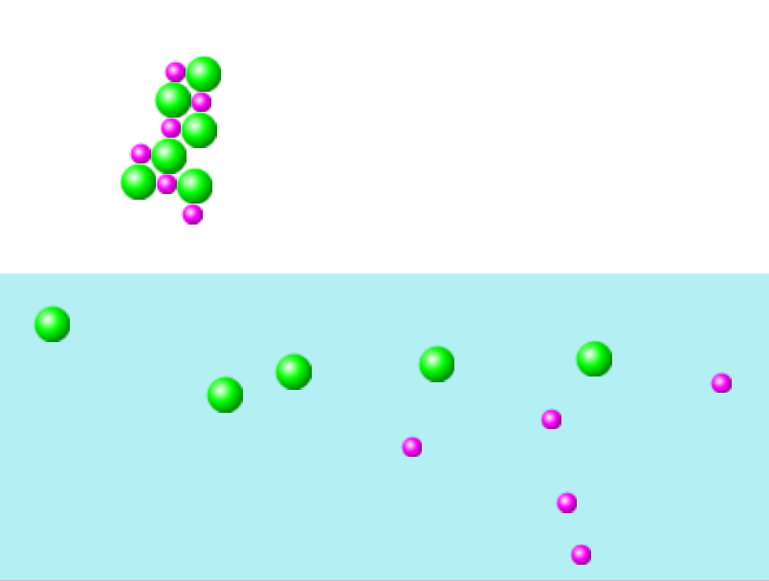
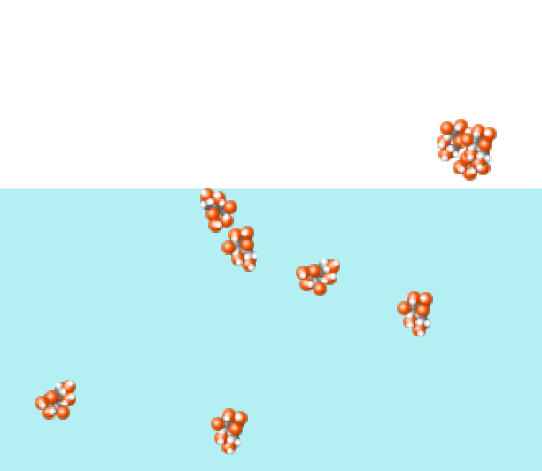
Which box shows an electrolyte dissolving in water?
K
+
1.
2.
a. Box 1 b. Box 2 c. Both d. Neither
Notes:
Note: The image on the left is actually NaCl dissolving in the simulation, but the ion sizes are still roughly appropriate, so this allowed students to extend to another ionic solid beyond the NaCl example already discussed.
Correct answer: A
Representative results from pre-general chemistry: 91% correct
Follow-up discussion: Students were asked to explain what features they used in the pictures to decide on their answer; focus on the before and after, and the presence or absence of charged particles

Slide 5


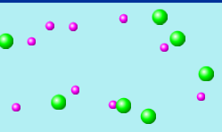
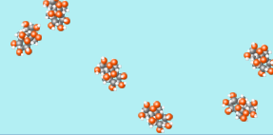
If the atom-scale view of a compound in water looks like the picture on the right (II.), you might categorize the compound as…
I.
II.
a. Ionic b. Molecular c. Neither
Notes:
Correct answer: B
Representative results from pre-general chemistry: 81% correct (when used after sim demo with micro tab); 66% correct (when using prior to micro tab)
Follow-up discussion: Students were asked to explain what features they used in the pictures to decide on their answer

Slide 6
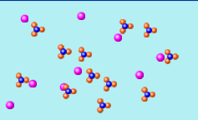
What kind of bonding is in this compound before it goes into the water?
a. Ionic b. Covalent c. Both d. Neither
Notes:
Correct answer: C
Representative results from pre-general chemistry when used prior to introducing polyatomic ions: 69% correct (20% B and 11% A)
Follow-up discussion: Students were asked to explain what features they used in the pictures to decide on their answer and this was used to introduce the topic of polyatomic ions in class

Slide 7
Which compound is ionic?
CO
MgF₂
Al₂O₃
Both CO and MgF₂
Both MgF₂ and Al₂O₃
Notes:
Pre-question sim demo: After introducing metals and non-metals in the periodic table, use the periodic table feature of the sim sim to show the elements in various compounds
Correct answer: E
Representative results from pre-general chemistry: 83% correct
Follow-up discussion: Use the next slide or the simulation to highlight that (binary) ionic compounds consist of metal and non-metal elements

Slide 8
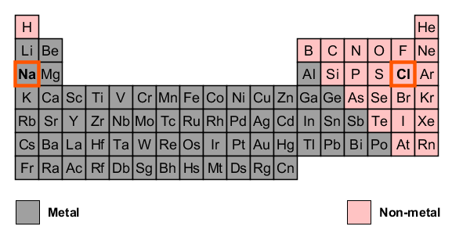
Which compound is ionic?
CO
MgF₂
Al₂O₃
Both CO and MgF₂
Both MgF₂ and Al₂O₃
A metal combined with a non-metal make an “ionic compound”.
Notes:
Follow-up discussion slide for previous clicker Q, using the periodic table representation shown in the simulation.

Slide 9
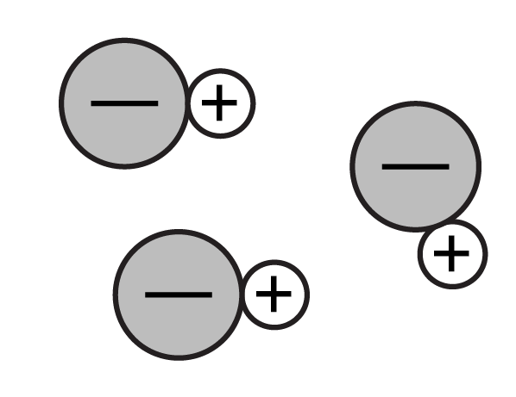
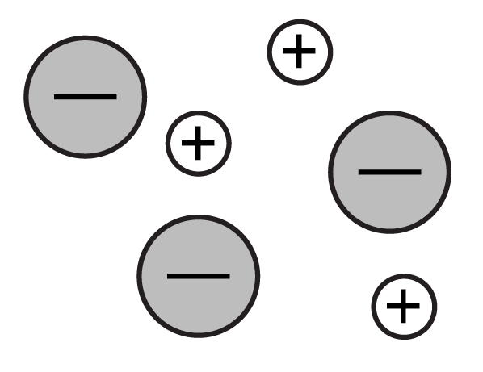
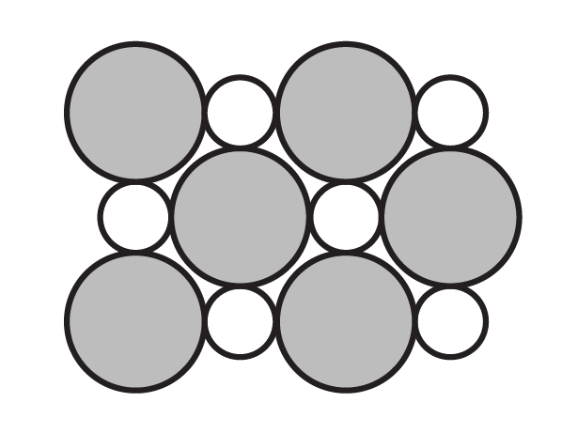
How many of these pictures correctly depict the all of the features of solid NaCl?
a. Zero b. 1 c. 2 d. 3
Notes:
Goal: Highlight that ionic solids are not molecular in structure (but form lattices) and that they contain charged ions even before they dissociate in water. Relate this back to the observed pre-dissolution and post-dissociation sim images.
Correct answer: A

Slide 10
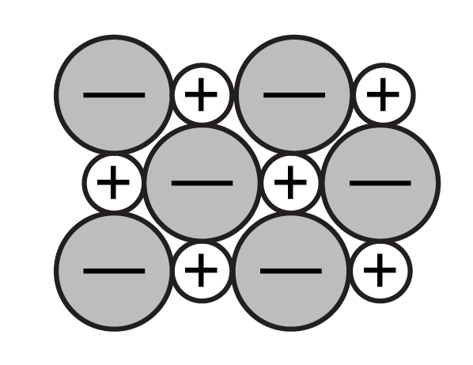
A correct (and complete) 2D representation of solid NaCl.
How many of these pictures correctly depict
all of the features of solid NaCl?
Incorrect – solid NaCl doesn’t form discrete molecules.
Incorrect – solid NaCl does not dissociate (until we dissolve it in water)
Incorrect, unless we define the circles as ions – solid NaCl does form an extended lattice like this, but it is made of charged ions even when it’s a solid.
a. Zero b. 1 c. 2 d. 3
Notes:
Follow-up discussion: During this discussion, use the 3rd (water) tab of sugar and salt solutions to highlight the structure of solid NaCl. Note that the diagram at the far right may have some ambiguity, since it is not explicitly stated that these do not represent charged ions.

Slide 11
Conductivity pairs
Which of these solutions will have higher conductivity?
A | B | C
Potassium chloride in water | Glucose (C₆H₁₂O₆) in water | Not enough information
Notes:
Correct answer: A
Representative results from pre-general chemistry after instruction: 95% correct

Slide 12
Conductivity pairs
Which of these solutions will have higher conductivity?
A | B | C
Potassium chloride in water | A different solution of potassium chloride in water | Not enough information
Notes:
Goal: Relationship between concentration and a measured macro-scale property like conductivity
Correct answer: C
Representative results from pre-general chemistry: 92% correct
Follow-up discussion: Use the discussion as an opportunity to refer to (or have students refer to) situations in the simulation – where we made the lightbulb brighter by adding more salt.

Slide 13
Conductivity pairs
Which of these solutions will have higher conductivity?
A | B | C
0.1 M KCl_{(aq)} | 0.2 M KCl_{(aq)} | Not enough information
Notes:
Multi-sim question: Sugar and salt solutions + Concentration
Correct answer: B
Representative results from pre-general chemistry: 91% correct
Follow-up discussion: Ask students about the concentration of each ion and discuss how conductivity is impacted by ion concentration

Slide 14
Conductivity pairs
Which of these solutions will have higher conductivity?
A | B | C
0.1 M KCl_{(aq)} | 0.1 M CaCl_{2 (aq)} | Not enough information
Notes:
Multi-sim question: Sugar and salt solutions + Concentration
Correct answer: B
Representative results from pre-general chemistry: 66% correct (with a roughly even split between the other two options)
Follow-up discussion: Ask students how they determined the higher conductivity solution – students have previously asked why this dissociates into 2 Cl⁻ instead of 1 Cl₂²⁻ since chlorine occurs naturally as Cl₂. Other students responded to this query with ideas about ion charges and the absence of charge on molecular Cl2 gas.

Slide 15
Conductivity pairs
Which of these solutions will have higher conductivity?
A | B | C
0.1 M KCl_{(aq)} | 0.1 M solution of a weak acid HA in water | Not enough information
Notes:
Note that this question actually does not target concepts from Sugar & Salt Solutions, but is included here to complete the set, in case these topics are covered earlier/later in a given course
Multi-sim question: Concentration + Acid-Base Solutions
Correct answer: A
Representative results from pre-general chemistry: 85% correct
Follow-up discussion: Ask students for their reasoning, specifically targeting whether we have complete or partial dissociation/ionization, and how that would affect total ion concentration.

