Slide 1

Clicker Questions for
Build an Atom
AUTHORS:
Yuen-ying Carpenter (University of Colorado Boulder)
Trish Loeblein (University of Colorado Boulder)
Robert Parson (University of Colorado Boulder)
COURSE:
Introductory / Preparatory College Chemistry
COPYRIGHT: This work is licensed under a Creative Commons Attribution 4.0 International License.

Slide 2
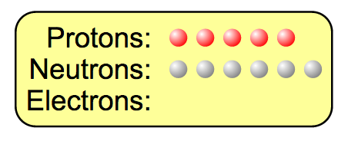
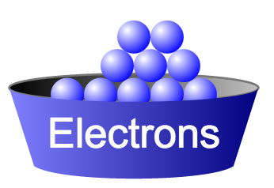
If you have 5 protons and 6 neutrons, how many electrons would you add to make a neutral atom ?
5 electrons
6 electrons
11 electrons
Notes:
Correct answer: A

Slide 3
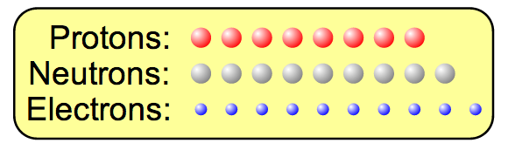
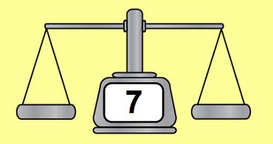
If you have an atom with
8 protons, 9 neutrons and 10 electrons, what is its mass number?
Zero
8
16
17
25
?
Notes:
Correct answer: D
Representative results from pre-general chemistry: 90% correct after lecture demo and recitation covering this material

Slide 4
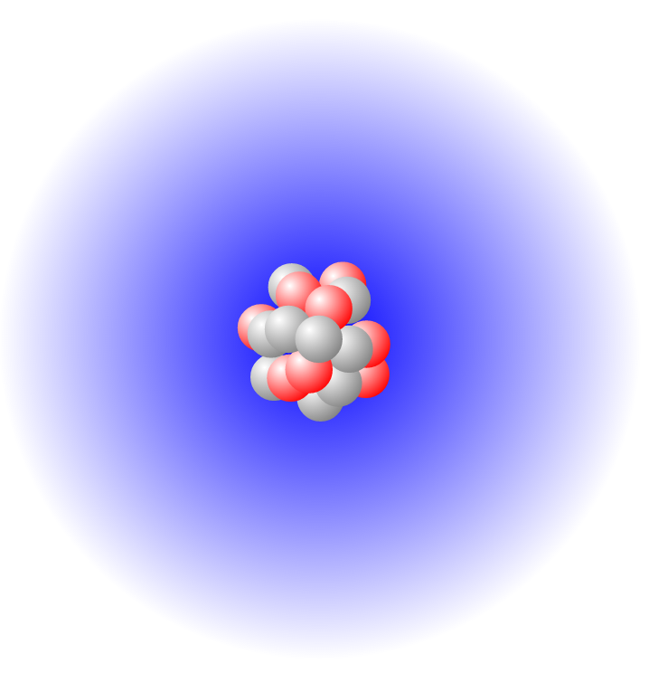
For the same atom, with
8 protons, 9 neutrons and 10 electrons,
what type of atom or ion is it?
Neutral atom
+2 ion
+1 ion
-1 ion
-2 ion
Notes:
Correct answer: E
Representative results from pre-general chemistry: 83% correct after lecture demo and recitation covering this material

Slide 5
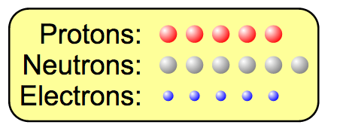
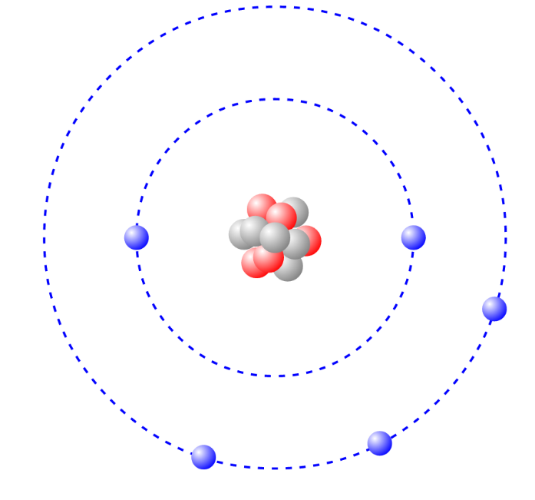
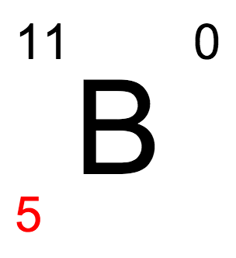
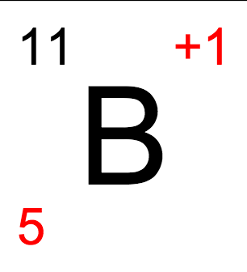
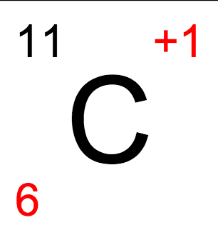
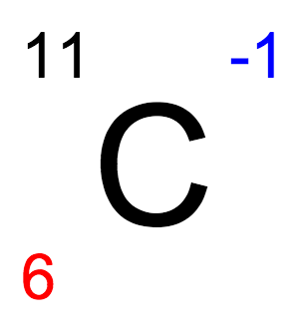
If you have 5 protons,
6 neutrons, & 5 electrons, what would the symbol look like?
A B C D
Notes:
Sim demonstration note: Must plan to cover the 2nd screen (Symbol) before this question
Correct answer: A
Representative results from pre-general chemistry: 83% correct after lecture demo and recitation covering this material

Slide 6
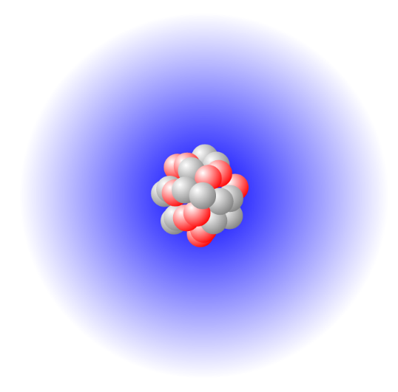
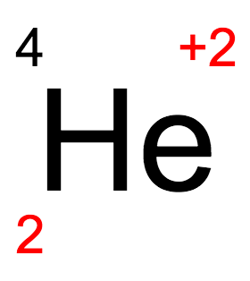
Remove
Start atom
Final atom
Which statement is FALSE about the final atom?
It is a different element than the start atom.
It has 4 neutrons less than the start atom.
It has 2 protons less than the start atom.
None of the above.
Notes:
Preface: This question was introduced by commenting that we had been building atoms and corresponding symbols in the sim by addition or removal of single subatomic particles. What if we removed enough particles to make an atom with this symbol?
Correct answer: B
Representative results from pre-general chemistry (1st polling): 47% correct (even split between other answers)
Follow-up discussion 1: Ask students about the subatomic particles in the atom represented by the symbol – write down the number of neutrons, protons, electrons corresponding to the symbol, then re-poll
Representative results from pre-general chemistry (2nd polling): 64% correct (roughly even split between other answers)
Follow-up discussion 2: Comment that this is a real process that occurs when some radioactive elements decay, and turn into other, more stable atoms

Slide 7
What is the correct symbol for an isotope of carbon with 7 neutrons?
₆C
₇C
₁₃C
₆C
⁷
¹³
⁶
¹³
Notes:
Correct answer: D
Representative results from pre-general chemistry: 81% correct after lecture demo and recitation covering this material

Slide 8
What is the correct identity of an element with the following isotopic symbol and how many neutrons does it have?
Gold, 114 neutrons
Bromine, 44 neutrons
Gold, 44 neutrons
Bromine, 114 neutrons
79
X
35
Notes:
Goal: Extend student application beyond the scope of the atoms in the sim, and have students make use of the periodic table
Correct answer: B
Representative results from pre-general chemistry: 86% correct

Slide 9



Which are isotopes?
I
I and II
II and III
I and III
I, II and III
II
III
Notes:
Note: This question is also included in the set of concept questions for Isotopes and Atomic Mass
Correct answer: D
Representative results from pre-general chemistry (when used as review of previous material): 58% correct (21% chose B)

Slide 10
Which of these pairs of atoms are isotopes?
 | Pair A |  | Pair B |  | Pair C
# of protons | 6 | 8 | 5 | 2 | 12 | 12
# of neutrons | 8 | 8 | 5 | 3 | 13 | 14
Notes:
Note: This question is also included in the set of concept questions for Isotopes and Atomic Mass
Correct answer: C
Representative results from pre-general chemistry: 88% correct

Slide 11
Which of these is not an isotope of ?
An atom with 6 protons and 7 neutrons.
The atom
An atom with 8 protons and 6 neutrons.
The ion
+2
Notes:
Goals: Connect isotopic symbols and the definition of isotopes
Correct answer: C
Representative results from pre-general chemistry: 88% correct
Follow-up discussion: Asked students to explain how they decided

Slide 12
Suppose you built a scale model of the atom the same width as a football field (100 m).
What could you use to represent the nucleus in your model?
A marble (1 cm)
A golf ball (4 cm)
A soccer ball (20 cm)
A yoga/exercise ball (50 cm)
Notes:
Goal: Extend from the cartoon picture of a nuclear atom in the simulation to get students to think about the relative scale of the atom and nucleus.
Correct answer: A
Representative results from pre-general chemistry: 46% correct post-instruction on Rutherford’s gold foil experiment, but with prior to instruction on the actual magnitudes of the nucleus vs the atom (answers decreased in popularity with increasing size of the model nucleus)
Follow-up discussion: Relate the approximate actual sizes of the nucleus and atom, and connect to metric unit conversions

