Slide 1
Building Fractions
Interactive

Slide 2
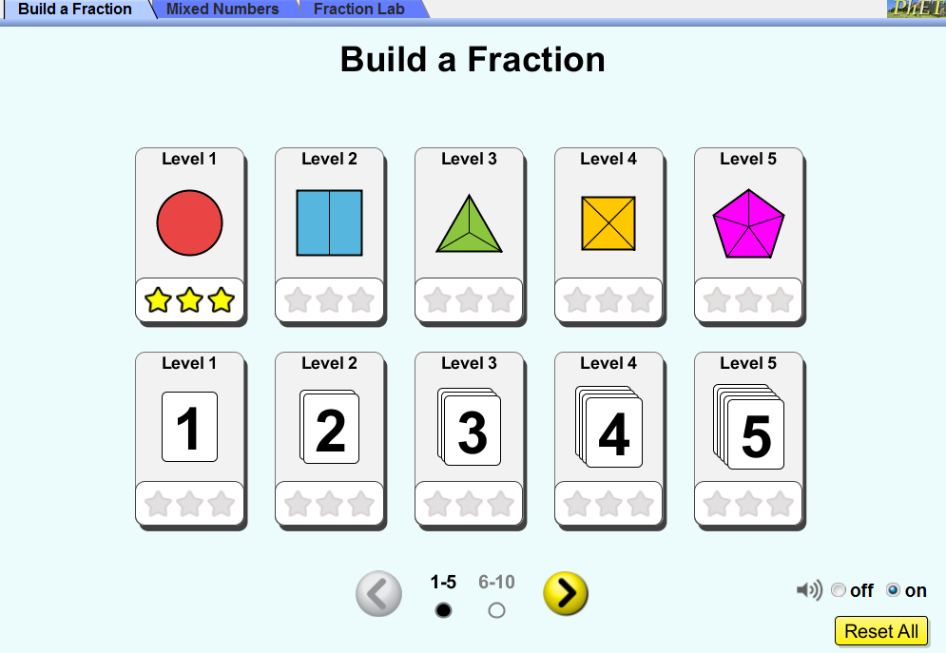
Start Screen
Start with Level 1

Slide 3
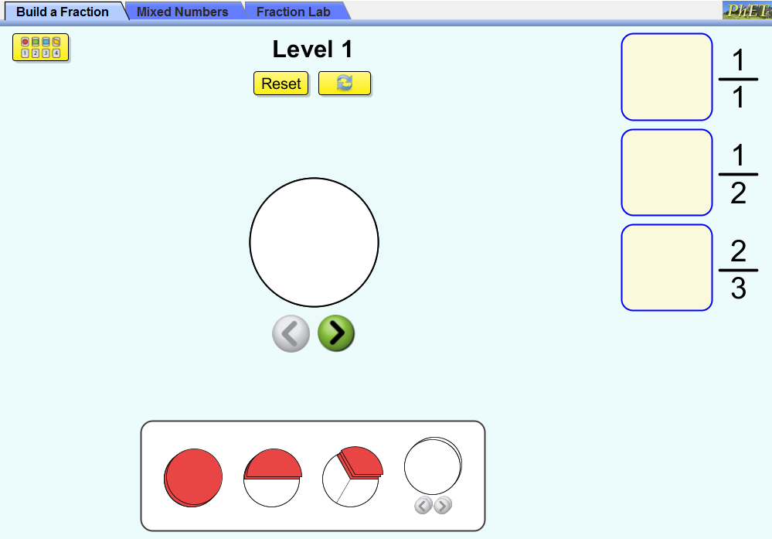
Build a Fraction Level 1 Challenge 1
How do the arrows work?

Slide 4

Build a Fraction Level 1 Challenge 1
Clicking the forward arrow will show guidelines on the shape.
Use these guidelines to check your work.

Slide 5
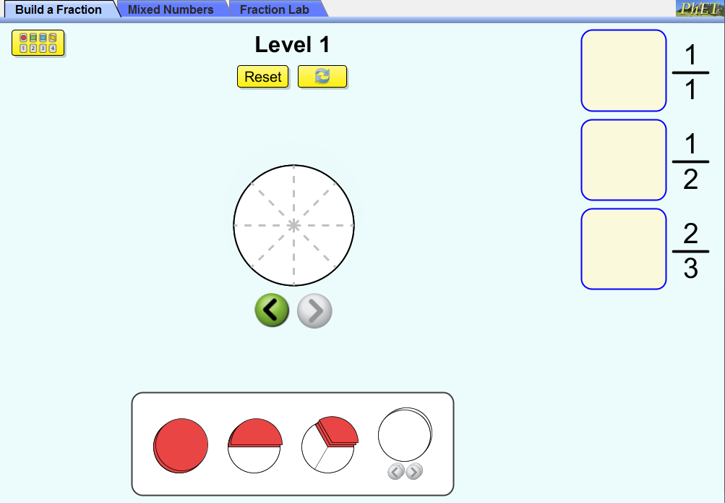
Build a Fraction Level 1 Challenge 1
You can use the arrows to show guidelines for dividing this shape into 2, 3, 4, 5, 6, 7, or 8 equal parts.
Use the arrow in the opposite direction to reduce the number of equal parts shown by the guidelines.

Slide 6
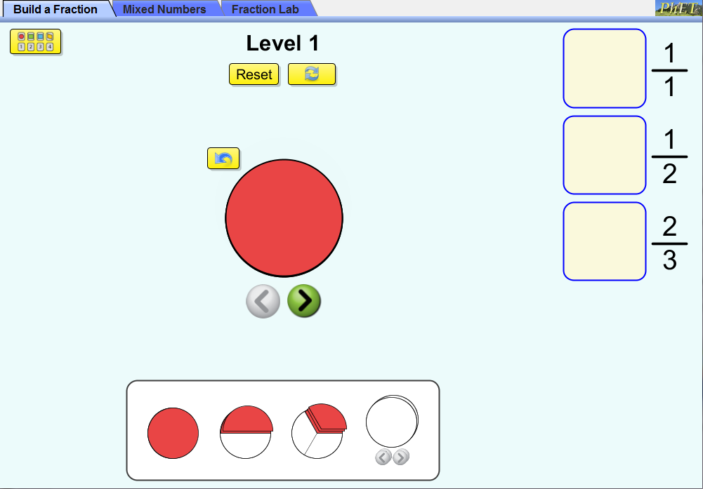
Build a Fraction Level 1 Challenge 1
The Reset button returns everything to the default start.

Slide 7

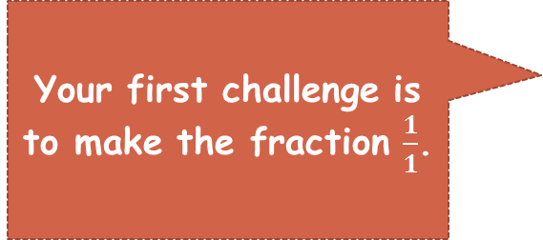
Build a Fraction Level 1 Challenge 1
Your first challenge is to make the fraction $\frac{1}{1}$.
A one in the denominator tells us the shape will have only one part.
A one in the numerator tells us that we will fill one part.

Slide 8
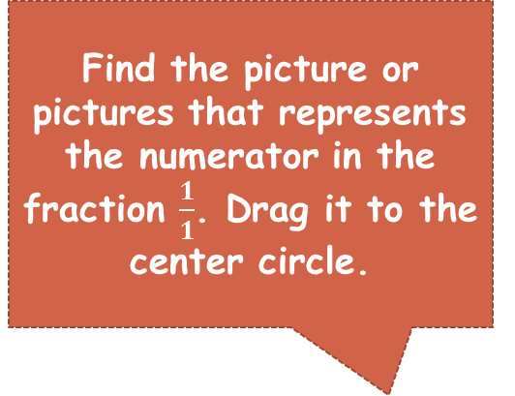
Build a Fraction Level 1 Challenge 1
Find the picture or pictures that represents the numerator in the fraction $\frac{1}{1}$. Drag it to the center circle.

Slide 9
Build a Fraction Level 1 Challenge 1
Use the return arrow if you change your mind.

Slide 10
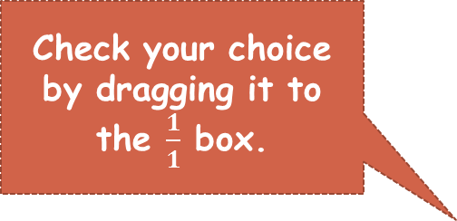
Build a Fraction Level 1 Challenge 1
Check your choice by dragging it to the $\frac{1}{1}$ box.

Slide 11
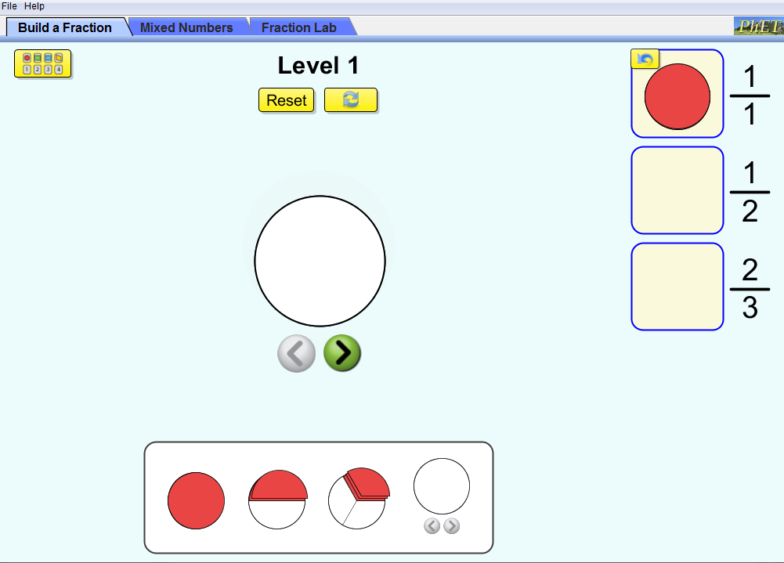
Build a Fraction Level 1 Challenge 1
If your answer is correct the fraction picture will stay in the square.
If it is not correct it will bounce out of the square.
You can try as many times as you like.
Use the return arrow if you change your mind.

Slide 12
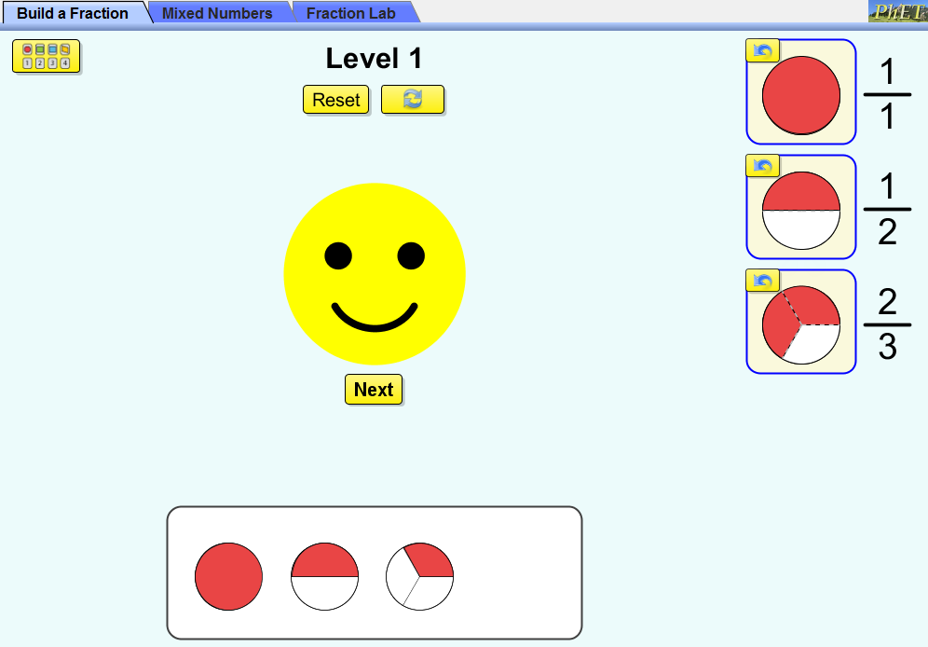
Build Fractions Level 1 Challenge 1
The smiley face means you have completed the challenge!
Click Next to go on tho the next challenge.

Slide 13
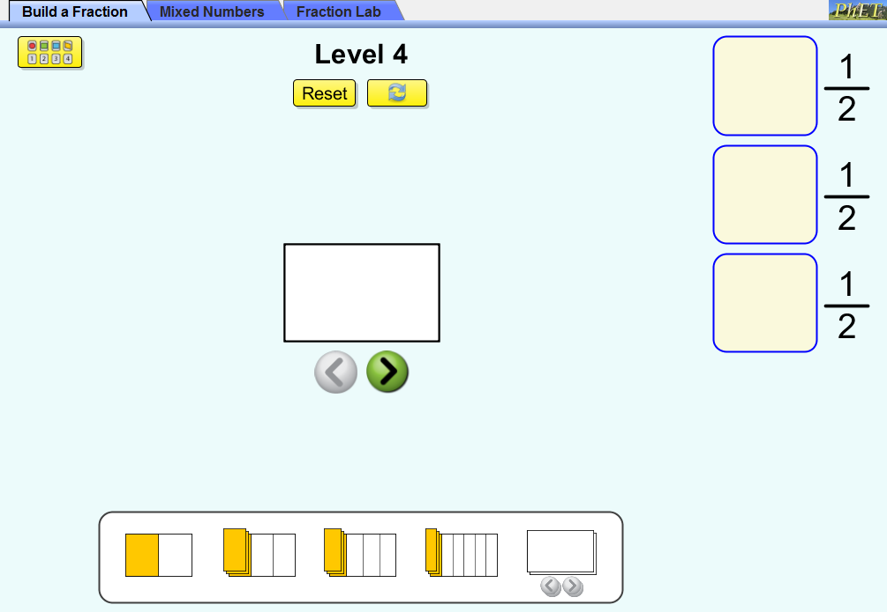
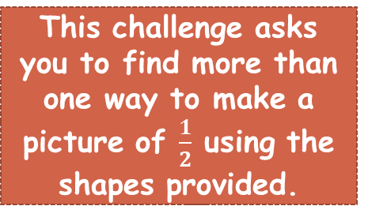
Build Fractions Level 1 Challenge 4
This challenge asks you to find more than one way to make a picture of $\frac{1}{2}$ using the shapes provided.

Slide 14
Fraction Lab
Interactive

Slide 15
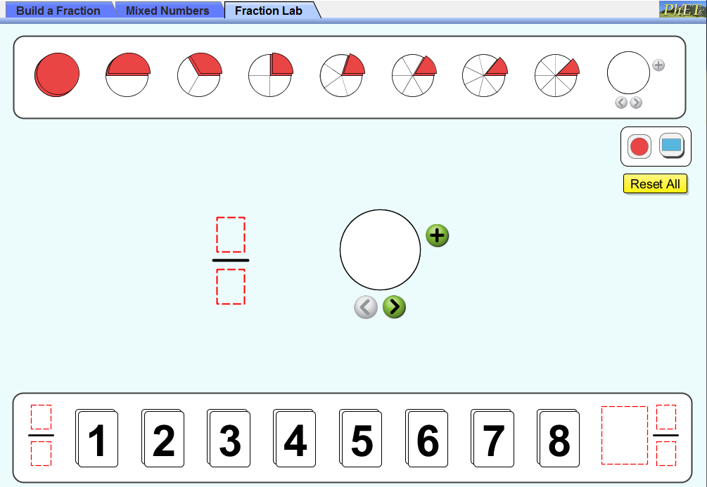
Fraction Lab Challenge!
Drag numbers to the numerator and denominator to name the fraction you will show in the picture.
Use the arrow to show the guidelines. The number of parts should be the same as you denominator.

Slide 16
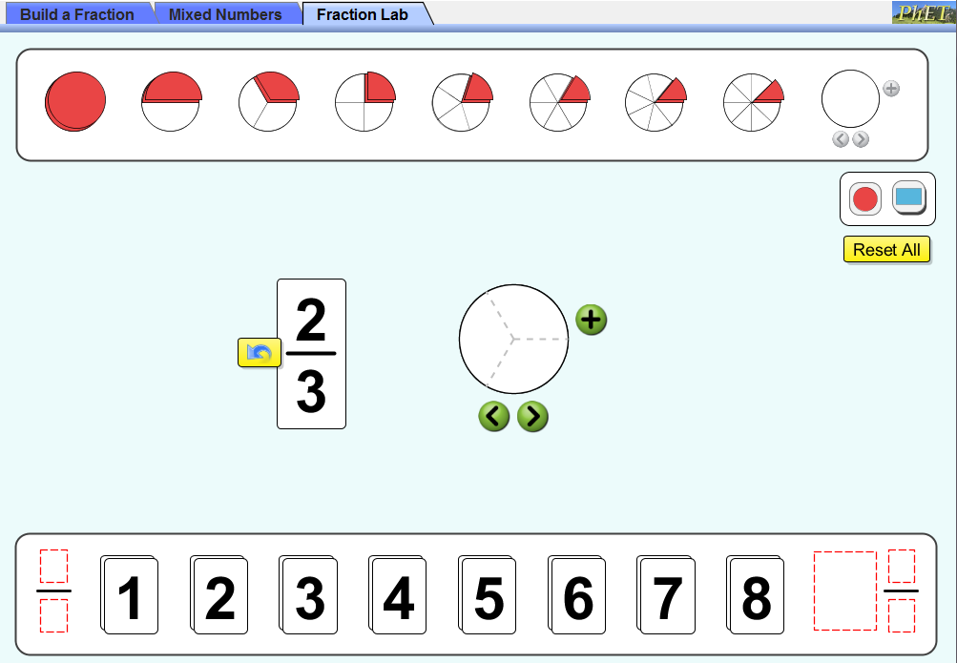
Fraction Lab Challenge!
The denominator is three and the shape is divided into three parts.

Slide 17
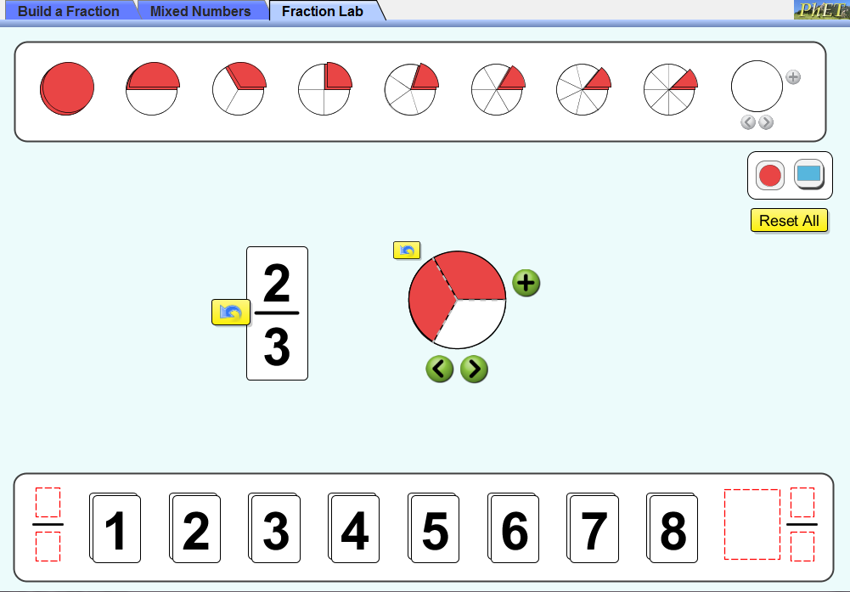
Fraction Lab Challenge!
Drag the parts to the shape. The number of parts is equal to your numerator.

Slide 18
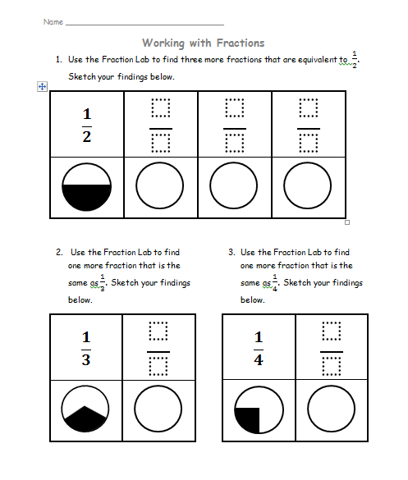
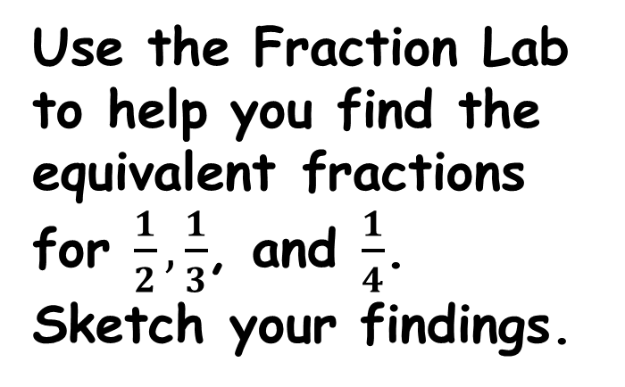
Fraction Lab Challenge 1
Use the Fraction Lab to help you find the equivalent fractions for $\frac{1}{2}, \frac{1}{3}$, and $\frac{1}{4}$. Sketch your findings.

Slide 19
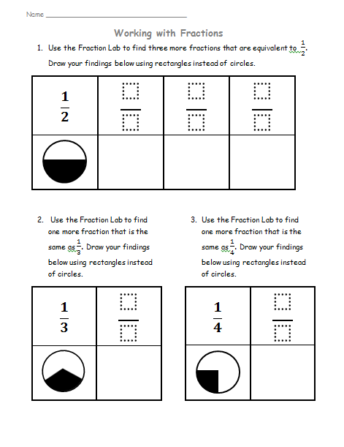
Fraction Lab Challenge 1
Use the Fraction Lab to help you find the equivalent fractions for $\frac{1}{2}, \frac{1}{3}$, and $\frac{1}{4}$. Sketch your findings.

Slide 20
Fraction Lab Challenge 2
Use the Fraction Lab to help you find fractions to compare using the signs provided. Sketch your findings.

Slide 21
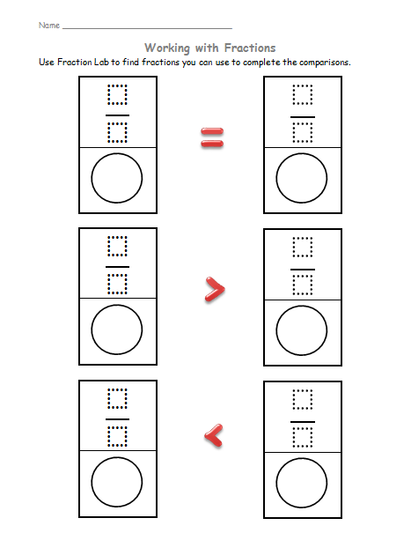
Fraction Lab Challenge 2
Use the Fraction Lab to help you find fractions to compare using the signs provided. Sketch your findings.

Slide 22
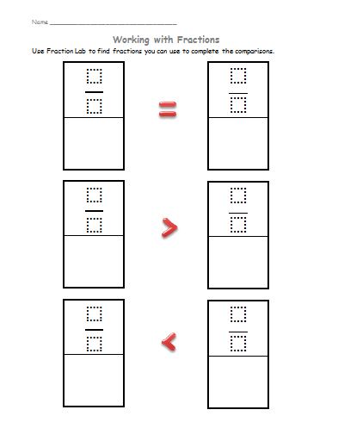
Fraction Lab Challenge 2
Use the Fraction Lab to help you find fractions to compare using the signs provided. Sketch your findings.

Slide 23
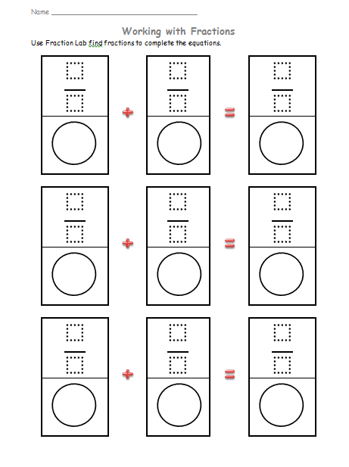
Fraction Lab Challenge 3
Use the Fraction Lab to help you find fractions to complete the equations. Sketch your findings.

Slide 24
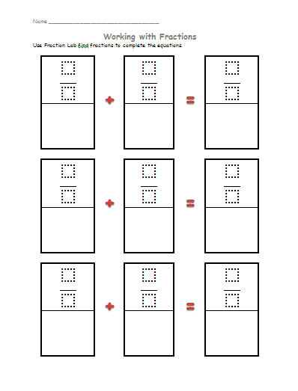
Fraction Lab Challenge 3
Use the Fraction Lab to help you find fractions to complete the equations. Sketch your findings.

Slide 25
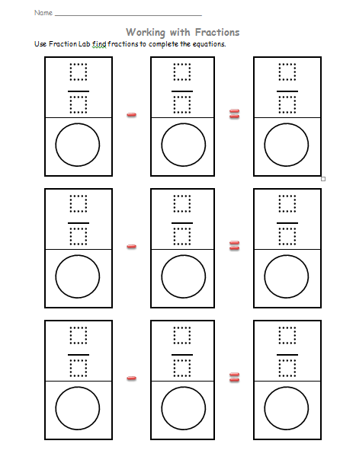
Fraction Lab Challenge 4
Use the Fraction Lab to help you find fractions to complete the equations. Sketch your findings.

Slide 26
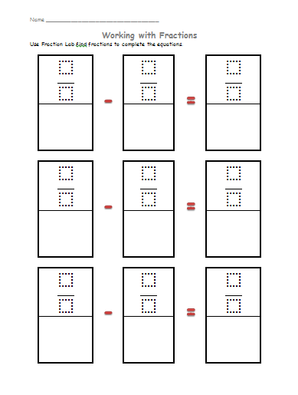
Fraction Lab Challenge 4
Use the Fraction Lab to help you find fractions to complete the equations. Sketch your findings.

