Slide 1
Under Pressure (also Fluid Pressure Flow- Pressure tab) by Trish Loeblein June 2012
Learning goals:
Students will be able to
Investigate how pressure changes in air and water.
Discover how you can change pressure.
Predict pressure in a variety of situations
Notes:
See lesson plan for more details about goals

Slide 2
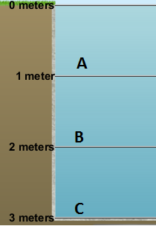
1. Order from lowest to highest pressure.
A<B<C
C<B<A
all are equal
Notes:
A

Slide 3
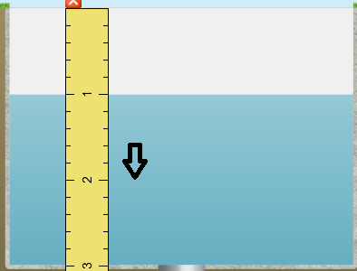
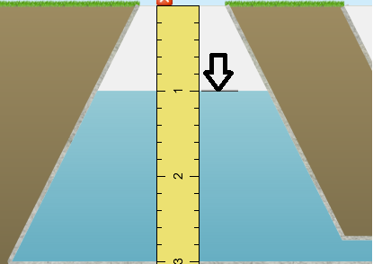
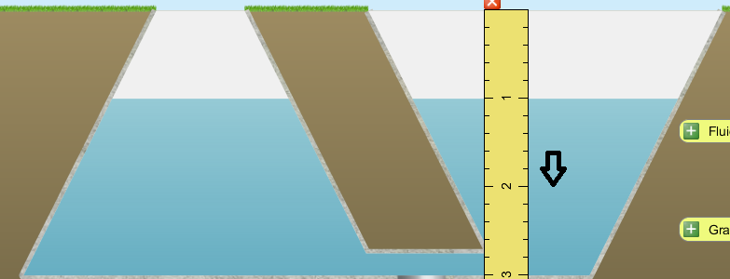
2. Look at the markers. Order from lowest to highest pressure.
X
A. Y<Z<X B. Y<X<Z C. Z<X<Y
D. X<Z<Y E. two are equal
Y
Z
Notes:
E

Slide 4
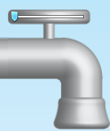
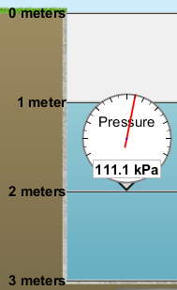
3. What will happen to the pressure if more water is added?
increase
decrease
stay the same
Notes:
A

Slide 5
4. What will happen to the pressure if more water is added while the same amount is removed?
increase
decrease
stay the same
Notes:
C

Slide 6
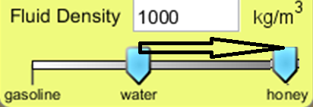
5. What will happen to the pressure if the fluid were changed to honey?
increase
decrease
stay the same
Notes:
A

Slide 7
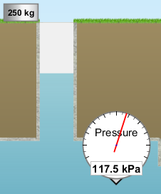
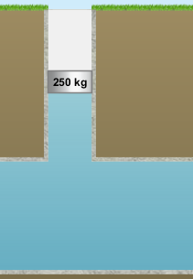
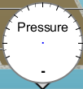
6. If the 250 kg mass was put on the water column, what will happen to the pressure?
increase
decrease
stay the same
Notes:
A

Slide 8
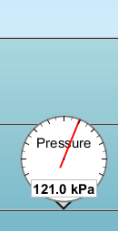

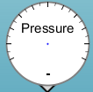
7. If the only change was to remove the air pressure , what will happen to the pressure?
increase by 101.3 kPa
decrease by 101.3 kPa
stay the same
Something else
Notes:
B

Slide 9
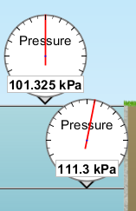
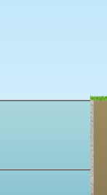

8. If the only change was to go to a place where the gravity was doubled, what will happen to the pressure?
Both pressures would double
Only the air pressure would double
The air pressure would double, and the water pressure would increase some
Something else
Notes:
A

Slide 10
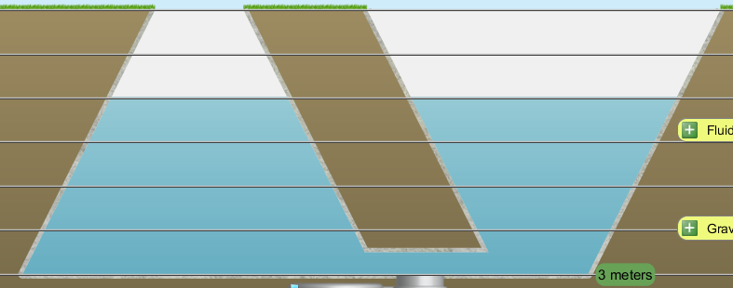
9. How do the pressures at the two locations compare?
X
Y
X>Y
Y>X
They are the same
Notes:
C

