Slide 1
Eating and Exercise Clicker questions
By Trish Loeblein
4/10/12
These could be used with Wendy Adams activity https://phet.colorado.edu/en/contributions/view/3325

Slide 2

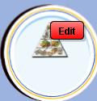


If you heard about a diet that recommended more protein and less carbs, how would you make this change, but keep your calories the same?
Add more lean meat and eat less of everything else
Exercise more
Drink more milk and eat less of everything else
Notes:
A the lean meat has no carbs, but some fat, but the skim milk has no fat and carbs

Slide 3
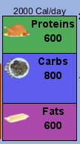
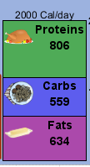
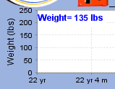

What happens if you change your diet by eating more protein and less carbs but still keep your calories the same?
Weight would reduce
Weight would increase
Heart strength would increase
Changes depend on the balance of your exercise and calorie intake, so there is not enough information
Notes:
If a person is eating more calories than they expend and have a sedentary lifestyle, changing the type of diet will not matter. However, if they are exercising, increasing protein and decreasing carbs will cause a weight loss. Try showing this using a sedentary person compared to a moderately active one. Edit the initial food to lower the calories and then drag in other food.

