Slide 1
Turkey Earthquake
October 23, 2011

Slide 2
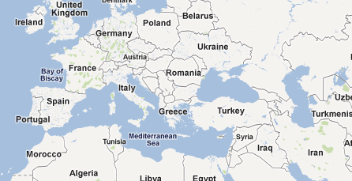
Where is Turkey?
Notes:
Photo Credit: Google Maps

Slide 3
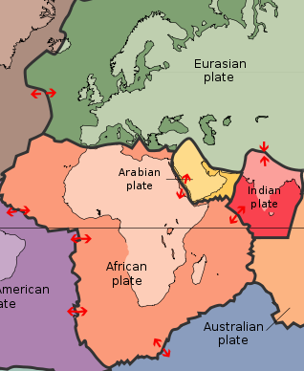
What caused the earthquake?
Notes:
Photo Credit: http://pubs.usgs.gov/gip/dynamic/slabs.html

Slide 4
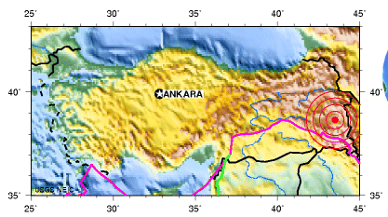
Where was the earthquake?
Notes:
Photo Credit: http://neic.usgs.gov/neis/eq_depot/2011/eq_111023_b0006bqc/neic_b0006bqc_l.html

Slide 5
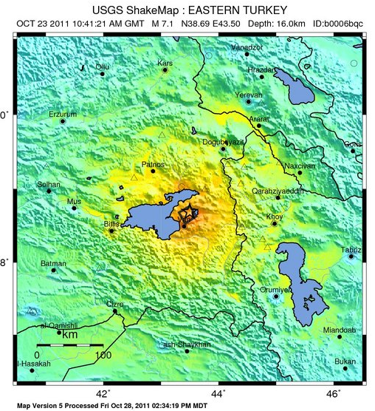
What did the earthquake feel like?
Notes:
It was on the Eastern border.
Photo Credit: http://earthquake.usgs.gov/earthquakes/shakemap/global/shake/b0006bqc/
Shake Map Key: green -> orange = felt very light shake -> severe

Slide 6
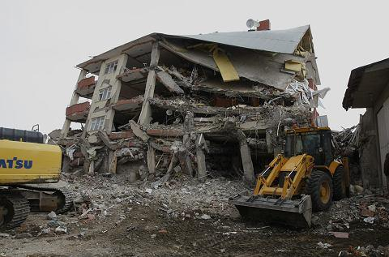
Why did buildings collapse?
Notes:
Photo Credit: http://www.washingtonpost.com/world/middle-east/turkish-workers-begin-clearing-debris-of-collapsed-buildings-in-quake-zone-one-week-on/2011/10/30/gIQAhZ79UM_story.html

Slide 7
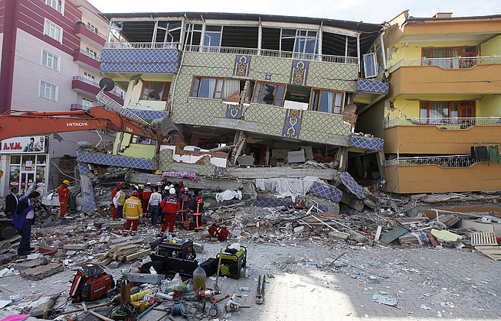
Notes:
Photo credit: http://knowledge.allianz.com/?736/natural-disasters-earthquakes

