Slide 1
Gas Properties Chemistry: Gas Laws
Learning Goals:
Design experiments to measure the relationships between pressure, volume, and temperature.
Create graphs based on predictions and observations.
Make qualitative statements about the relationships between pressure, volume and temperature using molecular models.
Previous knowledge: Students are able to describe a molecular model of gas pressure.
By Trish Loeblein see activity for Lesson Plans and Lab

Slide 2
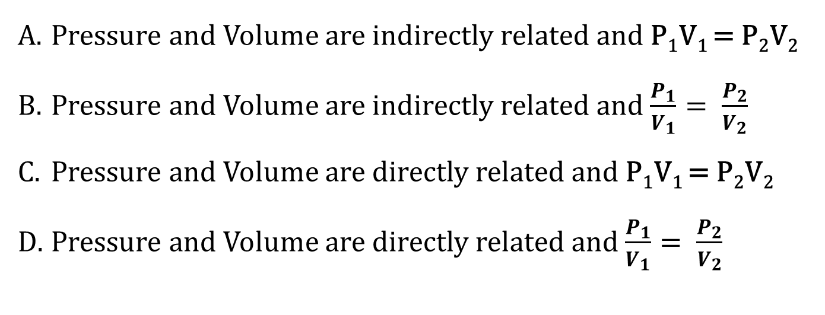
1. What does this graph indicate?
Pressure and Volume are indirectly related and P₁V₁ = P₂V₂
Pressure and Volume are indirectly related and $\frac{P_{1}}{V_{1}}= \frac{P_{2}}{V_{2}}$
Pressure and Volume are directly related and P₁V₁ = P₂V₂
Pressure and Volume are directly related and $\frac{P_{1}}{V_{1}}= \frac{P_{2}}{V_{2}}$
Notes:
A

Slide 3
2. What variables were held constant?
Pressure and Volume
Pressure, number of particles, and Volume
Number of particles and temperature
Volume, number of particles and temperature
Notes:
C

Slide 4
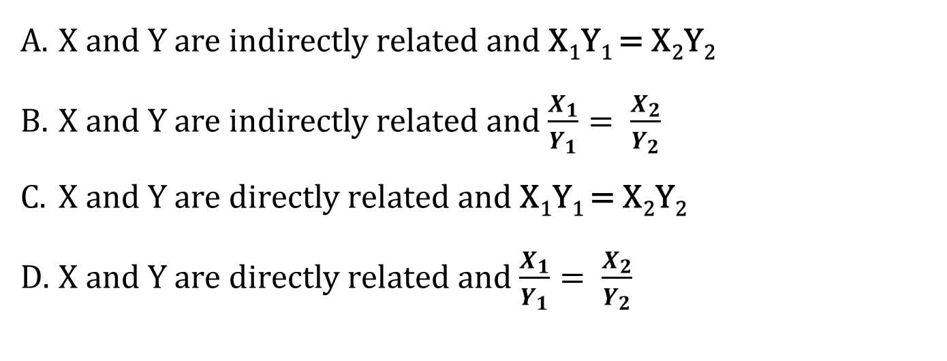
3. What does this graph indicate?
X and Y are indirectly related and X₁Y₁ = X₂Y₂
X and Y are indirectly related and $\frac{X_{1}}{Y_{1}}= \frac{X_{2}}{Y_{2}}$
X and Y are directly related and X₁Y₁ = X₂Y₂
X and Y are directly related and $\frac{X_{1}}{Y_{1}}= \frac{X_{2}}{Y_{2}}$
Notes:
D

Slide 5
4. Which explanation could be used to explain the relationship between temperature and pressure for gases?
Pressure depends on the number of collisions and if the temperature increases, the molecules increase speed, so they would hit the sides more and the pressure would go up.
Pressure depends on the energy of collisions and if the temperature increases, the molecules increase speed, so they would hit the sides with more energy and the pressure would go up.
Both help explain
Neither help explain
Notes:
C

Slide 6
List the things that affect gas pressure and draw graphs and equations that shows the correct relationships.

Slide 7
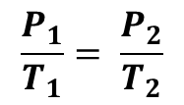
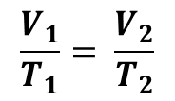
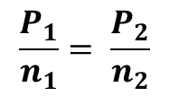
Gas Laws with just 2 variables
P₁V₁ = P₂V₂
$$\frac{P_{1}}{n_{1}}= \frac{P_{2}}{n_{2}}$$
$$\frac{V_{1}}{T_{1}}= \frac{V_{2}}{T_{2}}$$
$$\frac{P_{1}}{T_{1}}= \frac{P_{2}}{T_{2}}$$
Remember that the other variables must be held constant

