Slide 1
Acid Base Solutions:
Strength and Concentration by Trish Loeblein July 2011
Learning goals: Students will be able to
Generate or interpret molecular representations (words and/or pictures) for acid or base solutions
Provide or use representations of the relative amounts of particles in acid or base solutions to estimate strength and/or concentration
Use common tools (pH meter, conductivity, pH paper) of acid or base solutions to estimate strength and/or concentration
Some materials adapted from an activity by Lancaster /Langdon
Notes:
See lesson plan for more details about goals

Slide 2








Icons for Acid Base Solutions

Slide 3
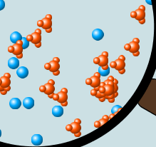
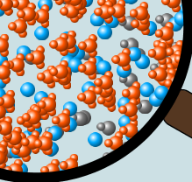
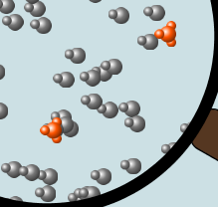
1.Order the solutions from lowest to highest pH.
X Y Z
A. X<Y<Z B. Y<X<Z C. Z<Y<X
D. Z<X<Y E. Y<Z<X
Notes:
B Y has most H30+ , then X then Z

Slide 4
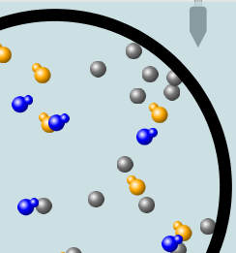
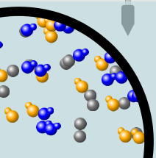
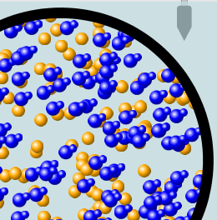
2.Order the solutions from lowest to highest pH.
X Y Z
A. X<Y<Z B. Y<X<Z C. Z<Y<X
D. Z<X<Y E. Y<Z<X
Notes:
A X has most OH- (the blue ones) , then Y then Z (might want to refer to images on slide 2 or show sim)

Slide 5
3. Which image is from a strong acid?
X Y Z
X B. Y C. Z
D. more than one E. none
Notes:
A because there are no HA left. Discuss that it does not have the highest pH.

Slide 6
4. Which image is from a weak base?
X Y Z
X B. Y C. Z
D. more than one E. none
Notes:
D note that there are 3 types of particles showing incomplete dissociation. Strong bases totally dissociate like salts, weak ones only partially dissociate.

Slide 7
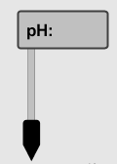

5. Strong acids have lower pH than weak acids.
Always True
Always False
Sometimes True
Notes:
C see next slide

Slide 8
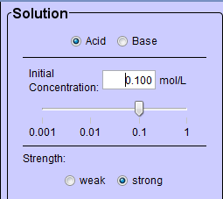
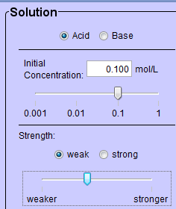
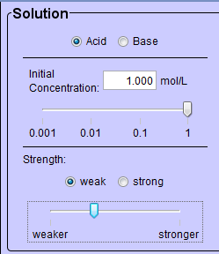
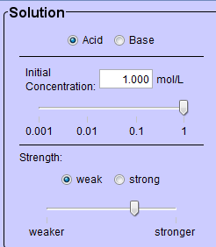
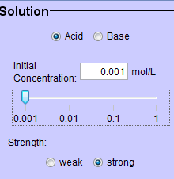
5. Strong acids have lower pH than weak acids?
pH = 1
pH = 3
Use pH meter to see that if the acids are the same concentration, then the statement is true, but there are other possibilities

Slide 9


7. A solution with [H₃O⁺] = .1 M contains a stronger acid than a solution [H₃O⁺] = .001 M.
Always True
Always False
Sometimes True
Notes:
C see next slide for demonstration.

Slide 10
8. A solution with [H₃O⁺] = .1 M contains a stronger acid than a solution [H₃O⁺] = .001 M?
.1 M Hydronium
.001 M Hydronium
Use the Equilibrium concentration View to see that if the acid is weak, then the statement is true, but if the acid is strong, concentration matters.
Notes:
Use the Equilibrium concentration View to see that if the acid is weak, then the statement is true, but if the acid is strong, concentration matters.

Slide 11
9. What ALWAYS distinguishes a weak acid from a strong acid?
A weak acid doesn’t react much in water; strong acids completely react.
A weak acid is more dilute than a strong acid.
A weak acid has a higher pH than a strong acid.
Statements a and c are both characteristics that distinguish weak acids from strong acids.
Statements a, b, and c are all characteristics that distinguish weak acids from strong acids.
Notes:
A

Slide 12
10. What ALWAYS distinguishes a weak base from a strong base?
A weak base doesn’t react much in water; strong bases completely react.
A weak base is more dilute than a strong base.
A weak base has higher pH than a strong base.
Statements a and c are both characteristics that distinguish weak bases from strong bases.
Statements a, b, and c are all characteristics that distinguish weak bases from strong bases.
Notes:
A

Slide 13
Icons for Acid Base Solutions
Use these icons to write reactions for strong and weak acids and then for strong and weak bases.

