Slide 1
Reactants, Products and Leftovers Clicker questions
by Trish Loeblein http://phet.colorado.edu
(assuming complete reactions)

Slide 2
Reactants, Products, and Leftovers Activity 1: Introduction to Chemical reactions by Trish Loeblein http://phet.colorado.edu
Learning Goals:
Students will be able to:
Relate the real-world example of making sandwiches to chemical reactions
Describe what “limiting reactant” means using examples of sandwiches and chemicals at a particle level.
Identify the limiting reactant in a chemical reaction
Use your own words to explain the Law of Conservation of Particles means using examples of sandwiches and chemical reaction
Notes:
https://phet.colorado.edu/en/contributions/view/3102
Discuss that many types of sandwiches can be made

Slide 3




1. Making a cheese sandwich can be represented by the chemical equation:
2 Bd + Ch → Bd₂Ch
What would you expect a sandwich to look like?
A B C D
Notes:
A

Slide 4
2. Making a cheese sandwich can be represented by the chemical equation:
Bd₂ + 2Ch → 2BdCh
What would you expect a sandwich to look like?
A B C D
Notes:
D

Slide 5



3. Making a cheese sandwich can be represented by the chemical equation:
2 Bd + Ch → Bd₂Ch
What does the “2” on the left side of the chemical equation represent?
2 pieces of bread stuck together
2 separate pieces of bread
2 loaves of bread
Notes:
B or C are actually accurate, but depending on whether the concept of mole has been introduced, you may get just A.

Slide 6
4. Making a cheese sandwich can be represented by the chemical equation:
Bd₂ + 2Ch → 2BdCh
What does the “2” on the left side of the chemical equation represent?
2 pieces of bread stuck together
2 separate pieces of bread
2 loaves of bread
Notes:
A is the best answer.

Slide 7
5. A menu at the Chemistry Café shows a sandwich: BdM₂Ch
What would you expect a sandwich to have?
2 pieces of bread, 2 pieces of meat, 1 piece of cheese
1 piece of bread, 2 pieces of meat, 1 piece of cheese
2 loaves of bread
Notes:
A is the best answer.

Slide 8
6. A menu at the Chemistry Café describes a sandwich as 3 pieces of bread, one meat and 2 cheeses.
What would you expect a sandwich name to be?
Bd₂MCh₂
Bd₃M₂Ch
Bd₃MCh₂
Notes:
A is the best answer.

Slide 9
7. The Chemistry Café owner was out of bread. She went to the bakery next door and bought a loaf which had 33 slices. Then she sells 12 sandwiches, which need 2 pieces of bread each. How much bread did she have left?
21
9
None, she gave the leftovers to the birds
Notes:
B 33-2*12=9

Slide 10





8. The Chemistry Café cook has a loaf which had 33 slices and a package of cheese that has 15 slices. He is making sandwiches that have 2 pieces of both bread and cheese. How many sandwiches can he make?
16
15
7
Notes:
B 33/2=16.5 15/2=7.5 so the max is 7.

Slide 11
Reactants, Products, and Leftovers
Activity 2: Limiting Reactants in Chemical reactions by Trish Loeblein http://phet.colorado.edu
(assuming complete reactions)
Learning Goals: Students will be able to:
Predict the amounts of products and leftovers after reaction using the concept of limiting reactant
Predict the initial amounts of reactants given the amount of products and leftovers using the concept of limiting reactant
Translate from symbolic (chemical formula) to molecular (pictorial) representations of matter
Explain how subscripts and coefficients are used to solve limiting reactant problems.
Notes:
July 2011

Slide 12
1. A mixture of 4 moles of H₂ and 3 moles of O₂ reacts to make water. Identify: limiting reactant, excess reactant, and how much is unreacted.
Limiting Excess
reactant reactant
H₂ 1 mole H₂
H₂ 1 mole O₂
O₂ 1 mole H₂
O₂ 1 mole O₂
No reaction occurs since the equation does not balance with 4 mole H₂ and 3 mole O₂
Notes:
B students will need to write the balanced chemical reaction or the teacher could provide it before showing the question.

Slide 13
2. A mixture of 6 moles of H₂ and 2 moles of O₂ reacts to make water. How much water is made?
6 moles water
2 moles water
3 moles water
4 moles water
No reaction occurs since the equation does not balance with 6 mole H₂ and 2 mole O₂
Notes:
D students will need to write the balanced chemical reaction or the teacher could provide it before showing the question.

Slide 14
3. A mixture of 2.5 moles of Na and 1.8 moles of Cl₂ reacts to make NaCl. Identify: limiting reactant, excess reactant, and how much is unreacted.
Limiting Excess
reactant reactant
Na 0.7 mole Na
Na 0.7 mole Cl₂
Na 0.55 mole Cl₂
Cl₂ 0.7 mole Na
Cl₂ 1 mole Na
Notes:
C
2.5 moles Na requires 1.25 moles of chlorine (diatomic) and 1.8 moles of chlorine would require 3.5 mole Na. So Na is the limiting reactant. 1.8-1.25 = .55 mole Chlorine

Slide 15
4. A mixture of 2.5 moles of Na and 1.8 moles of Cl₂ reacts to make NaCl. How much sodium chloride is made?
2.5 moles NaCl
1.8 moles NaCl
0.7 moles NaCl
0.55 moles NaCl
1 mole Nacl
Notes:
A
2.5 moles Na requires 1.25 moles of chlorine (diatomic) and 1.8 moles of chlorine would require 3.5 mole Na. So Na is the limiting reactant. The reaction is 2 Na + Cl2 = 2NaCl , so the moles of NaCl is equal to the moles of Na consumed

Slide 16

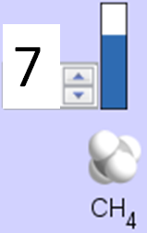
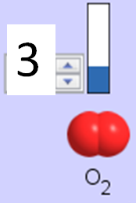
5. The reaction for combustion of methane is
Given the shown amounts for each reactant, predict the amounts of products and leftovers after complete reaction.
Notes:
Choices are on next slide

Slide 17
5. What are the amounts after the reaction?
Initial:
7 CH₄ and 3 O₂
After:
6 1 1 2
1 6 1 2
1 0 6 12
4 0 4 8
Notes:
A. use the sim to easily show this.

Slide 18

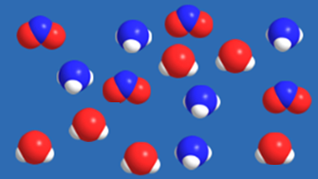
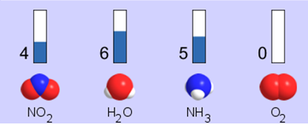




6. Given the shown amounts for the products and leftovers after a complete reaction, predict the initial reactants.
Notes:
Choices are on next slide

Slide 19




6. What are the amounts before the reaction?
After:
5 NH₃ 0 O₂ 4 NO₂ 6 H₂O
Before:
4 7
9 7
10 7
4 0
Notes:
B. This came from the game, so you would have to draw the reaction

Slide 20
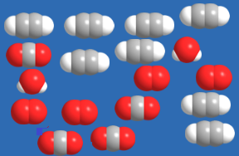


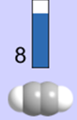





7. Given the shown amounts for the products and leftovers after a complete reaction, predict the initial reactants.
Notes:
Choices are on next slide

Slide 21

7. What are the amounts before the reaction?
After:
8 C₂H₂ 4 O₂ 4 CO₂ 2 H₂O
Before:
2 10
12 10
10 9
8 4
Notes:
C. This came from the game, so you would have to draw the reaction

Slide 22
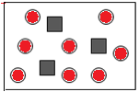

8. A mixture of S atoms ( ) and O₂ molecules ( ) in a closed container is represented by the diagrams:
Which equation best describes this reaction?
3X + 8Y → X₃Y₈
X₃ + Y₈ → 3XY₂ + 2Y
X + 2Y → XY₂
3X + 8Y → 3XY₂ + 2Y
X₃ + Y₈ → 3XY₂ + Y₂
From Lancaster/Perkins activity
Notes:
D

Slide 23

9. An initial mixture of sulfur( ) and oxygen( )is represented:
Using this equation: 2S + 3O₂ → 2SO₃ , what would the results look like?
From Lancaster/Perkins activity
Notes:
Answers on next slide. Give students some time before the answer selections are provided

Slide 24





9. Before: S O₂
2S + 3O₂ → 2SO₃
A B C D E
From Lancaster/Perkins activity
Notes:
D

Slide 25
10. Before: S O₂
2S + 3O₂ → 2SO₃
Which is the limiting reactant?
Sulfur
Oxygen
Neither they are both completely used
From Lancaster/Perkins activity
Notes:
B

