Slide 1
Calculus Grapher for Physics
Learning Goals: Students will be able to:
Use the language of calculus to discuss motion
Given a function sketch the derivative, or integral curves
Open Calculus Grapher and Moving Man before starting presentation
Trish Loeblein July 2009 to see course syllabi :
http://jeffcoweb.jeffco.k12.co.us/high/evergreen/science/loeblein/phys_syl/syllabus_p.html

Slide 2
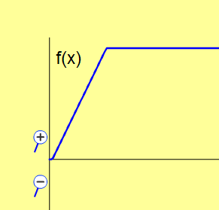
1. A car started from a stoplight, then sped up to a constant speed. This function graph describes his..
Position
Velocity
Acceleration
Notes:
B

Slide 3
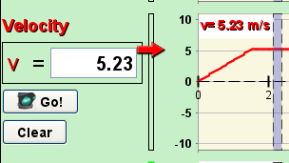
Use Moving man to show this: I set the acceleration at about 3 then paused the sim by the time the man got to the 4 spot, then I changed the acceleration to 0. If you have Moving man open with this type of scenario, you can use the grey bar to show that the speed was zero increasing and then constant.

Slide 4
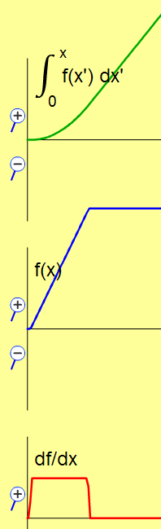
2. To find out how far he traveled, you would use
Integral
Function
Derivative
Notes:
A

Slide 5
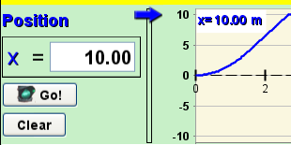
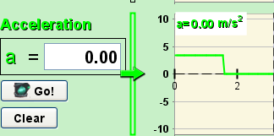
Use Moving Man Replay to show Position is found by the integral curve
Derivative curve shows acceleration
Notes:
B

Slide 6
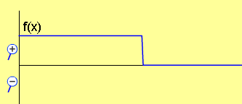
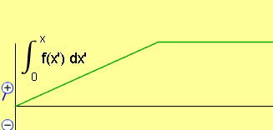
3. Your friend walks forward at a constant speed and then stops. Which graph matches her motion?
A. Position curve
B. Velocity curve
C. Position curve
D. Acceleration curve
E. More than one of these
Notes:
E. The answer is both B and C.

Slide 7
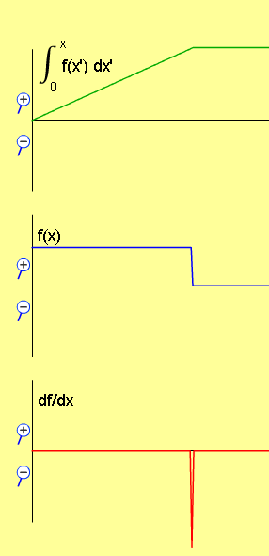
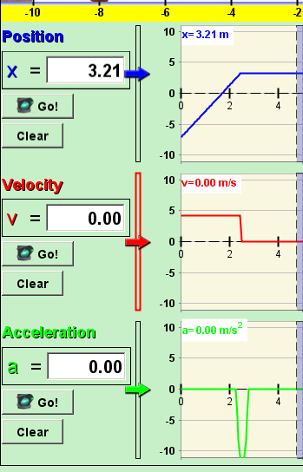
Use Moving man to show this: I set the Man at about -6 position, made the velocity about 4, then paused the sim by the time the man got to the 4 spot, then I changed the velocity to 0. If you have Moving man open with this type of scenario, you can use the grey bar to help.

Slide 8
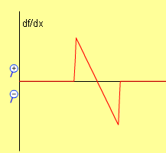
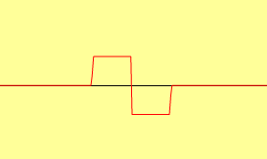
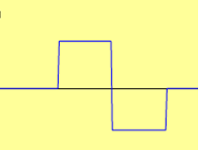
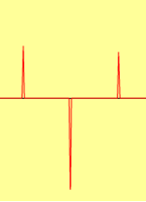
4. Which could be the derivative curve?
A
F(x)
B
C
Notes:
C

Slide 9
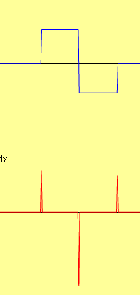
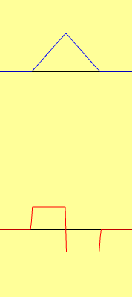
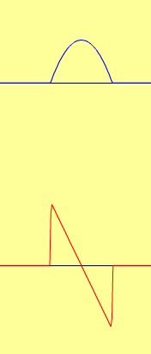

Pedestal Linear Parabola
F(x)
For each case, if the function, F(x) is velocity, what could a possible story for the motion of a person walking?
Notes:
For the pedestal, a person would be standing still, then walk forward, turn around and walk the other way and stop.
For the linear, a person would be standing still, accelerate at a constant rate forward (going faster), then still going forward slowing at a constant rate to a stop.
For the parabola, the story is nearly the same as the linear in that the object is going forward the whole time, but it might be easier to imagine a person driving a car. The car would be not increasing speed up as much, so more like the driver was using the gas all the way. then let up and then used the break more and more .

Slide 10





5. Three race cars have these velocity graphs. Which one probably wins?
A
B
C
D No way to tell

Slide 11
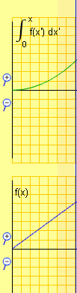
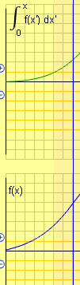

Use integral to tell that the parabolic one traveled farthest
Max value

