Slide 1
Calculus Grapher for Math
Learning Goals: Students will be able to:
Given a function sketch the derivative or integral curves
Explain what the effect of a discontinuity in a function has on the derivative and the integral curves
Explain the difference between smooth versus piecewise continuous function curve
Be able to describe in words with illustrations what the derivative and integral functions demonstrate
Open Calculus Grapher before starting class introduction
Open Calculus Grapher before starting and Moving Man before starting clicker questions
Trish Loeblein and Mike Dubson July 2009 to see course syllabi :
http://jeffcoweb.jeffco.k12.co.us/high/evergreen/science/loeblein/phys_syl/syllabus_p.html

Slide 2

Given this function, talk with your group about what you think the derivative and integral curves will look like and sketch
F(x)

Slide 3
answer
F(x)
F(x)
Notes:
This would be better demonstrated using the simulation.

Slide 4
Given this function, talk with your group about what you think the derivative and integral curves will look like and sketch
F(x)

Slide 5
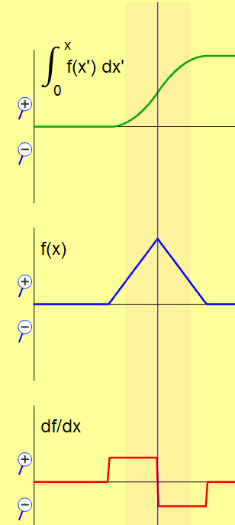
answer
ZOOMED integral graph only
Notes:
This would be better demonstrated using the simulation.

Slide 6
Post lesson slides start here

Slide 7
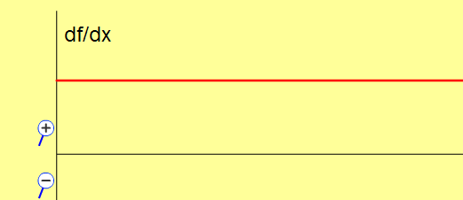
What does the function of this graph look like?

Slide 8
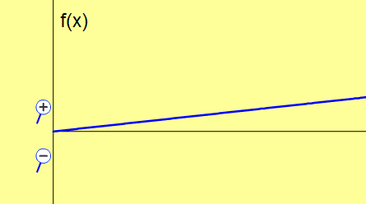
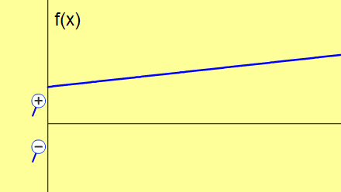
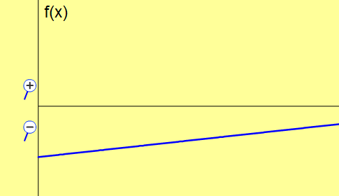
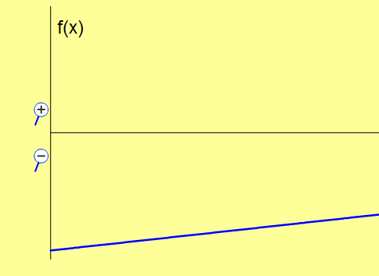
Possible answers
Notes:
This would be better demonstrated using the simulation.

Slide 9
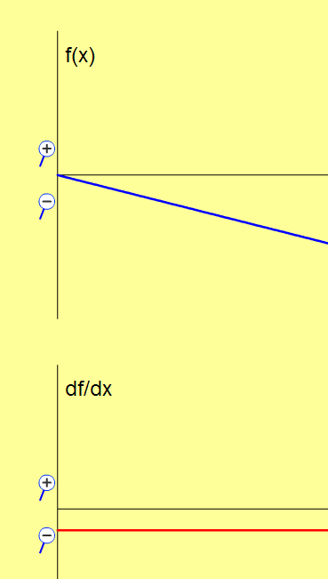
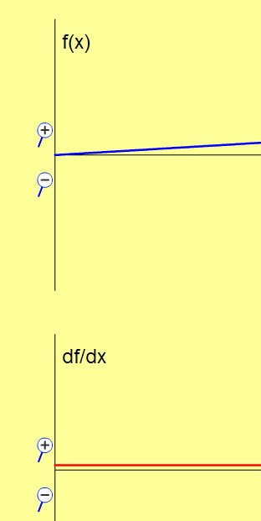
What does TILT do?
The derivative graph ZOOM was not changed; the height changed because of increased slope.
Notes:
This would be better demonstrated using the simulation.

Slide 10
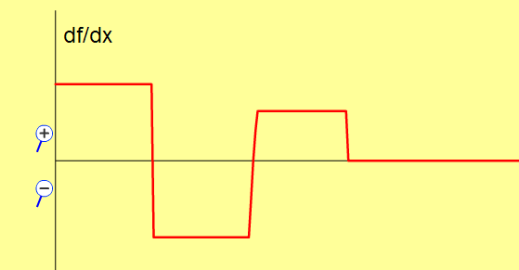
What does the function of this graph look like?

Slide 11
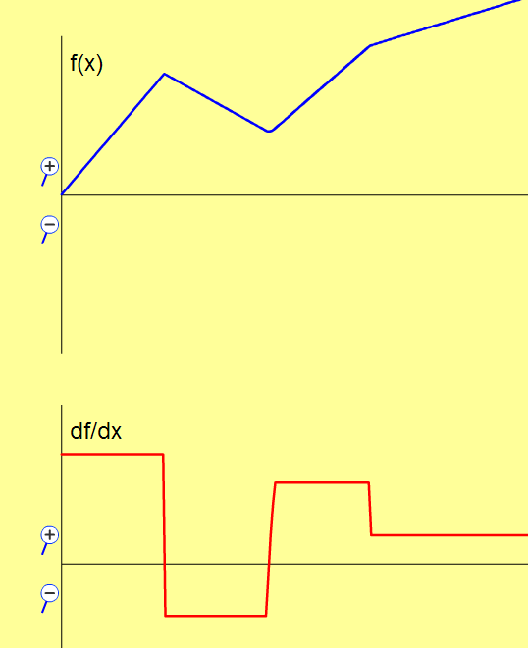
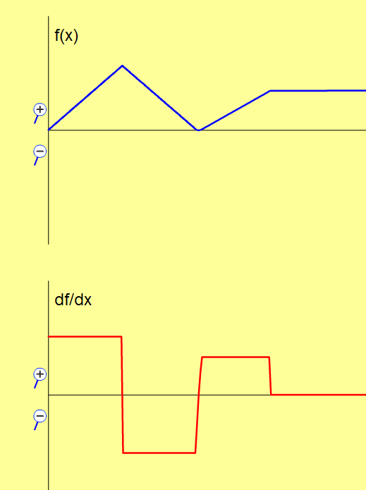
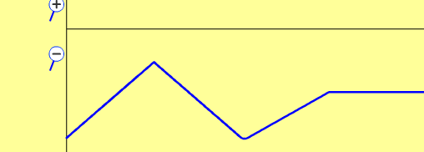
Possible answers: Shift doesn’t matter again, and TILT changes values of derivative graph
The derivative graph ZOOM was not changed; the height changed because of increased slope.
OR
Notes:
This would be better demonstrated using the simulation.

Slide 12
Clicker questions for post-lesson
Open Calculus Grapher and Moving Man before starting clicker questions

Slide 13
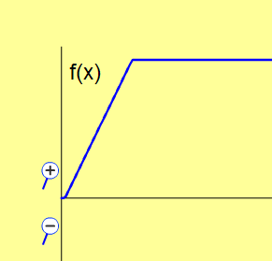
1. A car started from a stoplight, then sped up to a constant speed. This function graph describes his..
Position
Velocity
Acceleration
Notes:
B

Slide 14
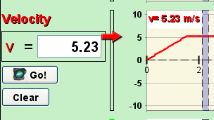
Use Moving man to show this: I set the acceleration at about 3 then paused the sim by the time the man got to the 4 spot, then I changed the acceleration to 0. If you have Moving man open with this type of scenario, you can use the grey bar to show that the speed was zero increasing and then constant.

Slide 15
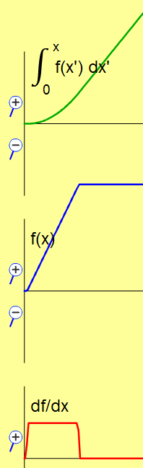
2. To find out how far he traveled, you would use
Integral
Function
Derivative
Notes:
A

Slide 16
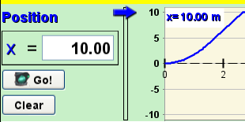
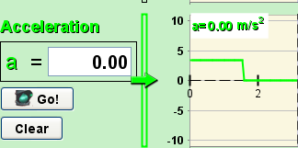
Use Moving Man Replay to show Position is found by the integral curve
Derivative curve shows acceleration
Notes:
B

Slide 17
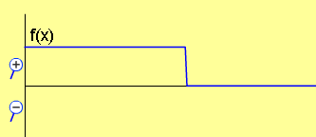
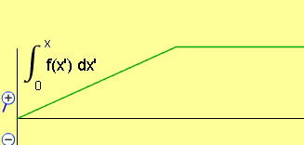
3. Your friend walks forward at a constant speed and then stops. Which graph matches her motion?
A. Position curve
B. Velocity curve
C. Position curve
D. Acceleration curve
E. More than one of these
Notes:
E. The answer is both B and C.

Slide 18
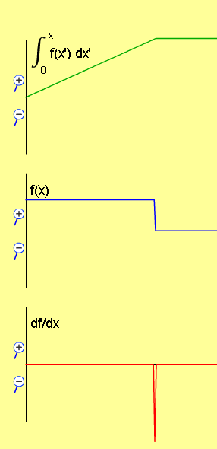
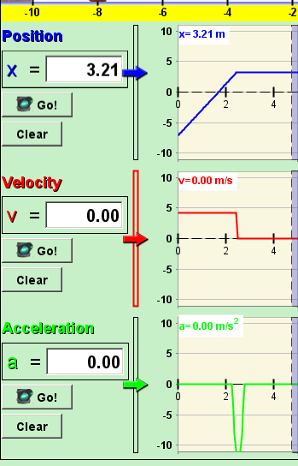
Use Moving man to show this: I set the Man at about -6 position, made the velocity about 4, then paused the sim by the time the man got to the 4 spot, then I changed the velocity to 0. If you have Moving man open with this type of scenario, you can use the grey bar to help.

Slide 19
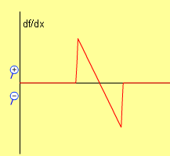
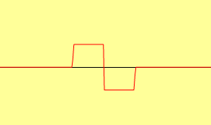
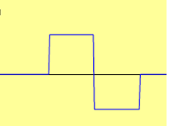
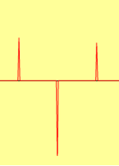
4. Which could be the derivative curve?
A
F(x)
B
C
Notes:
C

Slide 20
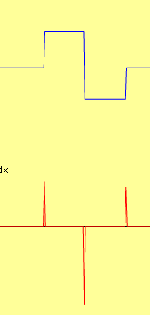
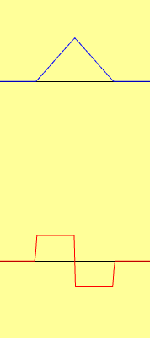
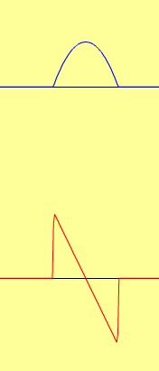

Pedestal Linear Parabola
F(x)
For each case, if the function, F(x) is velocity, what could a possible story for the motion of a person walking?
Notes:
For the pedestal, a person would be standing still, then walk forward, turn around and walk the other way and stop.
For the linear, a person would be standing still, accelerate at a constant rate forward (going faster), then still going forward slowing at a constant rate to a stop.
For the parabola, the story is nearly the same as the linear in that the object is going forward the whole time, but it might be easier to imagine a person driving a car. The car would be not increasing speed up as much, so more like the driver was using the gas all the way. then let up and then used the break more and more .

Slide 21





5. Three race cars have these velocity graphs. Which one probably wins?
A
B
C
D No way to tell

Slide 22
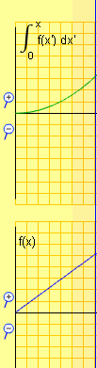
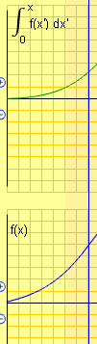

Use integral to tell that the parabolic one traveled farthest
Max value

