Slide 1
Loeblein’s Chemistry PhET clicker questions
Trish Loeblein
phet.colorado.edu

Slide 2
Table of contents by simulation
Gas properties 3-23
Gas properties, Friction, States of Matter (KMT review) 24-37
Salts and Solubility 38-82
Reactions and Rates 83-123
Balancing Chemical Equations 124-131
Isotope 132-144
pH Scale 145-158
Reactants, Products, and Leftovers 159-182
Build an Atom 183-192
Build a Molecule 193-200
Acid Base Solutions 201-213
Sugar & Salt Solutions 214-226
Molecule Shapes 227-235
Molecule Polarity 236-244
States of Matter Basics 245-254
Density 255-263
Alpha Decay 264-268
Molarity 269-279

Slide 3
Gas Properties Review
Describe image of gases using words and diagrams
How gases are distinguishable from a solid or liquid
How the particle mass and gas temperature affect the image.
How the size and speed of gas molecules relate to everyday objects
See also “Physics Topics for Gases handout”
Trish Loeblein phet.colorado.edu
Notes:
Activity http://phet.colorado.edu/teacher_ideas/view-contribution.php?contribution_id=18

Slide 4
Gas Properties: Understanding gas model
Goals: Describe a molecular model of gas pressure.
Trish Loeblein phet.colorado.edu

Slide 5
1. There are 2 balloons in a room. They are identical in size and material. One balloon is filled with air and the other balloon is filled with Helium. How does the pressure of the air balloon compare to the pressure of the Helium balloon. The pressure in the air balloon is
A. less B. equal C. greater
Notes:
b

Slide 6

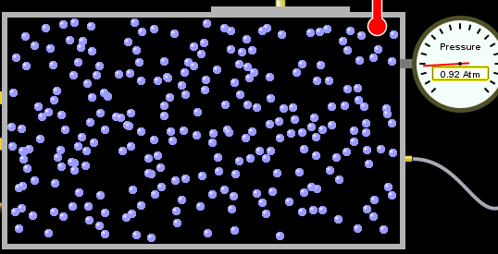
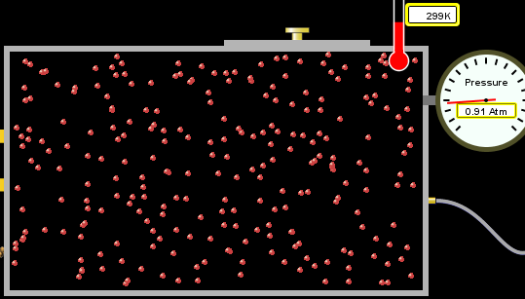
answer
For expandable container, set pressure constant

Slide 7
2. How does the pressure in the Helium balloon compare to the pressure of the air in the room? The pressure in the Helium balloon is
A. less B. equal C. greater
Notes:
b

Slide 8
3. How do the number of air molecules in the air balloon compare to the number of He atoms in Helium balloon?
The number of air molecules is
A. less B. equal C. greater
Notes:
b

Slide 9


answer
For expandable container, set pressure constant

Slide 10
4. How does the average speed of the Helium molecules compare to that of the air molecules?
The average speed of the He molecules is
A. less B. equal C. greater
Notes:
c

Slide 11


Answer to 4

Slide 12
Look at the animation of the particles bouncing around in the volume. Describe what visual information you can use to get a sense of the pressure that the gas particles are exerting on the walls.

Slide 13
Why does the pressure reading vary with time?
What visual cues are associated with an increase in pressure?

Slide 14
5. What will happen to the pressure if temp is held constant and the volume is decreased?
Pressure goes up because more collisions
Pressure goes up because more collisions are happening, but same force per collision
Pressure goes up because more collisions are happening, and increased force per collision
Nothing because pressure is only related to molecular speed

Slide 15

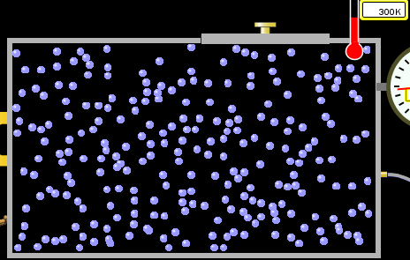

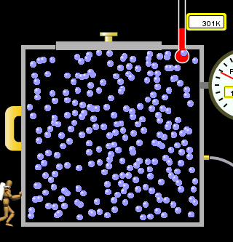
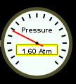
Answer to 5

Slide 16
14.7psi=1atm

Slide 17
The next slides follow the activity

Slide 18
Understanding physical change of gases continues
Learning Goals:
Describe a molecular model of gas pressure
Describe what happens to the measurable quantities if changes to the gas system are made.
Make sense of the measurable quantities of gases by analyzing examples of macroscopic things that are similar
Explain using physics what is happening on a molecular level when changes are made to a gas system.
Trish Loeblein phet.colorado.edu

Slide 19
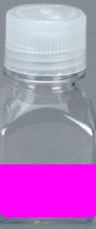
6. You are flying from Denver to Boston, and you bring along a ½ full bottle of shampoo that was well sealed before you left Denver. You land in Boston and proceed to your hotel. The number of air molecules within the shampoo bottle:
A. has decreased
B. has stayed the same
C. has increased
Notes:
b

Slide 20
7. If the walls of the shampoo bottle are strong and rigid so that the bottle has the same shape as before you left, how does the pressure of the air inside the bottle compare to the pressure of the air in Denver?
less than
equal to
greater than
Notes:
b

Slide 21
8. How does the pressure inside the bottle compare to the pressure of the air in Boston?
less than
equal to
greater than
Notes:
a

Slide 22
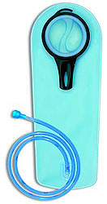
9. If you had a water bottle with very soft sides. When you open your suitcase in Boston, the bottle would look
squished
same size
puffed out
Notes:
a

Slide 23
What effects pressure for ideal gases?
Temperature
Number of particles
Volume
Mass of particles doesn’t effect pressure (Avogadro’s Principle)

Slide 24
Slides for next day

Slide 25
People who climb the tallest mountains in the world often use oxygen tanks to help them breathe. If a mountain climber asked you to explain the physics behind the “thin air”, what would you say to him?

Slide 26
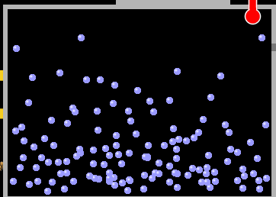

Gravity concentrates air closer to sea level

Slide 27
If you are in a building fire, you are supposed to lie on the ground. Why?
Notes:
No, not enough change in gravity.

Slide 28
If you are hiking in the mountains and find yourself short of breath, do you think if you lie on the ground you could breathe easier?
Notes:
Hot air rises and takes smoke, fresh air is more likely on floor. This has nothing to do with gravity

Slide 29
Review of KMT
PhET sims: Friction, States of Matter and Gas Properties
This is for College Chemistry for students who have already taken College Physics and completed the KMT inquiry lesson. The learning goals are from that lesson
http://phet.colorado.edu/teacher_ideas/view-contribution.php?contribution_id=765
Also uses Molecules 360 by Chem Ed DL
Have Friction, States of Matter and Gas Properties and Molecules 360 all running before class starts
Trish Loeblein phet.colorado.edu
Notes:
Activity http://phet.colorado.edu/teacher_ideas/view-contribution.php?contribution_id=661

Slide 30
Learning Goals:
Students will be able to describe matter in terms of molecular motion. The description should include
Diagrams to support the description.
How the particle mass and temperature affect the image.
What are the differences and similarities between solid, liquid and gas particle motion
How the size and speed of gas molecules relate to everyday objects

Slide 31
Rub your hands together. What does friction do to molecules?
Draw your ideas
Notes:
First, have the students rub their hands together, then write down and illustrate what they think is happening on a molecular level. Slide 3
Then project the Friction sim and gently rub the two layers together so that the students can see the rise in temp and the increase in molecular motion.
Have a class discussion on how their image and description match the simulation images. We will have a class discussion about how we could show the various motions of particles. Most of my students draw vectors off round balls.

Slide 32
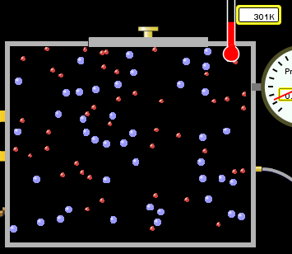
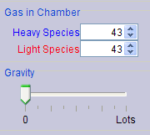
If you have a bottle with Helium & Nitrogen at room temperature, how do the speed of the particles compare?
All have same speed
The average speeds are the same
Helium particles have greater average speed
Nitrogen particles have greater average speed
Notes:
Use Gas Properties to show C is correct

Slide 33
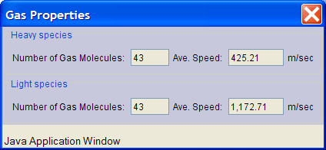
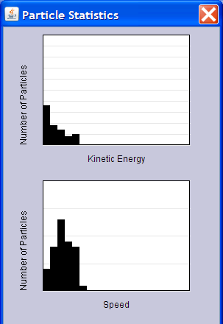
Light and heavy gas at same temperature 300K
Speed of each particle varies!!

Slide 34
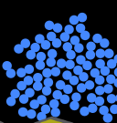
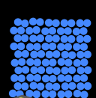
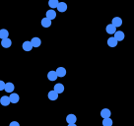
Which is most likely oxygen gas?
A B C
Notes:
C discussion how do you know?

Slide 35
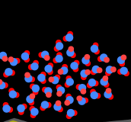
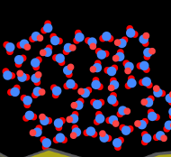
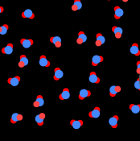
Which is most likely liquid water?
A B C
Notes:
discussion how do you know? A I am not sure that my students remember that water is less dense in solid form, but this would be a good time to remind them that ice floats.

Slide 36
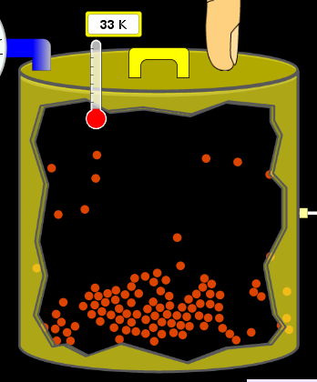
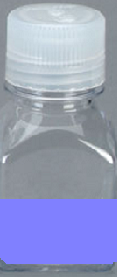
How could material be the same temperature and yet have different Phase?
Neon
Liquid-Gas
Like water-water vapor in a water bottle

Slide 37

What happens if you add energy using the heater?
No change other than all atoms speed up
More atoms would condense
More atoms would evaporate

Slide 38
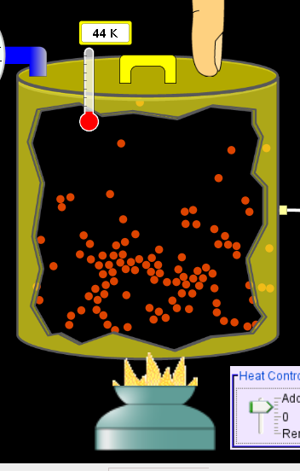
More are gaseous

Slide 39
KMT summary:
Matter is made up of particles having negligible mass are in constant random motion (vibrate, rotate, translate)
The particles are separated by great distances
The particles collide perfectly elastically (there are no forces acting except during the collision)
The temperature of a substance is related to the molecular velocity.

Slide 40
To show vibration
http://chemeddl.org/collections/molecules/index.php
Check Spin Molecule to see 3D rotation
Show vibration under Normal modes of vibration (toggle down to see bond length changing)

Slide 41
An air particle travels about ___ as fast as a car on the highway.
60 mph is about 26m/s
Notes:
26 *20=520 so that would be an ok answer This is a good time to remind students that air is mostly nitrogen

Slide 42
How many water molecules are in a raindrop(.5 cm diameter). The molecules are about .1nm
If we just look at how many are across .05m/.1E-9m = 5E7 or 50 million.

Slide 43
Salts and Solubility
Clicker questions for 5 actvitites
Each set of clicker questions and the activity can be downloaded from the Teaching Ideas database at PhET
by Trish Loeblein updated July 2008
phet.colorado.edu

Slide 44
Salts and Solubility Activity1
Learning Goals Students will be able to:
Determine the chemical formula by observation of ionic ratios in solutions
Relate the simulation scale to real lab equipment through illustration and calculations
Predict the chemical formula of compounds with a variety of ion charge combinations
Trish Loeblein July 2008 Questions 1-3 are a pretest. 4-8 are reflective
Notes:
Activity http://phet.colorado.edu/teacher_ideas/view-contribution.php?contribution_id=753 also to get Microsoft Office versions see individual activities by sorting selecting Salts and Solubility

Slide 45
Which is the formula for the compound made from
M⁺¹ and N⁻²
MN₂
M₂ N
MN
M₂ N₂
Notes:
B

Slide 46
2. Which is the formula for the compound made from
M⁺³ and N⁻¹
MN₃
M₃ N
MN
M₃ N₃
Notes:
A

Slide 47
3. Which is the formula for the compound made from
M⁺³ and N⁻²
MN
M₃ N₂
M₂ N₃
M₆ N₆
Notes:
C

Slide 48
4. I thought this lab was _________ USEFUL for learning about ionic formulas.
very
mostly
barely
not

Slide 49
5. I thought this lab was _________ ENJOYABLE for learning about ionic formulas.
very
mostly
barely
not

Slide 50
6. Which is the best drawing for Magnesium chloride in a water solution?
Mg
Cl
A B C D E
Notes:
E

Slide 51
7. How would the drawing change if Magnesium chloride were changed to Magnesium oxide?
The ratio of the ions would be the same
The ratio would change to 1 magnesium for every oxide
The ratio would change to 2 magnesium for every oxide
You would have to use different colors
Notes:
A

Slide 52

8. Which drawing best represents how large ions should be drawn in a 5 ml test tube of water?
A B C D
Notes:
D

Slide 53
Salts and Solubility Activity 2
Learning Goals: Students will be able to:
Write the dissolving reaction for salts
Describe a saturated solution microscopically and macroscopically with supporting illustrations
Calculate solubility in grams/100ml
Distinguish between soluble salts and slightly soluble salts macroscopically.
Trish Loeblein July 2008
phet.colorado.edu

Slide 54
1. Which is correct for dissolving barium iodide in water ?
BaI_{2(s)} → Ba_{(aq)} + 2I_{(aq)}
BaI_{(s)} → Ba_{(aq)} + I_{(aq)}
BaI_{2(s)} → Ba⁺²_{(aq)} + 2I⁻_{(aq)}
BaI₂ → Ba ⁺² + 2I⁻

Slide 55
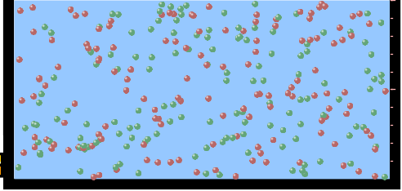
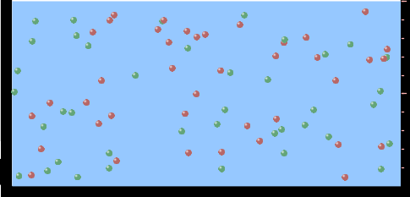
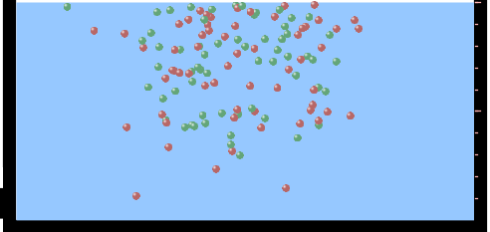
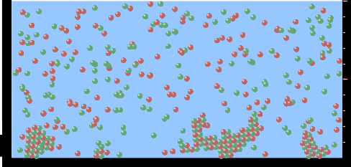
2. Sue used Salts to learn about “saturated solution”. Which image best shows a saturated solution?
A
B
C
D
Notes:
C is best answer because there are just few stuck to wall
A does not show complete dissolving so it hard to tell if they will all stay in solution
B could be, but C shows more particles do dissolve
D is past the saturation point.

Slide 56
3. Waldo added salt to a test tube of water to learn about “saturated solution”. Which image best shows a saturated solution?
A B C D
Notes:
C (same reasons as previous question)

Slide 57
4. If you used the sim to test silver chloride, you would see 80 Ag⁺ ions dissolved in 1E-17 liters. What is the solubility in 100 ml of water?
.0019 grams/100 ml water
.00019 grams/100 ml water
.0024 grams/100 ml water
.00024 grams/100 ml water
Notes:
I wanted this to be a “real problem”. Here’s how I determined how many particles would be correct:
K sp at 25 degrees =1.8×10^{–10} so 1.34E-5 moles/liter for each ion and the default volume is 1E-16L for slightly soluble. This would have given 807 particles; I decided to change the volume since the students might remember that the sim would show that many particles.
1.34E-5 moles/liter *6.02E23 particles/mole * 1E-17 L= 80.8 particles in 1E-E-17 L
K_{sp}, for AgCl is 1.8 x 10⁻¹⁰, which indicates that one liter of water will dissolve 0.000013 grams of AgCl. From http://en.wikipedia.org/wiki/Silver_chloride
There are many variations for the value of Ksp and solubility published; I chose this reference since it both for the same Temperature, but you’ll see by my calculations on the next slide that I have a very different solubility. I decided that they probably did not have the same temperature afterall and decided not to bother since I had already checked several sources for values.

Slide 58
The calculation for AgCl example:
80 AgCl /6.02E23 AgCl/mole) *(178.8grams/mole)
= 2.4E –20 grams
2.4E –20 grams/(1E-17L) = .0024 grams/L
.0024 grams/L* .1L/100ml=.00024 g/100ml
Notes:
If you forget to use the molecular mass and use just silver at 143.3 you get .00019 g/ml

Slide 59
5. You knew a salt was either sodium chloride or silver chloride.
If you put 1 gram in 10 ml of water in a test tube, and it looked like this
Which is it?
Sodium chloride
Silver Chloride
This is not an identifying test
Notes:
B Since the solubility of AgCl is .0024g/L then only about 2.4E-5 would dissolve in 10 ml. Sodium chloride is 35 g in 100 ml (3.5g in 10 ml) so it would dissolve.

Slide 60
6. How a drawing for Magnesium oxide be different from Magnesium chloride?
The ratio would be the same, but the balls would be connected
The ratio would change to 1 magnesium for every oxide and balls would be separate
The ratio would change to 1 magnesium for every oxide and balls connected
The ratio would change to 2 magnesium for every oxide and balls connected
Notes:
B

Slide 61
Salts and Solubility Activity 3
Solution Equilibrium and K_{sp}
Learning Goals: Students will be able to:
Describe the equilibrium of a saturated solution macroscopically and microscopically with supporting illustrations. (not covered in these questions)
Write equilibrium expressions for salts dissolving
Calculate K _{sp} from molecular modeling.
Trish Loeblein updated July 2008
I simplified the reactions by omitting (aq), my students have found this helpful and they know that they must put it on tests.
phet.colorado.edu

Slide 62
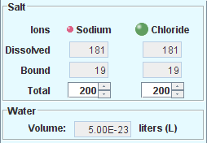
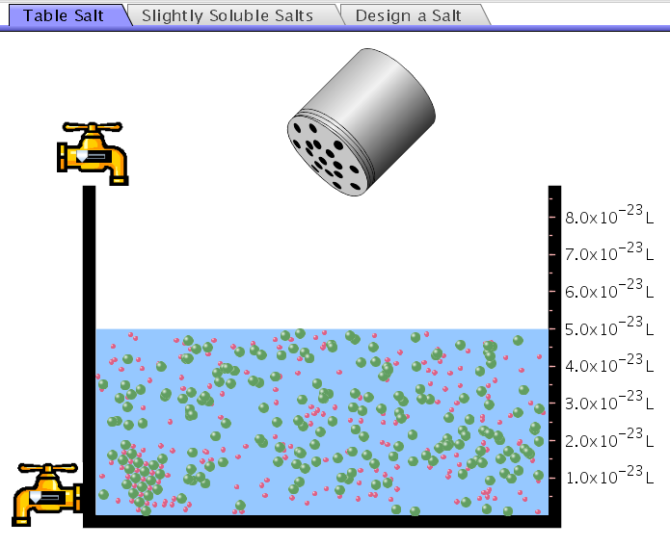
1 Write Ksp in terms of s (simple)
1. Table salt dissolves in water:
NaCl(s) ⇌ Na⁺ + Cl⁻
What is the correct K_{sp} expression if s is the molar solubility Sodium chloride?
K_{sp} = s²
K_{sp} = 2s²
K_{sp}= s⁵
K_{sp} = 4s⁴
Notes:
S²
Write Ksp in terms of s (simple)

Slide 63
Answer to previous slide
Table salt dissolves in water:
NaCl(s) ⇌ Na⁺ + Cl⁻
K_{sp} = [Na⁺] [Cl⁻]
For every NaCl molecule that dissolves there was one Na⁺ and one Cl⁻ put into solution, so if we let s equal the amount of NaCl that dissolved then the expression substitutes to be K_{sp} = s²
Notes:
Answer to previous slide

Slide 64
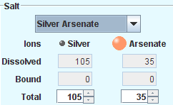
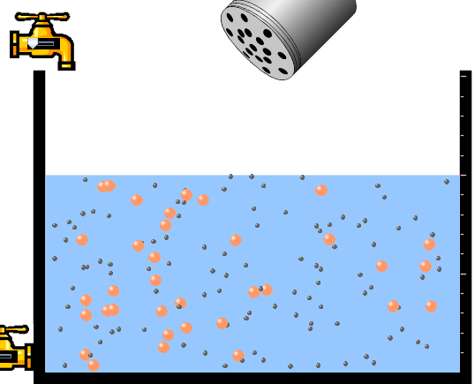
2 Write Ksp in terms of s coefficients and exponents required
2. Silver arsenate dissolves in water:
Ag₃AsO₄(s) ⇌ 3 Ag⁺ + AsO₄³⁻
What is the correct K_{sp} expression if s is the molar solubility Silver arsenate?
K_{sp} = s²
K_{sp} = 3s²
K_{sp}= s⁴
K_{sp} = 3s⁴
K_{sp} = 27s⁴
Notes:
e. K_{sp} = 27 s⁴
Write Ksp in terms of s coefficients and exponents required

Slide 65

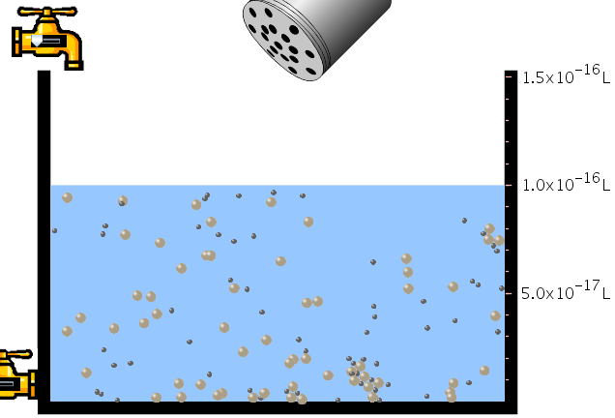
3 S in terms of Ksp
3. What is the proper expression for the molar solubility s of AgCl in terms of K_{sp}?
s = K_{sp}
s = (K_{sp})²
s = (K_{sp})^{1/2}
s = K_{sp}/2
Notes:
c. S = (K_{sp})^{1/2} K_{sp} = [Ag⁺][Br⁻] and since [Ag⁺]=[Br⁻] , K_{sp} = s²
S in terms of Ksp

Slide 66
Answer to previous slide
K_{sp} = [Ag⁺][Br⁻]
[Ag⁺]=[Br⁻] (44 of each are dissolved)
K_{sp} = s²
s = (K_{sp})^{1/2}
Notes:
Answer to previous slide

Slide 67
4 Effect of reducing Ksp
AgBr ↔Ag⁺ + Br⁻ K_{sp} = 5.0x10⁻¹³
4. A saturated solution of AgBr in 1x10⁻¹⁶ liters of water contains about 44 Ag⁺ and 44 Br⁻ ions as shown.
Suppose that K_{sp} were reduced to 2.5x10⁻¹³. How many Ag⁺ ions would you expect to see at equilibrium ?
a. 11 b. 22 c. 31 d. 44 e. 88
Notes:
c. 31 Effect of reducing Ksp
Adapted From Parson at CU

Slide 68
Answer to previous slide
AgBr ↔Ag⁺ + Br⁻ K_{sp} = 5.0x10⁻¹³
Suppose that K_{sp} were reduced to 2.5x10⁻¹³. How many Ag⁺ ions would you expect to see at equilibrium ?
31
Notes:
Answer to previous slide Remember from earlier question K_{sp} = [Ag⁺][Br⁻] and since [Ag⁺]=[Br⁻] , K_{sp} = s² so
s = (K_{sp})^{1/2} = (2.5x10⁻¹³)

Slide 69
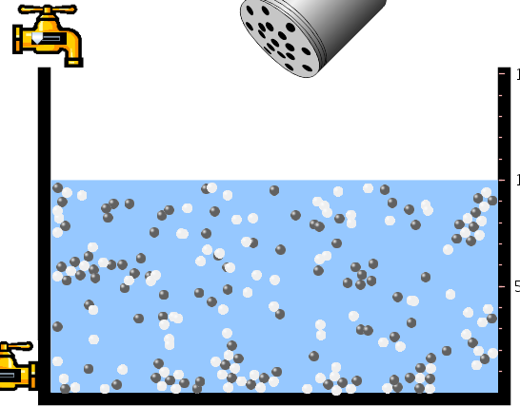
5 Predicting solubility by comparing K_{sp}
5. Two salts have similar formulas XY and AB, but they have different solubility product constants.
XY: K_{sp}= 1x10⁻¹²
AB: K_{sp}= 1x10⁻⁸
Which one would be more soluble?
AB
XY
The amount that dissolves would be the same.
Not enough information
Notes:
Predicting solublity by comparing K_{sp}
Assuming all conditions are equal.
A. AB

Slide 70
6 Predicting precipitation by comparing K_{sp}
6. Two salts have similar formulas XY and AB, but they have different solubility product constants.
XY: K_{sp}= 1x10⁻¹²
AB: K_{sp}= 1x10⁻⁸
Which one would be more likely to precipitate?
AB
XY
They behave the same
Not enough information
Notes:
Predicting precipitation by comparing K_{sp}
B. XY

Slide 71
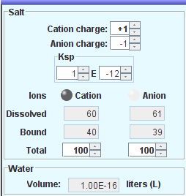
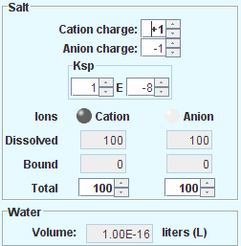
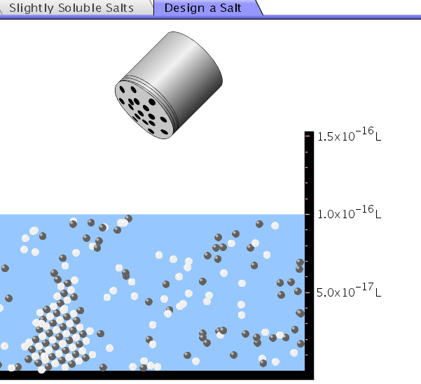
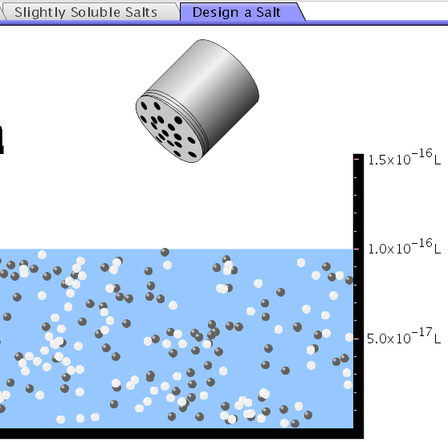
Demonstration of sim for previous question
XY: K_{sp}= 1x10⁻¹²
AB, K_{sp}= 1x10⁻⁸
Notes:
Demonstration of sim for previous 2 questions

Slide 72
Salts and Solubility Activity 4
The clicker questions do not directly address the goals because the are quantitative or have been well discussed by the group during the activities.
Learning Goals for 4: Students will be able to:
Calculate Q.
Predict what would be observed on a macroscopic level to a solution by comparing Q to K_{sp}.
Use microscopic illustrations, to help explain the predictions.
Use LeChatelier’s Principle to predict how changing the amount of water will affect the solution.
Trish Loeblein updated July 2008
phet.colorado.edu

Slide 73
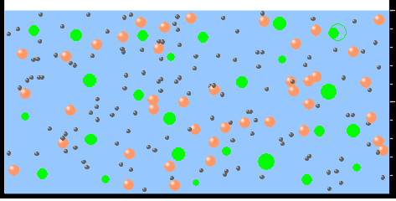
1 Predicting precipitation by comparing K_{sp} with common ion effect
Two salts, XB and AB, are dissolved in a beaker of water. There are equal number of moles. They have different solubility product constants.
XB: K_{sp}= 1x10⁻¹² AB: K_{sp}= 1x10⁻⁸
1. If you added B⁻ ions which would precipitate first?
AB
XB
They behave the same
Not enough information
Notes:
1 Predicting precipitation by comparing K_{sp} with common ion effect
B XB since it has a smaller Ksp

Slide 74
2 Precipitation prediction advanced with common ion effect
2. 0.010 moles of MgCl₂ and 0.020 moles of CuCl₂ are dissolved in 0.10 liters of water. A solution of NaOH is slowly stirred in. Which precipitate forms first ?
Cu(OH)₂ K_{sp} = 2.2x10⁻²⁰
Mg(OH)₂ K_{sp} = 6.3x10⁻¹⁰
a. MgCl₂ b. CuCl₂ c. Mg(OH)₂ d. Cu(OH)₂
Notes:
d. Cu(OH)₂
2 Precipitation prediction advanced with common ion effect
From Parson at CU

Slide 75
Salts and Solubility Activity 5
Learning Goal for 5: Students will be able to predict what would be observed on a macroscopic and microscopic level for salts with varying ionic charge given the K_{sp}.
Trish Loeblein July 2008
.
phet.colorado.edu

Slide 76
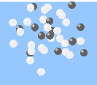
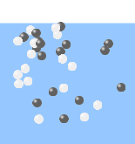
Which will have more dissolve particles in a saturated solution? K_{sp}=3 E –13
A compound made from
A. XY B. XY₂ C. no difference
Notes:
A

Slide 77
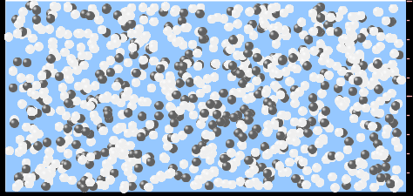
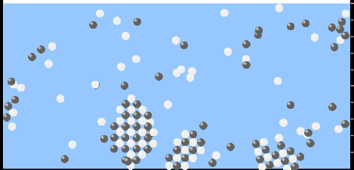
Answer to 1
XY
XY₂

Slide 78
Why doesn’t the mass of the particle matter?
Notes:
Moles/L only matter

Slide 79
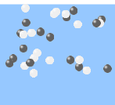
2. Which will have more dissolve particles in a saturated solution? K_{sp}=2 E –15
A compound made from
X⁺¹ and Y⁻¹
B. X⁺² and Y⁻² C. no difference
Notes:
C no difference

Slide 80
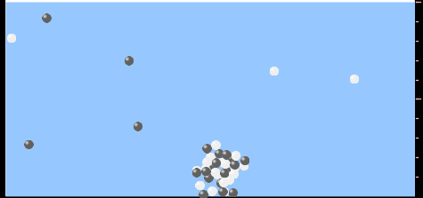
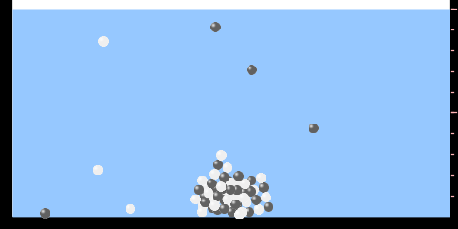
Answer to 2
XY
XY

Slide 81
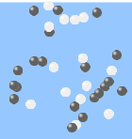
3. Which will have more dissolve particles in a saturated solution? K_{sp}=2 E –15
A compound made from
X⁺² and Y⁻²
B. X⁺² and Y⁻³ C. no difference
Notes:
A precipitates first.

Slide 82
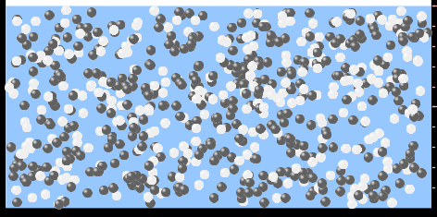
Answer to 3
If you run the sim at the default volume, you cannot get the second compound to ppt, but only 4 dissolve of the first.
XY
X₃Y₂

Slide 83
Reactions and Rates 1
Clicker Questions
Activity 1:
Introduction to reactions
Trish Loeblein phet.colorado.edu

Slide 84
Learning Goals
Students will be able to:
Describe reactions in terms of a simple molecular model.
Describe reactions in terms of molecular models with illustrations.
Differentiate between dissolving and reacting
Use the molecular model to explain why reactions are not instantaneous.
Use the molecular model to explain why reactions have less than 100% yields.

Slide 85
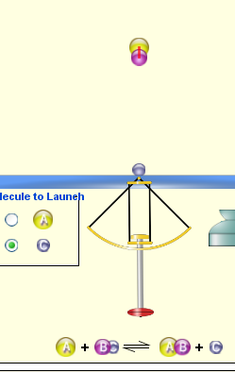


What will probably immediately happen ?
A
B
C
will form
will form
No reaction
Notes:
B

Slide 86
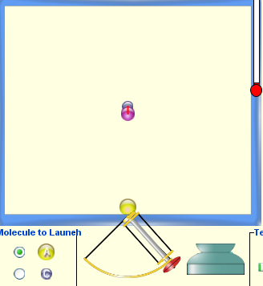
What will probably happen ?
A
B
C
will form
will form
No reaction
Notes:
C not correct angle and no energy

Slide 87
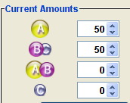
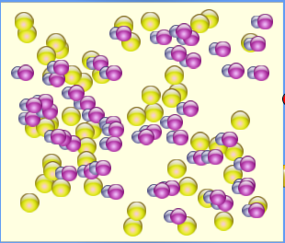
What will probably immediately happen ?
A
B
C
will form
will form
No reaction
Notes:
A

Slide 88
What will most likely be in the container after several minutes have passed ?
Container will have only &
Container will have only &
Container will have a mixture of all four
Notes:
C reactions are reversible

Slide 89
Reactions and Rates 2
Clicker Questions
Activity 2:
Introduction to reactions
Trish Loeblein phet.colorado.edu

Slide 90
Learning Goals
Students will be able to:
Describe how the reaction coordinate can be used to predict whether a reaction will proceed including how the potential energy of the system changes.
Describe what affects the potential energy of the particles and how that relates to the energy graph.
Describe how the reaction coordinate can be used to predict whether a reaction will proceed slowly, quickly or not at all.
Use the potential energy diagram to determine:
  The approximate activation energy for the forward and reverse reactions.
  The sign difference in energy between reactants and products.
Draw a potential energy diagram from the energies of reactants and products and activation energy.
Notes:
The concept questions only address some of these things; the textbook problems are used for reinforcement of many of these.

Slide 91
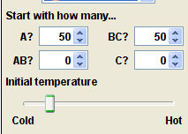




Which reaction would probably appear to be quickest?
A B C D
Notes:
B C because the reaction is exothermic and the first law of thermodynamics will predict more products. In addition, there is not enough activation energy for many reactants to reform

Slide 92

What would best describe what is in the container after several minutes have passed ?
Notes:
Answer choices on next slide

Slide 93
Answer choices
Container will have only &
Container will have only &
Container will have a mixture of all four with more &
Container will have a mixture of all four with more &
Notes:
D because there is not enough activation energy for many products to form

Slide 94


Using the heater would
Increase the number of &
Increase the number of &
Have no effect
Notes:
B because more collisions would have enough activation energy to form products and be stable with the higher energy required to maintain stability

Slide 95



What would best describe what is in the container after several minutes have passed ?
Notes:
Answer choices on next slide

Slide 96


Answer choices
Container will have only &
Container will have only &
Container will have a mixture of all four with more &
Container will have a mixture of all four with more &
Notes:
C because the reaction is exothermic and the first law of thermodynamics will predict more products. In addition, there is not enough activation energy for many reactants to reform

Slide 97



What would best describe what is in the container after several minutes have passed ?
Notes:
Answer choices on next slide

Slide 98





Answer choices
Container will have mostly &
Container will have mostly &
Container will have a mixture of all four with nearly equal amounts
No reaction will occur since the products and reactants have the same energy
Notes:
C because the reaction is thermally neutral, the first law of thermodynamics will predict equal products and reactants since there is enough activation energy for reactants to form

Slide 99
Reactions and Rates 3
Clicker Questions
Activity 3:
Introduction to Equilibrium
Trish Loeblein phet.colorado.edu
Notes:
Reactions and Rates activity 1 was done in September, #2 was done in December, 3 and 4 will be done in the same unit in March.

Slide 100
Learning Goals
Students will be able to:
Use a physical experiment to model chemical equilibrium
Sketch how the number of reactants and products will change as a reaction proceeds
Predict how changing the initial conditions will affect the equilibrium amounts of reactants and products.
Predict how the shape of the reaction coordinate will affect the equilibrium amounts of reactants and products.
Notes:
These are the questions that the students were asked about the sim.
How do you know when equilibrium has been reached?
How does changing the initial amounts of the reactants affect the amount of product?
How does changing the initial temperature of the reactants affect the amount of product?
Then they were asked to test another reaction and we had a share.

Slide 101
Which best shows that equilibrium has been reached?
A
B
Amount of substance vs time
Reaction Rates vs time
Amount
Rate
time
time
-Product -Reactants
-Forward -Reverse
Notes:
A see next slide for correct Rate graph

Slide 102
Correct rate graph
Forward reaction rate =Reverse rate
Reaction Rates vs time
Rate
-Forward -Reverse
time

Slide 103


Which could show that equilibrium has been reached?
C neither
D either
A
B
Notes:
C or D need more information like time graph

Slide 104









All are at equilibrium within limits

Slide 105
Which best shows that equilibrium has been reached?
The number of reactants is greater than the products
The number of products is greater than the reactants
The number of products is equal to the reactants
The number of products varies little
Notes:
D

Slide 106

At equilibrium, what would you predict is in the container?
Notes:
Answer choices on next slide

Slide 107
Answer choices
Container will have mostly &
Container will have mostly &
Container will have a mixture of all four with nearly equal amounts
No reaction will occur since the products and reactants have the same energy
Notes:
C

Slide 108



data

Slide 109

How will the equilibrium of second trial compare to the equilibrium of the first?
First experiment
Second experiment
Notes:
Answer choices on next slide

Slide 110


Answer choices
First trial
Second trial
There will be more &
There will be more &
There will be more & &
There will be more & &
The ratios will still be about the same
Notes:
C see next slide

Slide 111


Data for reactions

Slide 112

At equilibrium, what would you predict is in the container?
Notes:
Answer choices on next slide

Slide 113
Answer choices
Container will have only &
Container will have only &
Container will have a mixture of all four with more &
Container will have a mixture of all four with more &
Notes:
D because they have lower potential energy

Slide 114

data

Slide 115
Reactions and Rates 4
Also uses Salts & Solubility and States of Matter
Clicker Questions
LeChatlier’s Principle
Trish Loeblein

Slide 116
Learning Goals
Students will be able to:
Explain how to make equilibrium systems change and predict what changes will happen.
Compare and contrast salt-solution, phase, and chemical equilibriums.

Slide 117

If you add water to this salt solution, what will happen?
NaCl(s) ⇌ Na⁺ _{(aq)} + Cl⁻ _{(aq)}
The system will shift to the right
The system will shift to the left
LeChatlier’s principle doesn’t apply to physical systems
Notes:
A

Slide 118
If you increased the air pressure above this salt solution, what will happen?
NaCl(s) ⇌ Na⁺ _{(aq)} + Cl⁻ _{(aq)}
The system will shift to the right
The system will shift to the left
This system would not be effected by pressure changes.
Notes:
C The effect of pressure on solutions was not investigated in the experiments, but is clearly in the textbook reading and practice problems

Slide 119

If you cooled the container, what will happen? Ne_{(l)} ⇌ Ne_{(g)}
The system will shift to the right
The system will shift to the left
This system is not effected by temperature
Notes:
B

Slide 120

If you made the container smaller, while keeping the temperature constant, what will happen?
Ne_{(l)} ⇌ Ne_{(g)}
The system will shift to the right
The system will shift to the left
This system would not effected
Notes:
B Changing the container size without changing temperature clearly increases the pressure. The effect of pressure was not investigated in the experiments, but is clearly in the textbook reading and practice problems

Slide 121

What would happen if you added energy using the heater ?
The system will shift to the right
The system will shift to the left
Both reactants and products would have more energy, but the amounts would not change much
Notes:
A

Slide 122


What would happen if you added ?
The system will shift to the right
The system will shift to the left
The only change would be the amount of
Notes:
b

Slide 123



What would happen if you added energy using the heater ?
The system will shift to the right
The system will shift to the left
Both reactants and products would have more energy, but the amounts would not change much
Notes:
C

Slide 124
Balancing Chemical Equations Discussion and Clicker questions by Trish Loeblein
6/12/2011
phet.colorado.edu
Learning Goals: Students will be able to:
Describe what “reactants” and “products” in a chemical equation mean.
Explain the importance of knowing the difference between “coefficients” and “subscripts”.
Use pictures and calculations to show how the number of atoms for each product or reactant is found.
Identify the relationship between “reactants” and “products” atoms.
Balance a chemical equation using the relationships identified.
Given a chemical equation, draw molecular representations of the reaction and explain how the representations were derived.
Given a molecular drawing of a chemical reaction, write the equation and explain how the symbols were derived.
Notes:
https://phet.colorado.edu/en/contributions/view/3422

Slide 125






1. What would you do to balance this reaction?
Double the coefficient of N₂ (2 N₂ )
Multiply coefficient of H₂ by 3 (3 H₂ )
Multiply subscripts of H₂ by 3 ( H₆ )
Double the subscripts for NH₃ (N₂H₆)
Double the coefficient of NH₃ (2NH₃)
Notes:
This doesn’t have one answer. I would have the students discuss their ideas in pairs and then share out. The answers are B and E

Slide 126





2. Which visual cues can you use on a test to see if your equation is balanced or not?
Notes:
Count atoms using chemical equation coefficients and subscripts
Smiley face and yellow equation sign (not available on test)
Use drawings of atoms/molecules
Make a balance picture
Make a bar graph

Slide 127







3. Which chemicals are reactants?
HN₃ and O₂
O₂ and H₂O
N₂ and H₂O
NH₃ and N₂
Notes:
A

Slide 128

4. Which best describes the products of a chemical equation?
Chemicals before the reaction starts
Chemicals after the reaction ends
Chemicals on the left of the arrow
Chemicals on the right of the arrow
Notes:
D I want to emphasize that chemical reactions are not complete nor immediate. Also, that “product” is a relative term which is determined by the author.

Slide 129





5. Which are the products of this chemical equation?
a
b
F₂ and H₂O
OF₂ and HF
More than 2 answers
Notes:
I would prefer C as the answer, but would accept E. I want to emphasize “product” is a relative term which is determined by the author, that the equation does not need to be balanced, and that the coefficients are not neessary.

Slide 130
Which best describes the products of a chemical equation?
An author of a test or text may chose to write this reaction:
Lesson learned: Don’t try to memorize reactions, analyze each one that is given.

Slide 131





6. Is this reaction balanced?
Yes
No, there needs to be fewer red on the reactant side.
No, there needs to be more red on the product side.
No, for another reason.
Notes:
C, but D could be argued because if you try to balance, you’ll need more of the grey and white too.

Slide 132
Isotopes and Atomic Mass:
What does the mass on the periodic table mean?
By Trish Loeblein http://phet.colorado.edu
Learning Goals:
Define “isotope” using mass number, atomic number, number of protons, neutrons and electrons
Compare and contrast: element, atom, isotope
Given the number of protons, neutrons and electrons, find the mass and name of an isotope
Given the name of an element and the number of neutrons, find the mass of an isotope
Give evidence to support or dispute: “In nature, the chance of finding one isotope of an element is the same for all elements.”
Find the average atomic mass of an element given the abundance and mass of its isotopes
Notes:
https://phet.colorado.edu/en/contributions/view/3421

Slide 133
Pre-Lesson Discussion
Calculate the average mass of the eggs in the container.
Record the mass of each type of egg and the number of each.
What is difference between the “Average Mass” and “Individual Mass”?
Design a situation to make the mixture ____g
Notes:
The teacher will need to figure out reasonable average mass for challenge.

Slide 134
Post-Lesson Questions

Slide 135

What would this be?
Carbon-12
Carbon-14
Oxygen-14
More than one of these
Notes:
B

Slide 136




Reason: The number of protons tells the name of the atom; the mass is given by the sum of protons and neutrons
6 protons +8 neutrons = 14 amu

Slide 137



Which would be isotopes?
1 & 2
1 & 3
2 & 3
none
more than one combination
1
2
3
Notes:
A

Slide 138



Reason: Isotopes have same number of protons (so the same name), but different number of neutrons
1 and 2 are isotopes
1
2
3

Slide 139

What would the approximate average mass of Hydrogen be?
6 amu
2 amu
1.5 amu
1 amu
Notes:
Answer is C :
A. 6 amu is the total mass B. one of the isotopes C. see next slide for reasoning D. most common isotope and value on periodic table.

Slide 140





Reason: 3/6 gives 50% of each, so .5*2+.5*1=1.5 amu
Why are there more digits in the answer in the sim?
Notes:
You may discuss the fact that the isotope mass is rounded to whole numbers, but the exact values are
2.01410 and 1.00783. You can show this by using the sim. Just drag one isotope into the box and the value will be displayed.

Slide 141


What would the approximate average mass of Argon be?
40 amu B. 38 amu C. 37.5 amu
Notes:
a. Value on periodic table b. just the middle value c. 37.5 = (2*36+38+ 40)/4 or .5*36+.25*38+.25*40

Slide 142


Reason: .5*36+.25*38+.25*40 =37.5

Slide 143



Discussion Questions: How would you know if this combination is likely to be found in some dirt?
Notes:
See next slide

Slide 144




Reason: 10/14*14+4/14*15=14.285
On the periodic table, the mass of Nitrogen is given as 14.007, so this is not the most common mixture found in nature.
“My Mixture”
“Nature’s Mix”
Notes:
Students could use the sim to explain, but I want to emphasize use of the periodic table.

Slide 145
pH Scale: qualitative learning goals
Determine if a solution is acidic or basic using
    pH b) H₃O⁺/OH⁻ ratio molecular size representation c) Hydronium/Hydroxide concentration
Relate liquid color to pH.
Predict if dilution and volume will increase, decrease or not change the pH
Organize a list of liquids in terms of acid or base strength in relative order with supporting evidence.
Write the water equilibrium expression. Describe how the water equilibrium varies with pH.
Trish Loeblein phet.colorado.edu
Notes:
https://phet.colorado.edu/en/contributions/view/3183

Slide 146



1. The color of a solution identifies if it is an acid, base, or neutral solution.
True B. False C. Pink are base and clear are acid
Notes:
B Show sim: the left is milk, then blood, then a custom liquid like NaOH

Slide 147
2. Which solution is basic?
A B C
D. More than one E. None
Notes:
Correct answer D (B and C) A milk, B blood C. custom at pH =12

Slide 148




3. Which solution is acidic?
A B C
D. More than one E. Difficult to tell
Notes:
Correct answer is C, but they may argue E A. Custom pH =13 B. water pH =7 C. vomit pH=2

Slide 149



4. Which solution is basic?
A B C
D. More than one E. None
Notes:
Correct answer B A. Water pH =7 B. pH =13 C. soda pop pH =2.5

Slide 150




5. Which solution is acidic?
A B C
D. More than one E. None
Notes:
Correct answer D (A and B) A. Coffee pH =5 B. soda pop pH =2.5 C. custom pH =13,

Slide 151

6. How will adding water effect the pH?
Increase the pH
Decrease the pH
No pH change
Notes:
A more water lessens the acidity, so pH goes up

Slide 152

A: more water lessens the acidity, so pH goes up

Slide 153

7. How will equal amount of water effect the pH?
Increase the pH
Decrease the pH
The pH will be cut in half
No pH change
Notes:
B: more water lessens the basicity , so pH goes down, but not by 2 (log scale)

Slide 154

B: more water lessens the basicity , so pH goes down, from 10 to 9.7, but not by 2 (log scale)

Slide 155
8. What is the order from most acidic to most basic?
A B C
A B C
A C B
B A C
C B A
C A B
Notes:
Correct answer is A A milk, B blood C. custom at pH =12

Slide 156
9. What is the order from most acidic to most basic?
A B C
A C B
B A C
C B A
C A B
A B C
Notes:
Correct answer C A. Water pH =7 B. pH =13 C. soda pop pH =2.5

Slide 157
10. If spit has a pH = 7.4, what does that tell you about the water equilibrium?
2H₂O ↔ OH⁻ + H₃O⁺
Something was added that made the equilibrium shift left
Something was added that made the equilibrium shift right
pH has nothing to do with the water equilibrium
Notes:
A

Slide 158
Answer to 10
Since the pH is not 7, then something was added to make the equilibrium shift left. For example, if NaOH was added to water, OH⁻ is immediately in the solution and some of it will react with the H₃O⁺ , so the pH (which is inversely related to [H₃O⁺ ]), goes up.
If something like HCl were added there would be more H₃O⁺ , which would also cause a shift left, but there would be less OH⁻ , (which is directly related to pH), so the pH is less than 7.

Slide 159
Reactants, Products, and Leftovers Activity 1: Introduction to Chemical reactions by Trish Loeblein http://phet.colorado.edu
Learning Goals:
Students will be able to:
Relate the real-world example of making sandwiches to chemical reactions
Describe what “limiting reactant” means using examples of sandwiches and chemicals at a particle level.
Identify the limiting reactant in a chemical reaction
Use your own words to explain the Law of Conservation of Particles means using examples of sandwiches and chemical reaction
Notes:
https://phet.colorado.edu/en/contributions/view/3102
Discuss that many types of sandwiches can be made

Slide 160




1. Making a cheese sandwich can be represented by the chemical equation:
2 Bd + Ch → Bd₂Ch
What would you expect a sandwich to look like?
A B C D
Notes:
A

Slide 161
2. Making a cheese sandwich can be represented by the chemical equation:
Bd₂ + 2Ch → 2BdCh
What would you expect a sandwich to look like?
A B C D
Notes:
D

Slide 162



3. Making a cheese sandwich can be represented by the chemical equation:
2 Bd + Ch → Bd₂Ch
What does the “2” on the left side of the chemical equation represent?
2 pieces of bread stuck together
2 separate pieces of bread
2 loaves of bread
Notes:
B or C are actually accurate, but depending on whether the concept of mole has been introduced, you may get just A.

Slide 163
4. Making a cheese sandwich can be represented by the chemical equation:
Bd₂ + 2Ch → 2BdCh
What does the “2” on the left side of the chemical equation represent?
2 pieces of bread stuck together
2 separate pieces of bread
2 loaves of bread
Notes:
A is the best answer.

Slide 164
5. A menu at the Chemistry Café shows a sandwich: BdM₂Ch
What would you expect a sandwich to have?
2 pieces of bread, 2 pieces of meat, 1 piece of cheese
1 piece of bread, 2 pieces of meat, 1 piece of cheese
2 loaves of bread
Notes:
A is the best answer.

Slide 165
6. A menu at the Chemistry Café describes a sandwich as 3 pieces of bread, one meat and 2 cheeses.
What would you expect a sandwich name to be?
Bd₂MCh₂
Bd₃M₂Ch
Bd₃MCh₂
Notes:
A is the best answer.

Slide 166
7. The Chemistry Café owner was out of bread. She went to the bakery next door and bought a loaf which had 33 slices. Then she sells 12 sandwiches, which need 2 pieces of bread each. How much bread did she have left?
21
9
None, she gave the leftovers to the birds
Notes:
B 33-2*12=9

Slide 167





8. The Chemistry Café cook has a loaf which had 33 slices and a package of cheese that has 15 slices. He is making sandwiches that have 2 pieces of both bread and cheese. How many sandwiches can he make?
16
15
7
Notes:
B 33/2=16.5 15/2=7.5 so the max is 7.

Slide 168
Reactants, Products, and Leftovers
Activity 2: Limiting Reactants in Chemical reactions by Trish Loeblein http://phet.colorado.edu
(assuming complete reactions)
Learning Goals: Students will be able to:
Predict the amounts of products and leftovers after reaction using the concept of limiting reactant
Predict the initial amounts of reactants given the amount of products and leftovers using the concept of limiting reactant
Translate from symbolic (chemical formula) to molecular (pictorial) representations of matter
Explain how subscripts and coefficients are used to solve limiting reactant problems.
Notes:
July 2011

Slide 169
1. A mixture of 4 moles of H₂ and 3 moles of O₂ reacts to make water. Identify: limiting reactant, excess reactant, and how much is unreacted.
Limiting Excess
reactant reactant
H₂ 1 mole H₂
H₂ 1 mole O₂
O₂ 1 mole H₂
O₂ 1 mole O₂
No reaction occurs since the equation does not balance with 4 mole H₂ and 3 mole O₂
Notes:
B students will need to write the balanced chemical reaction or the teacher could provide it before showing the question.

Slide 170
2. A mixture of 6 moles of H₂ and 2 moles of O₂ reacts to make water. How much water is made?
6 moles water
2 moles water
3 moles water
4 moles water
No reaction occurs since the equation does not balance with 6 mole H₂ and 2 mole O₂
Notes:
D students will need to write the balanced chemical reaction or the teacher could provide it before showing the question.

Slide 171
3. A mixture of 2.5 moles of Na and 1.8 moles of Cl₂ reacts to make NaCl. Identify: limiting reactant, excess reactant, and how much is unreacted.
Limiting Excess
reactant reactant
Na 0.7 mole Na
Na 0.7 mole Cl₂
Na 0.55 mole Cl₂
Cl₂ 0.7 mole Na
Cl₂ 1 mole Na
Notes:
C
2.5 moles Na requires 1.25 moles of chlorine (diatomic) and 1.8 moles of chlorine would require 3.5 mole Na. So Na is the limiting reactant. 1.8-1.25 = .55 mole Chlorine

Slide 172
4. A mixture of 2.5 moles of Na and 1.8 moles of Cl₂ reacts to make NaCl. How much sodium chloride is made?
2.5 moles NaCl
1.8 moles NaCl
0.7 moles NaCl
0.55 moles NaCl
1 mole Nacl
Notes:
A
2.5 moles Na requires 1.25 moles of chlorine (diatomic) and 1.8 moles of chlorine would require 3.5 mole Na. So Na is the limiting reactant. The reaction is 2 Na + Cl2 = 2NaCl , so the moles of NaCl is equal to the moles of Na consumed

Slide 173



5. The reaction for combustion of methane is
Given the shown amounts for each reactant, predict the amounts of products and leftovers after complete reaction.
Notes:
Choices are on next slide

Slide 174
5. What are the amounts after the reaction?
Initial:
7 CH₄ and 3 O₂
After:
6 1 1 2
1 6 1 2
1 0 6 12
4 0 4 8
Notes:
A. use the sim to easily show this.

Slide 175







6. Given the shown amounts for the products and leftovers after a complete reaction, predict the initial reactants.
Notes:
Choices are on next slide

Slide 176




6. What are the amounts before the reaction?
After:
5 NH₃ 0 O₂ 4 NO₂ 6 H₂O
Before:
4 7
9 7
10 7
4 0
Notes:
B. This came from the game, so you would have to draw the reaction

Slide 177









7. Given the shown amounts for the products and leftovers after a complete reaction, predict the initial reactants.
Notes:
Choices are on next slide

Slide 178

7. What are the amounts before the reaction?
After:
8 C₂H₂ 4 O₂ 4 CO₂ 2 H₂O
Before:
2 10
12 10
10 9
8 4
Notes:
C. This came from the game, so you would have to draw the reaction

Slide 179


8. A mixture of S atoms ( ) and O₂ molecules ( ) in a closed container is represented by the diagrams:
Which equation best describes this reaction?
3X + 8Y → X₃Y₈
X₃ + Y₈ → 3XY₂ + 2Y
X + 2Y → XY₂
3X + 8Y → 3XY₂ + 2Y
X₃ + Y₈ → 3XY₂ + Y₂
From Lancaster/Perkins activity
Notes:
D

Slide 180

9. An initial mixture of sulfur( ) and oxygen( )is represented:
Using this equation: 2S + 3O₂ → 2SO₃ , what would the results look like?
From Lancaster/Perkins activity
Notes:
Answers on next slide. Give students some time before the answer selections are provided

Slide 181





9. Before: S O₂
2S + 3O₂ → 2SO₃
A B C D E
From Lancaster/Perkins activity
Notes:
D

Slide 182
10. Before: S O₂
2S + 3O₂ → 2SO₃
Which is the limiting reactant?
Sulfur
Oxygen
Neither they are both completely used
From Lancaster/Perkins activity
Notes:
B

Slide 183
Build an Atom
Demos for pre-lesson and clicker questions for post-lesson
Trish Loeblein 6/14/2011 http://phet.colorado.edu/
Learning Goals- Students will be able to:
Make atom models that show stable atoms or ions.
Use given information about subatomic particles to
Identify an element and its position on the periodic table
Draw models of atoms
Determine if the model is for a neutral atom or an ion.
Predict how addition or subtraction of a proton, neutron, or electron will change the element, the charge, and the mass of their atom or ion.
Describe all vocabulary words needed to meet the goals.
Use a periodic symbol to tell the number of protons, neutrons, and electrons in an atom or ion.
Draw the symbol for the element as you would see on the periodic table

Slide 184



1. What can you make with 4 protons and 4 neutrons?
Oxygen atom
Oxygen ion
Beryllium atom
Beryllium ion
2 of these
Notes:
E there are 4 protons so atom or ion is ok; oxygen has a atomic number of 8, so I used it for a distractor.

Slide 185

2. Would you predict that 4 protons and 4 neutrons will make a stable nucleus?
No, because the net charge
is high
No, because there should always be more protons than neutrons
Yes, because the number of protons and neutrons are about equal
Notes:
C electrons (net charge) is an independent variable to nuclear stability

Slide 186


3. If you have 5 protons & 6 neutrons, how many electrons would you add to make a neutral atom ?
5 electrons
6 electrons
11 electrons
Notes:
A

Slide 187



3. Reasoning: Neutrons don’t matter because they have zero charge; need equal number of protons and electrons

Slide 188

4. What is mass for an atom with 8 protons, 9 neutrons and 8 electrons?
?
Zero
8
16
17
25
Notes:
D

Slide 189





5. If you have 5 protons, 6 neutrons, & 5 electrons, what would the symbol look like?
A B C D
Notes:
A

Slide 190


6. If you have 8 protons, 9 neutrons, 10 electrons, what would the atom or ion be?
Zero, it’s an atom
+2 ion
+1 ion
-1 ion
-2 ion
Notes:
C

Slide 191

7. If you have 3 protons, 4 neutrons, & 3 electrons, what would the model look like?
3 red & 3 blue in center; 4 grey on rings
3 red & 4 grey in center; 3 blue on rings
3 blue & 4 grey in center; 3 red on rings
Notes:
B

Slide 192





8. If a particle has 3 protons, 4 neutrons, & 3 electrons, then a proton is added what would the symbol be?
$${{}_{3}^{7}{Li}}^{0}$$
$${{}_{4}^{7}{Li}}^{0}$$
$${{}_{4}^{8}{Li}}^{+1}$$
$${{}_{4}^{8}{Be}}^{+1}$$
A B C D
Notes:
D

Slide 193
Build a Molecule activity by Trish Loeblein http://phet.colorado.edu/
Learning Goals: Students will be able to:
Review:
Describe the differences between an atom and a molecule.
Describe what the subscripts and coefficients indicate in chemistry notation.
Use proper chemistry nomenclature.
New:
Construct simple molecules from atoms.
Write rules for how atoms are arranged given formulas for some common molecules
Draw, name, and write formulas for some common molecules.

Slide 194


1. Which picture best displays atoms?
.
Both would be described as “atoms”
Both are better described as molecules
Notes:
A

Slide 195



2. Which picture displays 2NH₃?
.
.
Two are correct
Notes:
D both B and C

Slide 196



3. Which could be hydrochloric acid?
.
.
Two are correct
Notes:
A only if in water solution…

Slide 197


4. Which could be CO₂?
.
Both are stable molecules
Notes:
B

Slide 198

5. What is the name of this molecule?
Methane
Tetrahydrogen carbide
Ammonia
Water
Notes:
A

Slide 199

6. What is the name of this molecule?
Dihydrogen oxide
Carbon dioxide
Ammonia
Water
Notes:
D

Slide 200

7. What is the name of this molecule?
Dichloride
Dichlorine
Chlorine
This is not a stable molecule
Notes:
C

Slide 201
Acid Base Solutions:
Strength and Concentration by Trish Loeblein July 2011
Learning goals: Students will be able to
Generate or interpret molecular representations (words and/or pictures) for acid or base solutions
Provide or use representations of the relative amounts of particles in acid or base solutions to estimate strength and/or concentration
Use common tools (pH meter, conductivity, pH paper) of acid or base solutions to estimate strength and/or concentration
Some materials adapted from an activity by Lancaster /Langdon
Notes:
See lesson plan for more details about goals

Slide 202








Icons for Acid Base Solutions

Slide 203



1.Order the solutions from lowest to highest pH.
X Y Z
A. X<Y<Z B. Y<X<Z C. Z<Y<X
D. Z<X<Y E. Y<Z<X
Notes:
B Y has most H30+ , then X then Z

Slide 204



2.Order the solutions from lowest to highest pH.
X Y Z
A. X<Y<Z B. Y<X<Z C. Z<Y<X
D. Z<X<Y E. Y<Z<X
Notes:
A X has most OH- (the blue ones) , then Y then Z (might want to refer to images on slide 2 or show sim)

Slide 205
3. Which image is from a strong acid?
X Y Z
X B. Y C. Z
D. more than one E. none
Notes:
A because there are no HA left. Discuss that it does not have the highest pH.

Slide 206
4. Which image is from a weak base?
X Y Z
X B. Y C. Z
D. more than one E. none
Notes:
D note that there are 3 types of particles showing incomplete dissociation. Strong bases totally dissociate like salts, weak ones only partially dissociate.

Slide 207


5. Strong acids have lower pH than weak acids.
Always True
Always False
Sometimes True
Notes:
C see next slide

Slide 208





5. Strong acids have lower pH than weak acids?
pH = 1
pH = 3
Use pH meter to see that if the acids are the same concentration, then the statement is true, but there are other possibilities

Slide 209


7. A solution with
[H₃O⁺] = .1 M contains a stronger acid than a solution [H₃O⁺] = .001 M.
Always True
Always False
Sometimes True
Notes:
C see next slide for demonstration.

Slide 210
8. A solution with [H₃O⁺] = .1 M contains a stronger acid than a solution [H₃O⁺] = .001 M?
.1 M Hydronium
.001 M Hydronium
Use the Equilibrium concentration View to see that if the acid is weak, then the statement is true, but if the acid is strong, concentration matters.
Notes:
Use the Equilibrium concentration View to see that if the acid is weak, then the statement is true, but if the acid is strong, concentration matters.

Slide 211
9. What ALWAYS distinguishes a weak acid from a strong acid?
A weak acid doesn’t react much in water; strong acids completely react.
A weak acid is more dilute than a strong acid.
A weak acid has a higher pH than a strong acid.
Statements a and c are both characteristics that distinguish weak acids from strong acids.
Statements a, b, and c are all characteristics that distinguish weak acids from strong acids.
Notes:
A

Slide 212
10. What ALWAYS distinguishes a weak base from a strong base?
A weak base doesn’t react much in water; strong bases completely react.
A weak base is more dilute than a strong base.
A weak base has higher pH than a strong base.
Statements a and c are both characteristics that distinguish weak bases from strong bases.
Statements a, b, and c are all characteristics that distinguish weak bases from strong bases.
Notes:
A

Slide 213
Icons for Acid Base Solutions
Use these icons to write reactions for strong and weak acids and then for strong and weak bases.

Slide 214
Sugar and Salt Solutions 1
Learning Goals: Students will be able to:
Identify if a compound is a salt or sugar by macroscopic observations or microscopic representations.
Explain how using combinations of solutes changes solution characteristics or not.
Use observations to explain ways concentration of a solute can change.
Describe ways the formula, macroscopic observations, or microscopic representations of a compound indicates if the bonding is ionic or covalent.
by Trish Loeblein updated October 2011
phet.colorado.edu

Slide 215
Which would you predict to be a salt?
CO₂
CaCl₂
C₁₂H₂₂O₁₁
HCl
Notes:
Make sure to ask :How did you decide?
B because it has a metal and non-metal

Slide 216

1. Ans Which would you predict to be a salt?
CO₂
CaCl₂
C₁₂H₂₂O₁₁
HCl
A metal combined with a non-metal make a “salt”.
Notes:
Make sure to ask :How did you decide?
B because it has a metal and non-metal

Slide 217

2. If a compound conducts electricity when in solution with water, you might categorize the compound as a
salt
sugar
Both conduct
Neither conduct
Notes:
A

Slide 218

3. Which would not conduct electricity very well in solution with pure water?
O₂
CaCl₂
C₁₂H₂₂O₁₁
HCl
More than one of these
Notes:
E make sure to discuss, salts and acids conduct. Molecular substances like sugar and oxygen do not.

Slide 219
3ans. Which would not conduct electricity very well in solution with pure water?
Non-metals combined with each other don’t break into ions in solution. Ions are needed to conduct. Acids are an exception (compounds that begin with H); usually they break into ions.
O₂
CaCl₂
C₁₂H₂₂O₁₁
HCl
More than one of these
Notes:
E make sure to discuss, salts and acids conduct. Molecular substances like sugar and oxygen do not.

Slide 220




4. If the microscopic view of a compound in water looks like the picture on the left (I.), you might categorize the compound as a
I.
II.
Salt B. Sugar C. Neither
Notes:
Salt because it breaks apart.

Slide 221

5. To increase the concentration of a solution, you could
Add more water
Add more salt
Evaporate
Drain out solution
More than one of these
Notes:
E. A and C

Slide 222
6. Which would you predict to be ionic?
NO
MgF₂
Al₂O₃
I₂
More than one of these
Notes:
Make sure to ask :How did you decide?
E (B and C) because they have a metal and non-metal

Slide 223
6ans. Which would you predict to be ionic?
NO
MgF₂
Al₂O₃
I₂
More than one of these
A metal combined with a non-metal make an “ionic compound”.
Notes:
Make sure to ask :How did you decide?
E (B and C) because they have a metal and non-metal

Slide 224
7. If the microscopic view of a compound in water looks like the picture on the left (I.), you might categorize the compound as a
I.
II.
Ionic B. Covalent C. Neither
7b What is the compound on the right (II.)?
Notes:
Ionic because it breaks apart. Some students might ask if it could be an acid; the answer is yes; so they
Covalent

Slide 225


8. If the microscopic view of a compound in water looks like the picture, you might categorize the compound as
Ionic B. Covalent
7b How are the particles bonded?
Notes:
a. A ionic because it breaks apart.
b. Covalent because they don’t break apart.

Slide 226


9. If Sodium Chloride is added to this solution, how will the concentrations change?
Only the Na⁺ will increase
Na⁺ and Cl⁻ will increase
NO₃⁻ will decrease
More than one of these
Notes:
B

Slide 227
Molecule Shapes
Learning Goals: Students will be able to:
Identify substances to which “Molecular geometry” applies.
Name molecule and electron geometries for basic molecules.
Explain the model being used to predict molecule geometry.
Predict common molecular geometry from the number of electron pairs and bonded atoms around a central atom of basic compounds.
by Trish Loeblein updated October 2011
phet.colorado.edu

Slide 228
Which is a molecule?
CO₂
CaCl₂
NH₄Cl
Li₂SO₄
Notes:
Make sure to ask :How did you decide?
A because it has only non-metals; Remind students that ionic compounds made of metals-nonmetals or polyatomic ions are not.

Slide 229
2. Which would have a linear shape?
HBr
CO₂
Both are linear
Notes:
C

Slide 230
3. Which has only single bonds?
HBr
CO₂
Both have all single bonds
Notes:
A

Slide 231
4. What shape is water?
Tetrahedral
Bent
Trigonal planar
Linear
Notes:
B

Slide 232
5. Which is an example of an exception to the octet rule?
O₂
N₂
BF₃
I₂
More than one of these
Notes:
Make sure to ask :How did you decide?
C

Slide 233

5ans. Which is an example of an exception to the octet rule?
O₂
N₂
BF₃
I₂
More than one of these
Notes:
Make sure to ask :How did you decide?
C

Slide 234

6. Which molecule could be represented with this diagram?
BH₃
CH₄
NH₃
6b. What would the structural formula look like?
Notes:
C

Slide 235

7. Which molecule could be represented with this diagram?
HCl
CH₄
NH₃
F₂
7b. What would the structural formula look like?
Notes:
a

Slide 236
Molecule Polarity
phet.colorado.edu
Learning Goals: Students will be able to:
Define bond polarity and molecular polarity
Explain the relationships between bond polarity and molecular polarity
Identify tools/representations to approximate bond and molecular polarity
  Use these common tools to approximate and compare polarity
Use standard notation to indicate polarity
Identify the bonds between atoms as nonpolar covalent, moderately polar covalent, very polar covalent, or ionic.
by Trish Loeblein updated October 2011

Slide 237

1. Which would represent the correct dipole?
There is no dipole
Notes:
B because the electronegativity is greater on atom A

Slide 238
2. Which would be the best description for the bond?
nonpolar covalent
moderately polar covalent
very polar covalent
ionic
Notes:
B because the electronegativity is greater on atom A, but not a great difference. Some students may chose C; this may be an acceptable answer since there are no values on the scales
(definitely not ionic since the sim is called “ Molecule Polarity” . Ionic compounds are not molecules.

Slide 239

3. The molecule shown would be described with
polar bonds, nonpolar molecule
nonpolar bonds, nonpolar molecule
polar bonds, polar molecule
nonpolar bonds, polar molecule
Notes:
A
Make sure to ask :How did you decide?

Slide 240


4. The bond dipole and molecular dipole would be
, no molecule dipole
,
, no molecule dipole
,
Notes:
A
Make sure to ask :How did you decide?

Slide 241


5. The molecule shown would be described with
polar bonds, nonpolar molecule
nonpolar bonds, nonpolar molecule
polar bonds, polar molecule
nonpolar bonds, polar molecule
Notes:
B
Make sure to ask :How did you decide? Draw the dipoles on your notes – There aren’t any

Slide 242

6. The molecule shown would be described with
polar bonds, nonpolar molecule
nonpolar bonds, nonpolar molecule
polar bonds, polar molecule
nonpolar bonds, polar molecule
Notes:
C
Make sure to ask :How did you decide?

Slide 243
7. Draw the dipole representations
Notes:
C
Make sure to ask :How did you decide?

Slide 244

7ans. Draw the dipole representations
Notes:
Run the sim to demonstrate

Slide 245
States of Matter Basics
Trish Loeblein
High School Chemistry lesson
January 2012
(this uses the simulation “Basics”, but the full version could be used)
For some questions, I turned on the Teacher menu item “ White background” because it works better with my projector.
Trish Loeblein phet.colorado.edu

Slide 246
Learning Goals:
Students will be able to:
Describe differences and similarities between solids, liquids and gases on a molecular level.
Explain gas pressure using the Kinetic Theory.
Determine processes you could use to make solids, liquids and gases change phases.
Compare and contrast the behavior of the 4 substances in the simulation and use your understanding about molecules to explain your observations.

Slide 247



Which is most likely oxygen gas?
A B C
Notes:
C discussion how do you know?

Slide 248



Which is most likely liquid water?
A B C
Notes:
discussion how do you know? A I am not sure that my students remember that water is less dense in solid form, but this would be a good time to remind them that ice floats.

Slide 249

How could there be 2 phases of oxygen at one temperapture?
Oxygen
Liquid-Gas
Like water-water vapor in a water bottle

Slide 250


What happens if you add energy using the heater?
No change other than all atoms speed up
More atoms would condense
More atoms would evaporate
Notes:
C

Slide 251
More are gaseous
Notes:
Demo this with the sim

Slide 252

What happens if you reduce the volume?
No change other than the atoms would be closer together.
More atoms would condense
More atoms would evaporate
Notes:
B is the best answer, but discuss that the atoms in the gaseous phase might be closer together. Demo this with the sime

Slide 253

What happens if you reduce the volume a little?
No change
More atoms would condense
More atoms would evaporate
Notes:
A is the best answer, since this is a picture of solid water, vapor pressure is probably not significant to be affected by volume.

Slide 254



Which liquid material is most likely shown on the left?
Argon
Neon
Water
Oxygen
Temperature shown is the melting point.
Notes:
A argon would have a higher melting point because it has a greater mass which is the determining characteristic substances with just Van Der Waals forces.

Slide 255
Density Concept Question by Trish Loeblein used with Density Activity
Learning Goals:
Students will be able to use macroscopic evidence to:
Measure the volume of an object by observing the amount of fluid it displaces or can displace.
Provide evidence and reasoning for how objects of similar:
  mass can have differing volume
  volume can have differing mass.
Identify the unknown materials by calculating density using displacement of fluid techniques and reference tables provided in the simulation.
Notes:
I used these after the activity.

Slide 256


1. You put in a pool with 100 L of water. Then you drop an aluminum block in and the volume rises to 105 L. What is the volume of the block?
5L
105 L
Depends on block shape
Not enough information
Notes:
A.

Slide 257


2. You put in a pool with 100 L of water. Then you drop an wood block in and the volume rises to 102 L. What is the volume of the block?
5L
105 L
Depends on block shape
Not enough information
Notes:
D because it is floating

Slide 258


3. Two different blocks, both with a mass of 5 kg have different volumes. How is it possible?
One is more dense
They are made of the same material
They are made of different material
More than one of these
None of the above
Notes:
D both A and C

Slide 259


4. Two different blocks, both with a volume of 3.38L have different mass. What would be a good explanation?
A is more dense
D is more dense
A sinks
D floats
More than one of these
Notes:
A is the best answer. D is a true statement but not relevant.

Slide 260




Some information for 4
Volume changes when submersed
Mass found using scale
It is true that D floats, but it is irrelevant to question. The important thing is that A is more dense – it’s mass is greater even though volume is the same.
Notes:
Go over vocabulary “submersed”

Slide 261

5. What is the density of the block?
0.63 L/kg
1.6 L/kg
0.63 kg/L
1.6 kg/L
Notes:
D is correct Distractors: a. wrong calc 4L/6.3 kg =.63 b. wrong units C. wrong calc and units

Slide 262


6. Joe was doing a lab. He massed an object and then pushed it into some water. He recorded- 3.5 kg and 5 L. What might the object be?
A.
B.
C.
D.
E.
Notes:
B 3.5/5 = .66 kg/L close to Apple

Slide 263

7. What is the mass of the block if it has a density of 0.86?
5.0 kg
91 kg
0.15 kg
6. kg
Notes:
a

Slide 264
Alpha Decay Questions
Trish Loeblein 6/14/2011 http://phet.colorado.edu/
Learning Goals: Students will be able to:
Explain alpha decay process.
Explain what half-life means in terms of single particles and larger samples.
Lesson Plans and Activity

Slide 265
1. If you read a test question that says: Hg-202 undergoes alpha decay to Pt-198. What does that tell you?
A particle that has a mass of 4 is given off
A particle that has a mass of 4 is absorbed
“emitted” is another way to say “given off”

Slide 266

Hg-202 undergoes alpha decay to Pt-198.
2. What else do you know?
The particle emitted also has no charge
The particle emitted also has a charge of 2
The particle emitted also has a charge of 4
The particle emitted also has a charge of -2
Alpha particles are represented as

Slide 267


Hg-202 undergoes alpha decay to Pt-198.
3. What would the reaction look like?
$\frac{202}{80}$ Hg $\frac{202}{80}$ Pt + $\frac{4}{2}$ α
$\frac{202}{80}$ Hg $\frac{198}{80}$ Pt + $\frac{4}{2}$ α
$\frac{ 202}{80}$ Hg $\frac{198}{78}$ Pt + $\frac{4}{2}$ α
Remember mass and charge must be equal on both sides of reaction
Notes:
C

Slide 268
4. If you know the half-life of a substance is 50 seconds and the initial amount can be represented as which can you know for certain?
After 50 seconds the representation would be
After 50 seconds the representation could be
If the sample size is small, it could be very different after 50 seconds.
A and C
B and C
Notes:
E show on sim

Slide 269
5. If you know the half-life of a substance is 50 seconds and the initial amount can be represented as what would you predict the graph to look like after 150 seconds?
D nothing would be left
B
C
A
Notes:
C

Slide 270

Molarity PhET
Learning Goals: Students will be able to
Determine the solubility for some solutes and explain why the solubility cannot be determined for others given experimental constraints.
Identify the relationships for measurable variables by designing quantitative experiments, collecting data, graphing, and using appropriate trend lines.
Trish Loeblein March 2013 Molarity
Notes:
These questions could be used after completing the activity.

Slide 271



Which of these solutions look like they are saturated?
A. B. C.
D. none of these E. two of these
Notes:
B only

Slide 272
2. What do you think the solubility of this solution is?
0.7 moles B. 1.4 M
C. 2.0M/moles D. Can’t be determined
Notes:
B
FYI: 2.0 1s 1.4/.7 ,which is slope before saturation, but slope is not the solubility

Slide 273
3. Which could help you identify the independent variables?
Move a slider and see if another measurement changes
Assume that there is only one independent variable
Move a slider and anything that changes is an independent variable
More than one of these
Notes:
A

Slide 274
4. Given this graph, what can you say about the experiment?
Amount of solute was the independent variable
Amount of solution was the independent variable
Concentration was the independent variable
More than one of these
Notes:
B

Slide 275
5. Given this graph, what can you say about the relationship between amount of solute and concentration?
The amount and concentration are directly related
Some chemicals are not as soluble as others
The relationship is the same for the chemicals used
More than one of these
Notes:
D both A and C Graph of some experiment with all the same curve

Slide 276



6. What was held constant in the experiment that gives this graph? (Assume good experimental design)
The amount of solute
The solution volume
The concentration
More than one of these
Notes:
A Might want to show the sim if the slide is difficult to read

Slide 277
7. Given this graph, what can you say about the relationship between amount of solution and concentration?
The amount and concentration are directly related
Some chemicals are not as soluble as others
The relationship is the same for the chemicals used
More than one of these
Notes:
B Graph of some experiment with one curve showing that one is saturated.

Slide 278
8. Given this graph, what would you predict for the concentration at
0.8 moles of solute for each chemical?
Red(♦) is 1.6M and Blue ( ) is 1.4 M
They are both 0.4M
They are both 1.6 M
Notes:
A

Slide 279
9. Given this graph, what would you predict the solubility of the red chemical?
Red(♦) solubility is 1.6M
Red(♦) solubility is 1.4M
Red(♦) solubility is 0.8M
Cannot be determined by this experiment
Notes:
D Ask Why?

