Slide 1
Reactions and Rates 4
Also uses Salts & Solubility and States of Matter
Clicker Questions
LeChatlier’s Principle
Trish Loeblein
PhET
Notes:
Reactions and Rates activity 1 was done in September, #2 was done in December, 3 and 4 will be done in the same unit in March.

Slide 2
Learning Goals
Students will be able to:
Explain how to make equilibrium systems change and predict what changes will happen.
Compare and contrast salt-solution, phase, and chemical equilibriums.

Slide 3
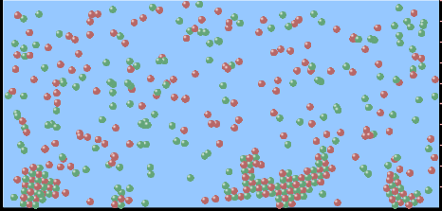
If you add water to this salt solution, what will happen?
NaCl(s) ⇌ Na⁺ _{(aq)} + Cl⁻ _{(aq)}
The system will shift to the right
The system will shift to the left
LeChatlier’s principle doesn’t apply to physical systems
Notes:
A

Slide 4
If you increased the air pressure above this salt solution, what will happen?
NaCl(s) ⇌ Na⁺ _{(aq)} + Cl⁻ _{(aq)}
The system will shift to the right
The system will shift to the left
This system would not be effected by pressure changes.
Notes:
C The effect of pressure on solutions was not investigated in the experiments, but is clearly in the textbook reading and practice problems

Slide 5
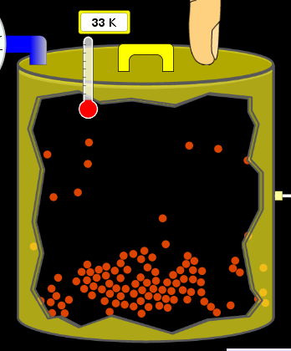

If you cooled the container, what will happen? Ne_{(l)} ⇌ Ne_{(g)}
The system will shift to the right
The system will shift to the left
This system is not effected by temperature
Notes:
B

Slide 6
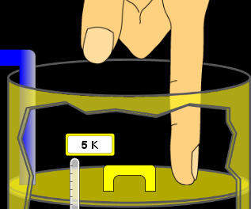
If you made the container smaller, while keeping the temperature constant, what will happen?
Ne_{(l)} ⇌ Ne_{(g)}
The system will shift to the right
The system will shift to the left
This system would not effected
Notes:
B Changing the container size without changing temperature clearly increases the pressure. The effect of pressure was not investigated in the experiments, but is clearly in the textbook reading and practice problems

Slide 7

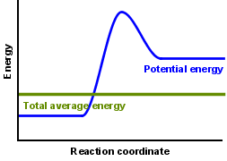
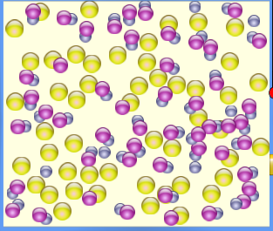

What would happen if you added energy using the heater ?
The system will shift to the right
The system will shift to the left
Both reactants and products would have more energy, but the amounts would not change much
Notes:
A

Slide 8
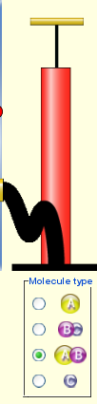
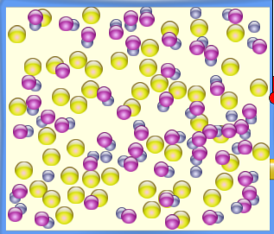
What would happen if you added ?
The system will shift to the right
The system will shift to the left
The only change would be the amount of
Notes:
b

Slide 9
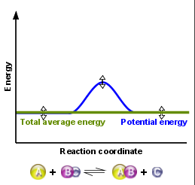
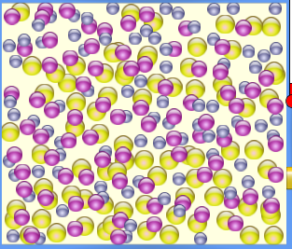
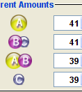
What would happen if you added energy using the heater ?
The system will shift to the right
The system will shift to the left
Both reactants and products would have more energy, but the amounts would not change much
Notes:
C

