Slide 1
Clicker Questions for Wave unit
I gave these clicker questions after the activity was completed except for the Wave interference demonstration day.

Slide 2
Waves on a String

Slide 3

A
Notes:
Say this: The figure below shows a rope on a tile floor with a knot at point A. Someone has shaken the end sideways to make a pulse. You are looking down and taking a movie of the motion. Below is one freeze frame of the movie.
Have a rope to demonstrate.

Slide 4
A
1. If you advance the movie one frame, the knot at point A would be
in the same place
higher
lower
to the right
to the left
Notes:
B higher

Slide 5
A
2. If the person generates a new pulse like the first but more quickly, the pulse would be
same size
wider
narrower
Notes:
C

Slide 6
A
3. If the person generates another pulse like the first but he moves his hand further, the pulse would be
same size
taller
shorter
Notes:
B

Slide 7
A
4. If the person generates another pulse like the first but the rope is tightened, the pulse will move
at the same rate
faster
slower
Notes:
B

Slide 8
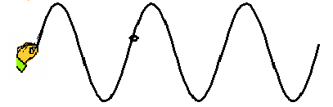
Intro slide for following questions
A
Notes:
Now the person moves his hand back and forth several times to produce several waves. You freeze the movie and get this snapshot.

Slide 9
5. If you advance the movie one frame, the knot at point A would be
A
in the same place
higher
lower
to the right
to the left
Notes:
C

Slide 10
A
6. If you advance the movie one frame, the pattern of the waves will be _________relative to the hand.
  in the same place
  shifted right
  shifted left
  shifted up
  shifted down
Notes:
B

Slide 11
A
7. If the person starts over and moves his hand more quickly, the peaks of the waves will be
the same distance apart
further apart
closer together
Notes:
C

Slide 12
8.If you lower the frequency of a wave on a string you will
lower its speed.
increase its wavelength.
lower its amplitude.
shorten its period.

Slide 13
Fourier clicker questions

Slide 14
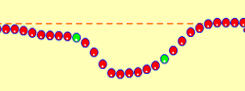
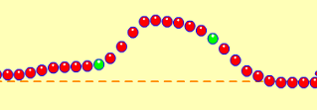
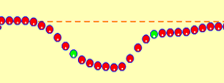
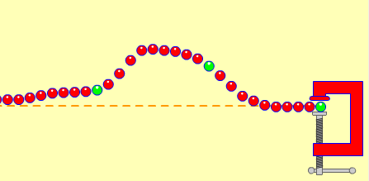
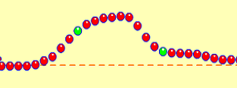
1. What will this wave look like after it reflects?
A.
B.
Fixed end
c.
D.
Notes:
C

Slide 15
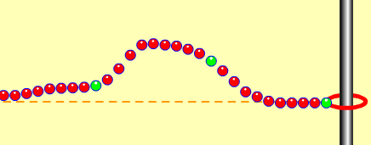
2. What will this wave look like after it reflects?
A.
B.
Loose end
c.
D.
Notes:
B

Slide 16
11 Wave addition simple pulse
3. The pulse on the left is moving right, the pulse on the right is moving left. What do you see when the pulses overlap?
Notes:
Adapted From Pollock at CU course: Physics of Sound and Music for nonscientists there are a total for 4 slides for this

Slide 17
Rest of question

Slide 18
answer
B

Slide 19
After interacting

Slide 20
4. If these two waves were moving through water at the same time, what would the water look like?
Wave 1
A
x
B
Wave 2
x
C
D
Notes:
D

Slide 21
Wave Interference
Notes:
There is a detailed lesson plan that uses this slide show. Not all the parts are included in the slide notes.

Slide 22
1. What will this wave look like after it reflects?
A.
B.
Fixed end
c.
D.
Notes:
C

Slide 23
2. What will this wave look like after it reflects?
A.
Loose end
B.
c.
D.
Notes:
B

Slide 24
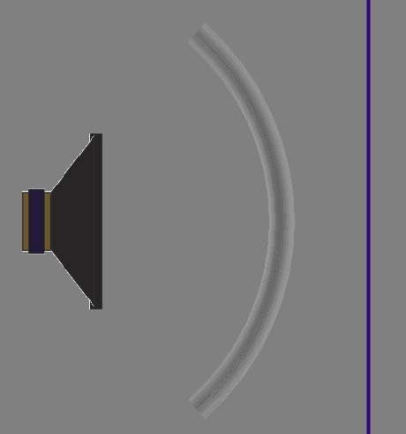
Draw what you think this wave will look like after reflecting off the barrier.

Slide 25


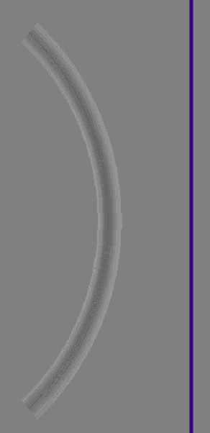
3. Which one is the reflection pattern?
Wave pulse from speaker
A
B
Notes:
A

Slide 26
“Sound waves are three dimensional.”
Talk to your partner:
What evidence you have that supports this.
How the wave could be represented
How would reflection change?
Notes:
Make a 3D standing wave with Tygon tubing by twirling in a circular motion instead of just up and down.
Use Wave Interference: Water tab with faucet moved to middle. Use Rotate view, Show Graph and add detectors.
Sound tab in the particle mode to show one wave to represent 3d.
Show water waves in the wave tank.

Slide 27
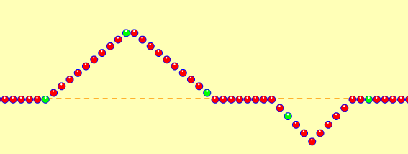
Sketch what you think the pattern will look like
Notes:
I used the Pulse feature with Zero damping. First I set the wave characteristics, then pulsed and paused quickly. Then I reset the characteristics and sent another pulse. Quickly ,I paused again and used the Step feature for slow motion. You can cycle through the waves interactions many times by stepping.

Slide 28


Measurements
Notes:
May or may not use this slide and the next

Slide 29
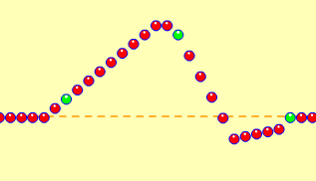
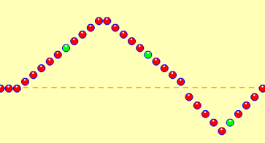
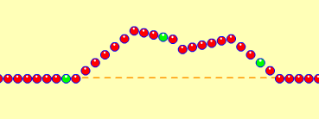
Paused clips
Notes:
Optional slide

Slide 30
Sound activity
I used questions 1-8 with the sound activity and the rest on the next day.

Slide 31

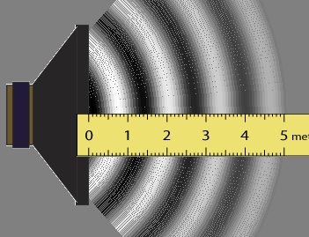
1. A student started the speaker by clicking on the stopwatch. How many sound waves are there is this trial?
3
5
4
8
Notes:
C 4 although you may get some argument about more exact numbers. I used 4 for all the following questions about this trial.
A 3 because there are 3 dark areas
B lots of students confuse the ruler reading with other things
D I count 8 light and dark areas total

Slide 32
2. What is the speed of the sound waves shown here?
300 m/s
330 m/s
0.0030 m/s
66 m/s
Notes:
B is correct 5/.0151=331
A is the number that our text uses for speed of sound in all problems
C is .0151/5
D is 1/.0151

Slide 33
3. What is the frequency of the sound waves shown here?
0.0037 hz
66 hz
260 hz
300 hz
330 hz
Notes:
C is correct 4/.0151=260 The sim actually said 228 but I count 4 waves
A is .0151/4 waves
B is 1/.0151
D is the number that our text uses for speed of sound in all problems
E 330 is speed

Slide 34
4. What is the period of the sound waves shown here?
0.0151 s
0.0037 s
260 s
300 s
330 s
Notes:
B is correct 1/f or is .0151/4 waves
A is stop watch time
C is frequency
D is the number that our text uses for speed of sound in all problems
E 330 is speed

Slide 35
5. What is the wavelength of the sound waves shown here?
5 m
1.3 m
1 m
0.71 m
300 m
Notes:
B 5/4
A distance of first wavefront
C 5/5 incase can’t count waves
D 5/7 count dark and light areas
E is the number that our text uses for speed of sound in all problems

Slide 36

6. If your lab partner moved the frequency slider to the left so that it changed from 500 to 250 the period would be
twice as big
1/2 as big
Stays the same
1/4 times as big
Not enough information to decide
Notes:
A

Slide 37

7. If you moved the slider to the far right, doubling the amplitude, the period would be…
twice as big
1/2 as big
Stays the same
1/4 times as big
Not enough information to decide
Notes:
C they are independent

Slide 38
8. If the speaker vibrates back and forth at
200 Hz how much time passes between each time it produces a maximum in pressure?
Sound waves traveling out
0.2 seconds
0.200 seconds
0.005 seconds
0.02 seconds
e. 0.05 seconds
Notes:
From Pollock at CU 1240 course
Answer is c. 0.005 seconds.
Period = 1 second/ 200 cycles
= 0.005 seconds/cycle

Slide 39
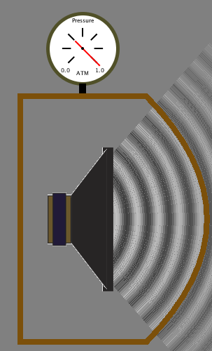
9.A speaker is playing a constant note.
What happens to the sound when you
put a solid, thick glass jar over it and
pump the air out from the jar.
1 => hardly any difference
2 => hardly any difference
1=> hardly any difference
2 => much quieter
1=> noticeably quieter
2 => hardly any MORE quiet
1=> noticeably quieter
2=> much quieter still (near silence)
E) None of these/something else/??
Notes:
D. I would show just the question before clicking to show the answers
Adapted from From Pollock at CU 1240 course

Slide 40
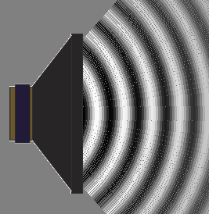
10. If you could put a dust particle in front of the speaker. Which choice below shows the motion of the dust particle?
(up and down)
(steadily to the right)
(left and right)
(no motion)
(circular path)
dust
Notes:
C
Adapted From Pollock at CU 1240 course

Slide 41
Fundamentals of waves
11.The picture shows “displacement as a function of location along a string”
What is the wavelength (“λ”)?
E none of these
C
D
B
A
Remember X axis is position not time
Notes:
A

Slide 42
12.The picture shows “displacement as a function of location along a string”
What is the amplitude?
E none of these
C
D
B
A
Remember X axis is position not time
Fundamentals of waves
Notes:
C

Slide 43
13.Looking at the following waveform, what is the period? assume it repeats itself over and over
1
2
time (sec)
1 sec
2 sec
1 m/s
2 m/s
Not enough information
Notes:
B
Adapted From Pollock at CU 1240 course

Slide 44
14 Looking at that same wave,
what is its speed?
1
2
Time (sec)
1/2 m/s
2 m/s
5 m/s
20 m/s
Not enough information
Notes:
E.
Adapted From Pollock at CU 1240 course
His notes follow:
Obviously important that “not enough info” occasionally be the RIGHT answer! (80% correct)
Now given that λ=10 m what is the speed of
the wave?

Slide 45
CT 2.1.10
15 The wavelength, λ, is 10 m. What is the speed of this wave?
Time (sec)
1
1 m/s
just under 7 m/s
C) 10 m/s
D) 15 m/s
E) None of the above/not enough info/not sure
Notes:
D 10/(2/3)
Adapted From Pollock at CU 1240 course

Slide 46
17 What is the period of this wave?
t₁
t₂
t₂-t₁
t₃-t₁
None of the above
Amp
time
t₁
t₂
t₃
t₄
0
Notes:
D
Adapted From Pollock at CU 1240 course

Slide 47
18 Which one of the following is most likely to be impossible?
A. Transverse waves in a gas
B. Longitudinal waves in a gas
C. Transverse waves in a solid
D. Longitudinal waves in a solid
E. They all seem perfectly possible
Notes:
E
From Pollock at CU 1240 course

Slide 48
Reflection and Lenses
Plane mirrors only
Notes:
Flat Mirrors
Apply the law of reflection for flat mirrors
Describe the nature of images formed by flat mirrors
Refraction
Recognize situations in which refraction will occur
Identify which direction light will bend when it passes from one medium to another
Solve problems using Snell’s law
Thin Lenses
Find the position of an image produced by a converging or diverging lens, and identify the image as real or virtual
Calculate the magnification of lenses

Slide 49
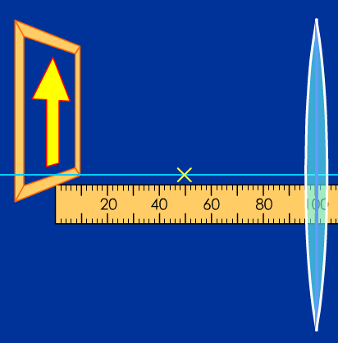
Where will the image appear?
On the left, at the zero mark.
On the right, at the 150 mark.
On the right, at the 200 mark.
On the right, at the 300 mark.
Notes:
C
1/f=1/d(image) + 1/d(object) 1/50= 1/d+1/100 d=100 positive sign indicates right side

Slide 50
How will the image look?
Same size
Smaller
Larger
Same size
Smaller
Notes:
D real images are inverted
M=d(image)/d(object) M=100/100=1

Slide 51
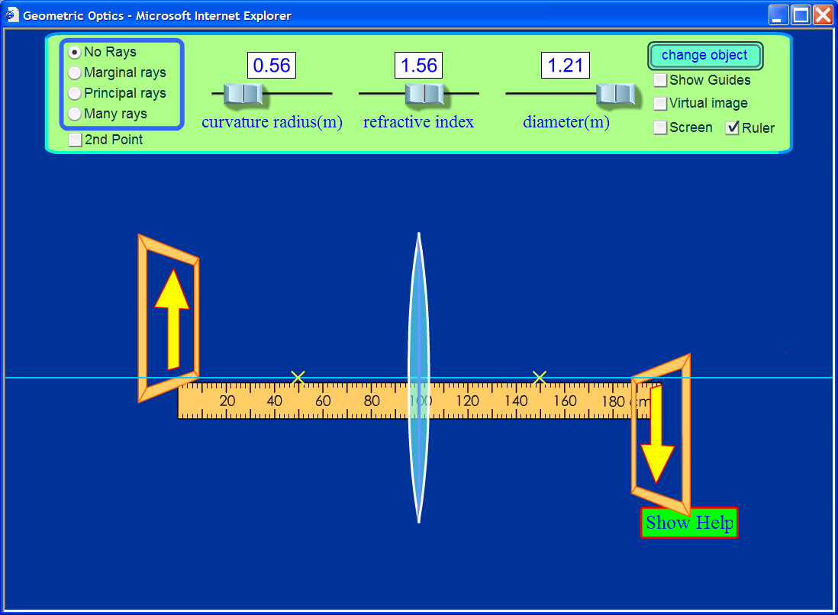
Simulation results

Slide 52
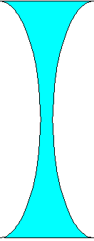

Where will the image appear if the lens were concave?
On the left, at the zero mark.
On the left, at the 67 mark.
On the left, at the 33 mark.
On the right, at the 200 mark.
Notes:
B
1/f=1/d(image) + 1/d(object) 1/-50= 1/d+1/100
d=-33 negative sign indicates left side

Slide 53
How will the image look?
Same size
Smaller
Larger
Same size
Smaller
Notes:
B
Vitual images are upright
M=d(image)/d(object) M=33/100=.33

Slide 54
If the lens is made fatter in the middle, how will the image change?
Larger, further away
Smaller, further away
Larger, closer
Smaller, closer
Notes:
D.

Slide 55
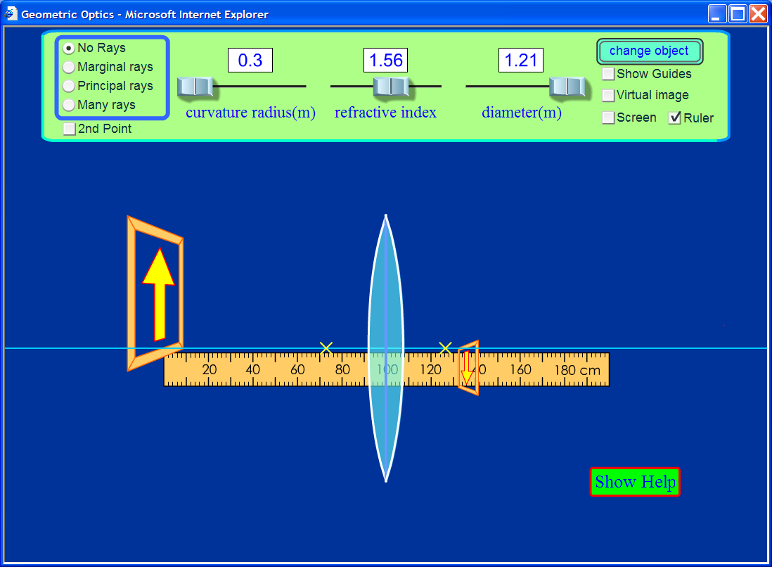
Answer: closer and smaller

Slide 56
If you replace the lens with a mirror, the image will be
Same size
Smaller
Larger
Same size
Smaller
Notes:
A

Slide 57
If you move the arrow towards the mirror, the image will be
Same size
Smaller
Larger
Same size
Smaller
Notes:
A plane mirrors do not change magnification

Slide 58
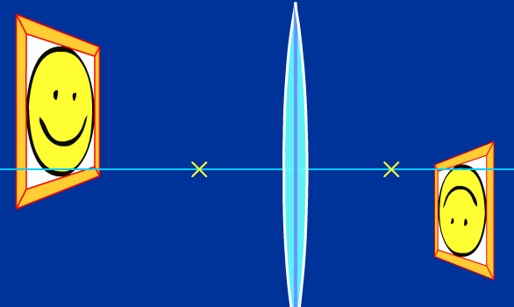
If the lens had a lower index of refraction, the image be
Same size
Smaller
Larger
Same size
Smaller
Notes:
C however, if you make the index, too small you may get a virtual image because object will be between lens and focal point.

Slide 59
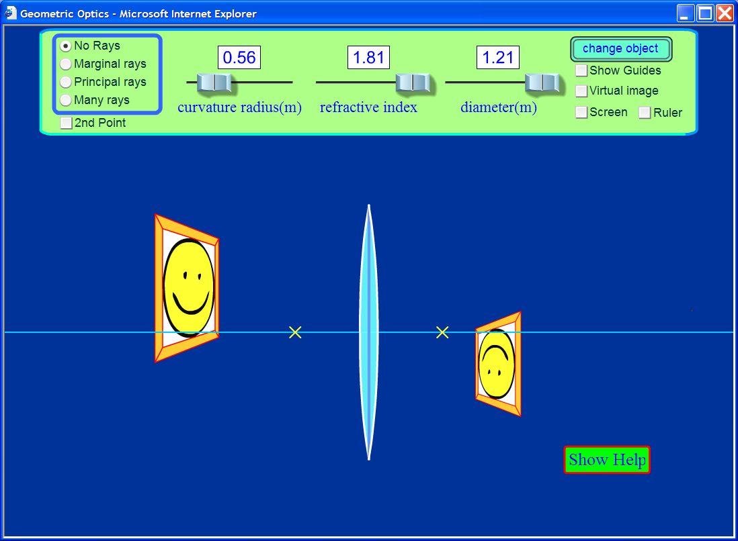
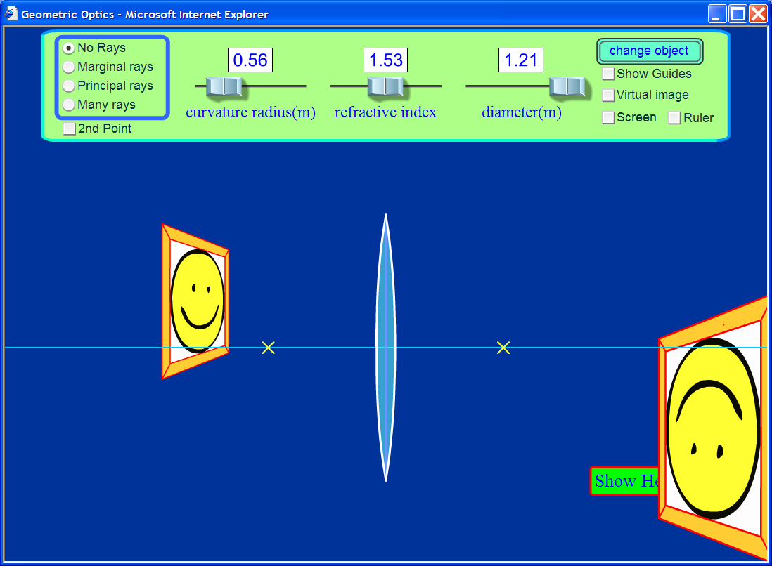
answer
Notes:
It would be nice to show how changing the index can make a virtual image.

Slide 60
Resonance
Clicker questions by Trish Loeblein and Mike Dubson
Learning Goals: Students will be able to:
Describe what resonance means for a simple system of a mass on a spring.
Identify, through experimentation, cause and effect relationships that affect natural resonance of these systems.
Give examples of real-world systems to which the understanding of resonance should be applied and explain why. (not addressed in CQs)

Slide 61
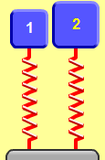
1. Which system will have the lower resonant frequency?
Mass (kg) | 2.5 | 5.0
Spring constant (N/m) | 100 | 100
A) 1 B) 2 C) Same frequency
Notes:
B because of the heavier mass. Some students may select C since the spring constants are equal. Use the sim to show the students.

Slide 62
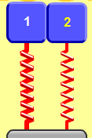
2. Which system will have the lower resonany frequency?
Mass (kg) | 5.0 | 5.0
Spring constant (N/m) | 200 | 100
A) 1 B) 2 C) Same frequency.
Notes:
B because of the lower spring constant. Some students may select C since the masses are equal. Use the sim to show the students. 1 has 1 hz and 2 has .7hz

Slide 63
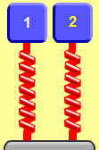
3. Which system will have the lower resonance frequency?
Mass (kg) | 3.0 | 3.0
Spring constant (N/m) | 400 | 400
Driver Amplitude (cm) | 0.5 | 1.5
A) 1 B) 2 C) Same frequency.
Notes:
C amplitude of the driver is an independent variable of frequency

Slide 64

4. Which best describes how the motion of the masses vary?
Less driver amplitude results in greater max height & faster oscillation
More driver amplitude results in greater max height & faster oscillation
Less driver amplitude results in greater max height
More driver amplitude results in greater max height
Mass (kg) | 3.0 | 3.0
Spring constant (N/m) | 400 | 400
Driver Amplitude (cm) | 0.5 | 1.5
Notes:
D amplitude of the driver is directly related to oscillation distance (A and B include another way to relate frequency; the frequency is not dependent on driver amplitude)

Slide 65
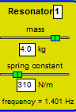



4. If the frequency f of the driver is not the same as the resonant frequency, which statement is most accurate?
The steady-state amplitude is ..
smallest at the highest driver f.
largest at the highest driver f.
is largest at driver f nearest the resonant frequency.
is independent of driver f.
Notes:
C

